Slide 1
LNG Masterplan for Rhine-Main-Danube
2012-EU-18067-S
Workshop Danube Commission

Slide 2
What is Pro Danube International?
Platform of private companies with strategic economic interest in better framework conditions and higher public investment in the Danube transport & logistics system
Established autumn 2011 by companies & associations
Non-profit association based in Vienna
Network of currently more than 120 companies
More than a lobbying organisation as it initiates and executes projects which improve framework conditions resulting into a higher use of the Danube
Industry & Wholesale
“Transport User”
Logistics Service Providers
Ports & Terminal Operators
(Associations)
Barge Operators
(Associations)
Shipyards & Suppliers & Others

Slide 3
What are our core objectives?
Create a more favourable policy framework
Improve waterway infrastructure
Promote investment in ports & fleet, education & training and innovation
Work with the European Institutions on programs and initiatives for Danube region
Contribute to implementation of EUSDR Action Plan & Naiades
Support members in defining and lobbying national action programs & initiatives
Lobby for public funding schemes and active national inland navigation policy
Increase awareness of decision makers, media & public
support members in design and execution of lobbying strategies and by implementation of projects
Maximise use of EU funds for project implementations
Enforce minimum standards in waterway maintenance through monitoring and interaction with responsible authorities
Support elimination of TEN–T bottlenecks (shallow water sections) following UNECE/AGN recommendations
Engage in further development of River Information Services
Act for better maintenance of locks
Push for upgrading of connecting waterways/existing canals and for missing links
Engage in sustainable waterway development (e.g. ICPDR)
Lobby for investment programs in ports and terminals as well as for modernization of Danube fleet
Trigger implementation projects for improvement of ports and fleet with regard to higher efficiency and sustainability
Initiate and support implementation of LNG as fuel for Danube navigation and as cargo
Initiate and execute RTD and modal shift projects
Identify and implement projects to ensure skilled nautical and logistics personal

Slide 4
Rationale of “LNG Masterplan”
Strong need to modernise the fleet (in particular in the Danube region)
Environmental triggers
    LNG as fuel will significantly reduce vessel emissions (-20% CO2, -80 to 90% NOx, almost zero PM & SOx) and will increase the competitiveness of Danube transport (fuel cost savings relate into lower transport costs of est. up to 15%)
    Further CO2 reduction possible by blending with BIO-LNG
Economic triggers
    LNG as cargo will increase transport volumes and will offer energy (cost) savings to many industries in the entire region
But, implementation of LNG requires co-ordination of public and private actions along a well defined strategy. This is a place for
MASTERPLAN FOR THE IMPLEMENTATION OF LNG ON RHINE-MAIN-DANUBE
In line with European Union Climate Action - Climate Energy Policy (2009), with Europe 2020 – New Economic Strategy; White Paper on transport; NAIADES and in particular with EUSDR

Slide 5
Contribution to the EU policy
Europe 2020 – New Economic Strategy (March 2010) with highest relevance for the Flagship initiatives: “Innovation Union”, “Resource Efficient Europe”
European Union Climate Action - Climate Energy Policy (2009) with 20-20-20 targets until year 2020 which aims:
    to cut greenhouse gases by 20% below 1990 levels (30% if internationally agreed),
    to reduce energy consumption by 20% through increased energy efficiency,
    to meet 20% of energy needs from renewable sources
White Paper on transport – 2030/2050 perspective (March 2010) in relation to the contributions to:
    creation of modern infrastructure and multimodality assisted by smart management and information systems,
    provision of a roadmap to a low carbon transport system and independency from oil
    shift 30%of road freight over 300km to rail and waterborne transport by 2030 and more than 50% by 2050

Slide 6
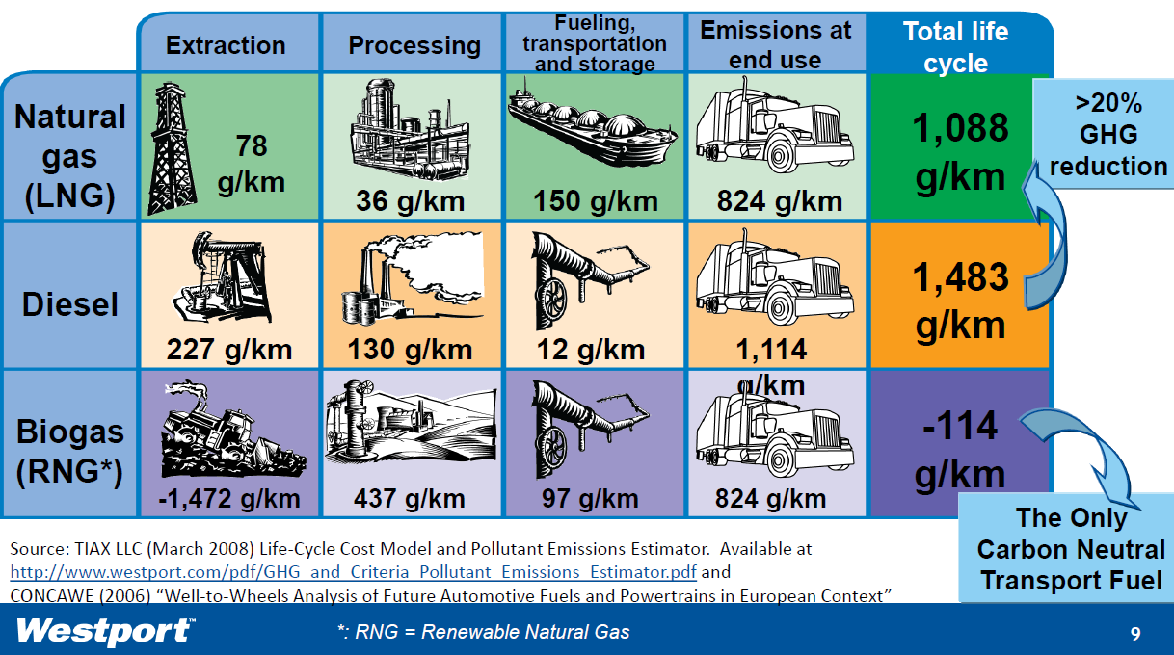
LNG - reduced greenhouse gas emissions

Slide 7
What are the key drivers for LNG as fuel?
Planned EU Greenhouse Gas Emissions legislation (forthcoming air emissions regulations; ECA/SECA for maritime, for IWW revision NRMM directive 97/68/EC, gap towards EURO VI; proposal CCNR IV(2016))
  high costs of SCR & DPF (200-600 k€ capex, replacement time SCR 2y, DPF 4y, urea c.0.4€/l, 4% more fuel, etc
Price gap Gasoil-LNG and estimated price reduction for LNG (LNG 300-400€/t; EN 590 c730€/t; LNG US 90€/t (status 07/2012)) due to massive production increase; payback time of investment <3 years; reduction in fuel consumption
    NAIADES 2/Panteia-NEA report: “LNG most effective measure to reach stage IV for medium and large inland vessels”
(Draft) Directive on Deployment of Alternative Fuels Infrastructure (COM 2013 18/2) demands implementation of LNG infrastructure

Slide 8
EU Directive for alternative fuel infrastructure
Article 6: Natural gas supply for transport
MS shall ensure that publicly accessible LNG refuelling points for maritime and inland waterway transport are provided in all maritime ports of the TEN –T Core Network by 31 Dec 2020 at the latest.
MS shall ensure that publicly accessible LNG refuelling points for inland waterway transport are provided in all inland ports of the TEN –T Core Network by 31 Dec 2025 at the latest.
MS shall cooperate to ensure that heavy duty motor vehicles running on LNG can travel along roads of TEN T Core Network. … refuelling point for LNG … within distances not exceeding 400 km by 31 Dec 2020 at the latest.

Slide 9
European framework – It is the right time to act!
Several initiatives in Europe to use LNG as fuel for maritime vessels
  Drivers: ECA & SECA regulation, oil price forecasts, EU transport & energy policy
  Several EU funded projects (DMA Nordic LNG Feasibility, SSS Projects in TEN T, etc.)
Built-up of LNG infrastructure in Europe
  Gate Terminal Rotterdam, Wilhelmshaven, Stockholm, Swinoujscie, several other projects in France, Spain, Italy, etc.
First LNG inland vessels on Rhine
  Deen Shipping vessel operational as well as other vessels under construction
  Interstream/Shell chemical tanker “Greenstream”
CCNR authorized use of LNG as fuel for inland vessels in 01/2012
Key LNG technology available on market
  All major engine producers offer gas or dual-fuel products
  Small-scale bunkering solutions already implemented
High potentials for LNG use in transport sector
  Example: 5.000 trucks in US, 4.000 in China, 200 in Europe
  Build up of LNG filling stations networks in several countries
  Blue Gas Corridor Initiative of NGVA
EU program period 2014-2020 will offer new opportunities
  Connecting Europe Facility, Structural Funds, Horizon 2020

Slide 10
LNG Masterplan: Objectives
co-ordinate and harmonise legislation and public – private investments
be a driving force in terms of harmonised government law and legislation on the use and transport of LNG on inland waterways and roads, along with the new LNG technologies and standards
provide assessments of potential LNG pioneer markets in the hinterland of river ports and to explore these markets as part of a hub & spoke distribution concept
investigate costs and benefits of the implementation of LNG as a fuel and as cargo for the European inland fleet
increase and transfer know-how from Northern Europe & maritime sector to the inland navigation sector in general and to Central/ South Eastern Europe in particular
identify obstacles and to elaborate solutions for cost-effective and stepwise deployment in co-operation of public authorities and private industry
position LNG as a green and alternative fuel for inland water transport
trigger the follow-up development and modernisation in inland water transport (both infrastructure and fleet) by introducing the cleaner alternative fuel and a valuable commodity (all-in-one)
facilitate pilot implementation of the waterborne LNG chains, with built-up of pilot LNG infrastructure in ports as well as pilot LNG powered vessel(s) (newly built / and retrofitted)
strengthen European innovation in ship-building and related technologies and thus improve the competitive position of European shipyards and equipment provider

Slide 11
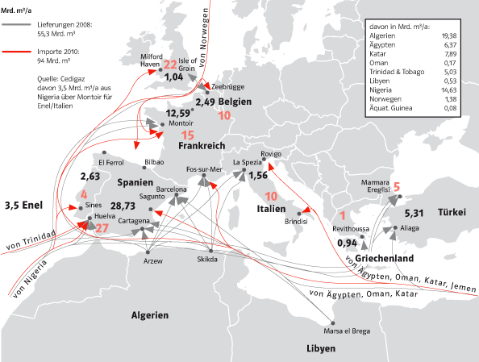
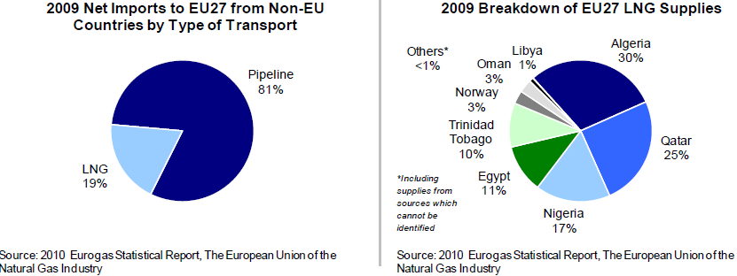
LNG Supply & Distribution in Europe
Source: PREEF Research, 2011

Slide 12
LNG Masterplan for Rhine-Main-Danube
Platform for cooperation of authorities and industry stakeholders with the purpose to:
    Facilitate the creation of a harmonised European regulatory framework considering LNG as fuel and as cargo for inland navigation
    Deliver technical concepts for new and retrofitted vessels
    Execute pilot deployments of vessels and terminals
    Develop a comprehensive strategy with a detailed roadmap for the implementation of LNG in line with the EU policies in transport, energy and environment
Pilot deployment
Technical concepts
Regulatory framework

Slide 13
LNG Masterplan: Basic data
Programme:
    TEN-T Multi-annual Call 2012
Timeframe:
    1 January 2013 - 31 December 2015
Budget (eligible costs): 80,5 mil. EUR (out of 69,2 mil. EUR pilot activities)
EU funding: 40,25 mil. EUR
Beneficiaries: 33 public / private bodies / incl. 1 member state
Endorsed by Ministries of Transport of NL, AT, CZ, SK, BG and CCNR
Non-funded partners: 37 public / private bodies & professional associations (as of 21.8.2013)

Slide 14
LNG Masterplan: Partner structure
33 funded partners (beneficiaries)
    Barge operators & shipyards
    Terminal operators
    Logistics providers
    Port authorities (Rotterdam, Antwerp, Strasbourg, Mannheim, Romania + Basel)
    Classification societies
    Professional associations
    Energy sector
    Banking sector & legal services
    Universities & research institutions & consulting
37 not funded partners as members of the industry reference group, advisory group or steering committee group (status 21.8.2013)

Slide 15
Advisory Group & Industry Reference Group
Industry Reference Group
via donau (AT)
Stevas Shipping (BE)
Caterpillar Marine Power Systems (DE)
Gaztransport & Technigas SAs (FR)
Westport (FR)
Danube Logistics (MD)
Cryonorm Systems B.V. (NL)
DNV Kema Nederland B.V. (NL)
N.V. Nederlandse Gasunie (NL)
Mercurius Shipping Group (NL)
QaGroup Holding BV (NL)
Wartsila Netherlands B.V. (NL)
NAVMAR Inc. Srl. (RO)
Shipyard ATG Giurgiu (RO)
Stroje a Mechanizmy, a.s. (SK)
Bulgarian River Shipping JSCo (BG)
Constanta Port Administration (RO)
SEATECH Engineering Ltd. (PL)
MOL Hungarian Oil and Gas Plc. (HU)
Advisory Group
Port Authority Osijek
International Sava River Basin Commission
Bundesverband Öffentlicher Binnenhäfen (BÖB)
European Barge Unit (EBU)
European Federation of Inland Ports (EFIP)
European Skippers’ Organisation (ESO)
Inland Navigation Europe (INE)
Lloyds Register EMEA
Bureau Veritas
Duisburger Hafen AG
Port of Switzerland
Romanian Inland Ports Union (UPIR)

Slide 16
Beneficiaries (project partners)
A3PS - Austrian Agency for Alt. Propulsion Systems
Erste Group Bank AG
EVN AG
FH OÖ Forschungs & Entwicklungs GmbH
Pro Danube Management GmbH
Schönherr Rechtsanwälte
LINZ AG
Gemeentelijk Havenbedrijf Antwerpen
Bulmarket DM Ltd.
Asociace NGV o.s.
DST Entwicklungszentrum für Schiffstechnik und Transportsysteme e.V.
Germanischer Lloyd SE
Universität Duisburg Essen
Staatl. Rhein-Neckar-Hafengesell. Mannheim mbH
Port autonome de Strasbourg
Bernhard Schulte (Cyprus) Ltd
LU
Chemgas Barging Sarl
Argos Bunkering B.V
Chemgas Holding B.V.
DCL Barge B.V.
Havenbedrijf Rotterdam N.V.
Stichting STC-Group
Kooiman Marine B.V.
Veka Mariska BV
Bodewes Binnenvaart B.V.
National Company The Maritime Danube Ports Administration, Galati
Ceronav
Navrom S.A.
Transport Trade Services S.A.
University of Craiova
Danube LNG (EEIG)
Výskumný ústav dopravný, a. s.
Ministero delle Infrastrutture e dei Trasporti
AT
BE
NL
BG
CZ
DE
RO
SK
FR
IT
CY

Slide 17
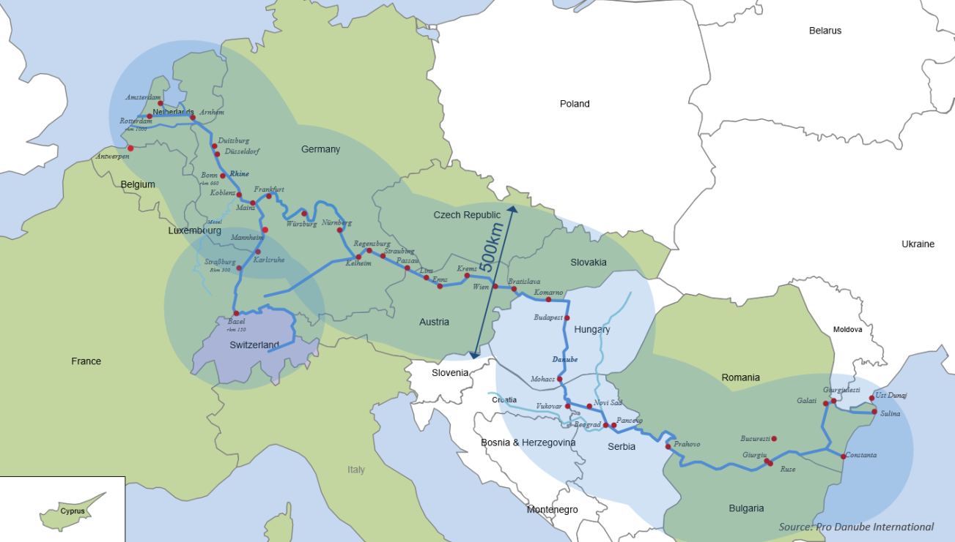
LNG Masterplan: Geographical scope

Slide 18
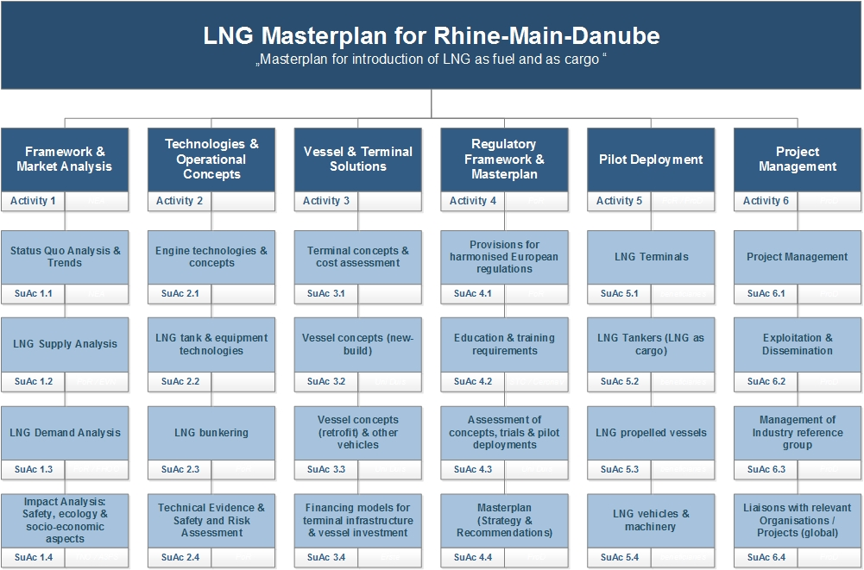
LNG Masterplan: Work Breakdown Structure

Slide 19
Activity 5 - Pilot deployment - overview
LNG terminals / bunker stations
  Bunker station – Port of Antwerp
  LNG Terminal in Ruse (Bulmarket DM Ltd.)
LNG vehicles & Machinery
  Combined LNG/CNG fuelling stations (Bulmarket DM Ltd.)
  LNG fuelled tank trucks (Bulmarket DM Ltd.)
LNG tankers
  Combined LNG – MGO tanker (Argos Bunkering B.V.)
  LNG Tanker (Veka Mariska B.V.)
  LNG Inland Tanker (Chemgas Shipping B.V.)
  LNG coastal carrier (Bernhard Schulte Cyprus Ltd.)
LNG propelled vessels
  Container vessel (DCL Barge B.V.)
  LNG pusher (Kooiman Marine B.V.)
  LNG propelled chemical tanker (Chemgas Barging S.a.r.l.)
  LNG Propelled pushers (Navrom S.A. Galati)
  LNG Propelled chemical tanker (Bodewes Binnenvaart B.V.)

Slide 20
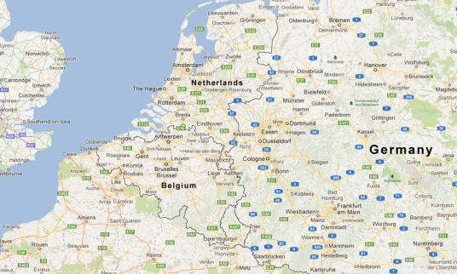
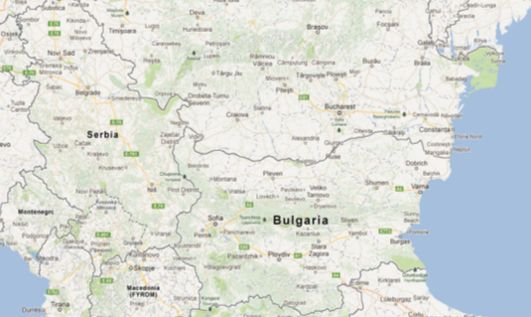
Pilot deployments - Terminals
Bunker station (Port of Antwerp)
  Initial project to build –up a LNG bunkering network for inland vessel sin NW Europe (Rhine-Meuse)
LNG Terminal in Ruse (Bulmarket DM Ltd.)
    Waterfront storage unit of min. 1.000 m³ including fuelling for vessels & trucks
    Hinterland demand / base load in the first year approx. 40.000 m³
Feasibility study
  LNG Terminal Port of Constanta (Transport Trade Services S.A.)
      Small scale LNG receiving terminal in the Port of Constanta with fuelling facilities for vessels and trucks up to approx. 5.000 m³ storage capacity
      → essential element in setting-up a LNG
      supply chain on the Danube
Antwerp
Ruse
Constanta

Slide 21
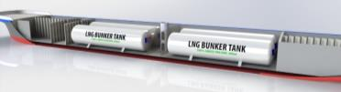
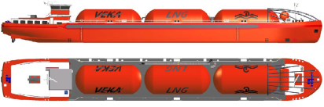
Pilot deployments - LNG Tankers I
Combined LNG – MGO tanker (Argos Bunkering BV)
    A combined LNG & MGO tanker to be used for ship to ship LNG & MGO bunkering of inland barges
    Use of boil-off LNG for electric propulsion and generating electricity
    Working area: Ports of Amsterdam, Rotterdam and Antwerpen
    Pilot operation: Q3 2015
LNG Tanker (Veka Mariska B.V.)
    Dual fuel Type G tanker for LNG transport 86 x 10.5 x 2.6 m (LNG bunker tanker for Rhine)
    Electric compulsion with dual fuel engines as generator sailing on the ‘boil-off’ of the LNG cargo (2 x 500 kW dual fuel engines)
    LNG tanks: 2250 m3 LNG (1000 tons)
    Pilot operation: Q2/Q3 2015

Slide 22
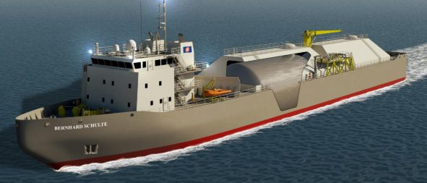
Pilot deployments - LNG Tankers II
LNG coastal carrier (Bernhard Schulte Cyprus Ltd.)
    Coastal LNG carrier connected LNG import terminal in the Easter Mediterranean with the planned receiving terminal in Constanta
    (Preliminary) specification: 110,0m x 16,8m, draught 4,8m; capacity 5.000 cbm LNG.
    Pilot operation: Q3 2015
LNG Inland Tankers (Chemgas Shipping B.V.)
    LNG inland gas tanker being a part of the LNG supply chain on the Danube
    Working area: (1) Lower Danube & (2) connecting Constanta with Upper Danube
    Innovative propulsion system using boil-off LNG as fuel
    Pilot operation: Q3 2015

Slide 23
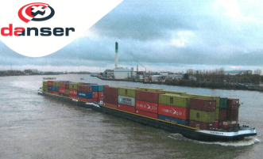
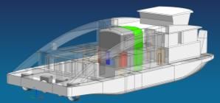
Pilot deployments - LNG propelled vessels I
Container vessel (DCL Barge B.V.)
    Retrofitting of container vessel (year 2000) long 105 m and capacity 206 TEU (total capacity 348 TEU)
    2 dual fuel engines + 60 m3 LNG fuel tank (for 1 round-trip). Advanced concept development in close contact with Lloyd’s
    Route: Rhine-service (Antwerp – Rotterdam – Basel)
    Pilot operation: April 2014
LNG pusher (Kooiman Marine B.V.)
    Dual fuel push boat for Rhine and inland service (able to push 6 loaded barges)
    Propulsion: dual fuel engines 4 X 1060 kW (Wartsila), 160m³ LNG fuel tank & 80 m³ diesel tank
    Length/beam/draught: 40 x 18 x 1,6 m
    Route: Rotterdam – Duisburg (24h/7 days)
    Pilot operation: Q3 2015
    Owner & operator: ThyssenKrupp Veerhaven

Slide 24
Pilot deployments - LNG propelled vessels II
LNG propelled chem. tanker (Chemgas Barging S.a.r.l.)
    Conventional type-G tanker for the transport of liquefied gases with LNG used as propulsion
    Propulsion: dual fuel engine (Wartsila), 1400 kW. Two auxiliary engines only LNG. Vessel can operate on gasoil
    Length/beam/draught: 110x 11,4 x 3,15 m
    Cargo tank capacity: 6 * 437 m3
    Pilot operation: Q3 2014
LNG propelled chem. tanker (Bodewes Binnenvaart B.V.)
    Based on the EcoLiner concept foreseeing an air lubricated hull offering savings of up to 15% due to reduced hull resistance
    Usage: transport of chemicals and oil products
    Length: 110 m
    Capacity: 45 m3 LNG
    Pilot operation: Q3 2014

Slide 25
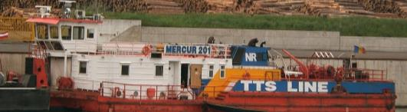
Pilot deployments - LNG propelled vessels III
LNG Propelled pushers (Navrom S.A. Galati)
    Retrofit 3 pushers with LNG propulsion
    Propulsion: dual fuel engine (Caterpillar)
    Pilot operation: Q3 2015

Slide 26
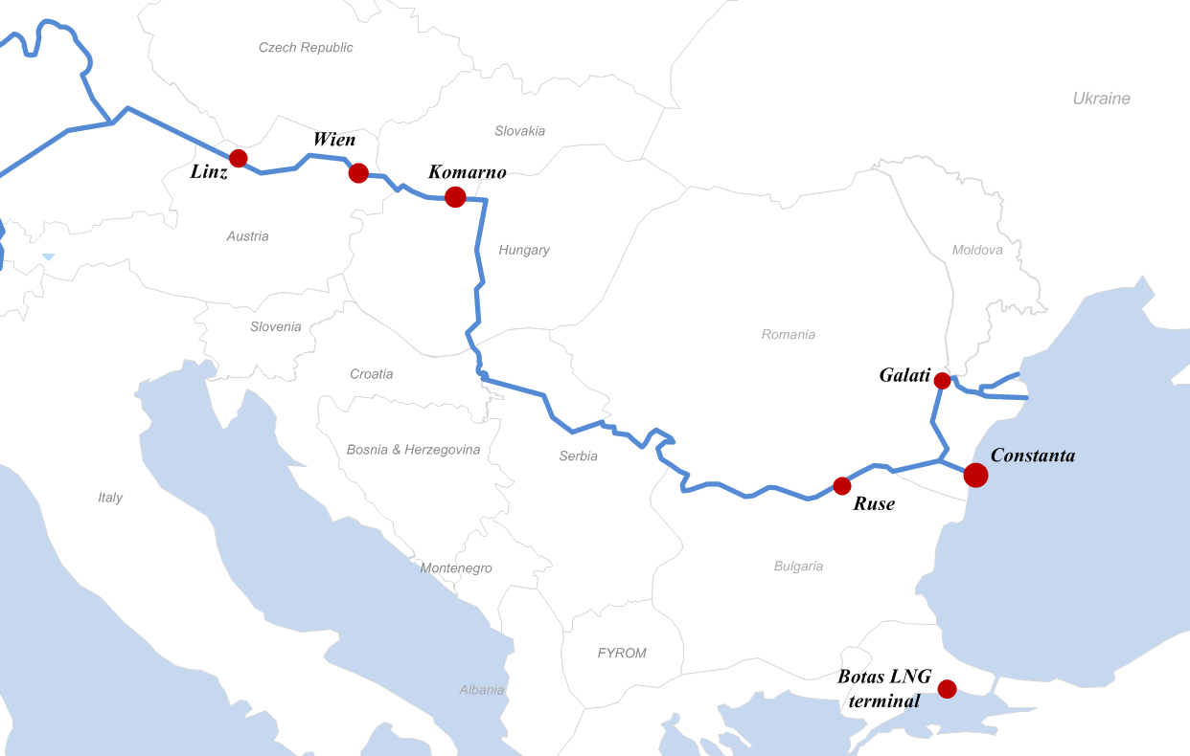

LNG SUPPLY CHAIN IN DANUBE REGION
(Key partners and their total budget in €)
LNG Supply & Demand Study (NGVA)
Time: Q3/2014
€ 211,500
Study for LNG Terminal in Komarno & vessels (Danube LNG)
Studies and preliminary designs for terminal & vessels (fuel & cargo)
€ 2,500,000
LNG Supply & Demand Study (FHOÖ & Linz AG)
Time: Q3/2014
€ 556,600
LNG Supply & Demand Study (EVN)
Time: Q3/2014
€ 511,200
Study for development of LNG terminals on the Romanian maritime Danube (Port Authority APDM)
Pre-feasibility study
€ 246,700
LNG gas tanker (Chemgas)
Innovative LNG gas carrier. Connecting terminal in Constanta with Upper Danube.
Depl.: Q3/2015
€ 7,334,500
Retrofitting of 3x pushers for LNG propulsion (NAVROM)
Depl.: Q2-Q3/2015
€ 1,846,500
Study for the LNG Import Terminal (TTS Group)
Small scale LNG import terminal in the Port of Constanta
Feasibility study
€ 413,000
Small scale LNG terminal in Ruse (Bulmarket)
storage of min. 1,000 m3, incl. fuelling devices for vessels & trucks
Studies, design & pilot deployment
Depl.: Q3/2015
€ 2,065,300
LNG Coastal Carrier (Bernhard Schulte)
Multipurpose LNG carrier fuelled by LNG and used as a trans-shipment / bunkering vessel for LNG fuelled vessels & other marine craft and delivering LNG to a small on-shore facilities
Depl.: Q3/2015
€ 15,880,500
Combined LNG/CNG fuelling stations & LNG fueled trucks with LNG trailers (Bulmarket) as part of the logistic chain to the end-customers
Depl.: Q3/2015
€ 450,000
Status: August 2013

Slide 27
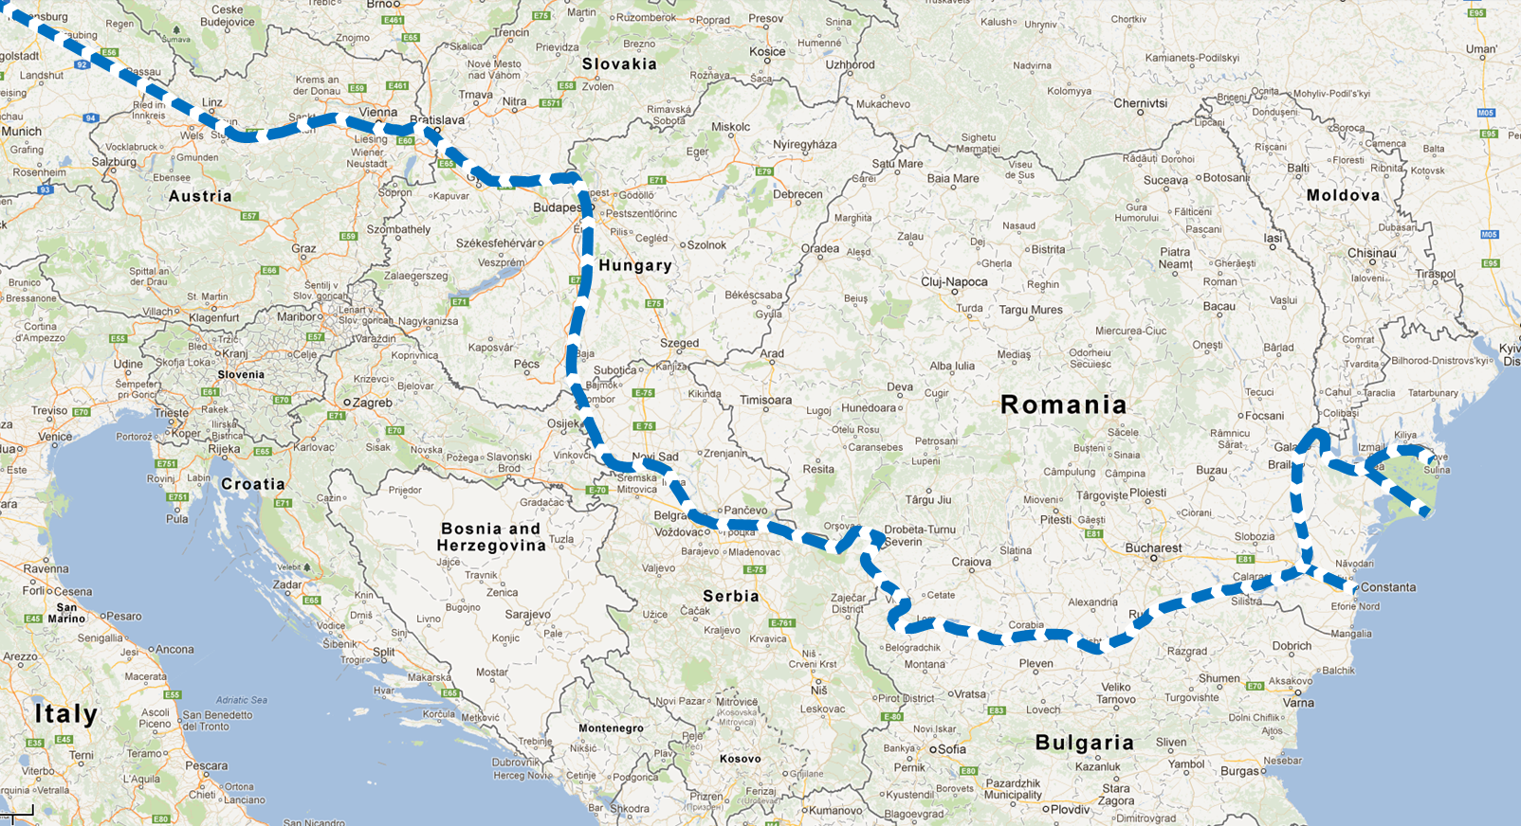
Danube Ports for LNG distribution to the hinterland
Linz
Bratislava / Komarno
Budapest / Györ
Vienna
Vukovar
Pancevo
Giurgiulesti
Galati
Lom/Vidin
Giurgiu/Ruse
CONSTANTA
Danube = GREEN „BLUE GAS CORRIDOR“

Slide 28
Conclusions
EU- wide Masterplan will overcome “Chicken and Egg” – situation
Provides an appropriate project plattform and fosters a co-ordinated & structured development & pilot deployment for LNG terminals and vessels
Provides basis of an European wide legal & organisational framework for development & deployment of LNG (vessel technical regulations, terminal regulations, etc.)
Inland navigation will be more competitive and the most environmentally friendly transport mode; LNG as cargo will increase the political awareness for the Danube as import transport resource
Inland barging sector is a pioneer market for LNG as fuel and a cost-effective transport solution to reach European hinterland
Inland terminals will functions as satelites to the hinterland enabling to reach other pioneer markets like public (transport) sector and heavy duty transport industry (buses, garbage collection trucks, city logistics)
The LNG masterplan will pave the way for a full scale-deployment and provides guideance for public and private investment as well as for EU funding

Slide 29

Further information
    Manfred Seitz
    General Secretary
    Pro Danube International
    Email: seitz@prodanube.eu
    Mobil: +43 (0)676 4067878
    Lucia Karpatyova
    Senior Project Manager
    Email: karpatyova@prodanube.eu
    Mobil: + 43 (0)680 22 60 575

