Slide 1
Activities of Pro Danube International

Slide 2
Content
What is Pro Danube International?
What are our priorities?
Danube Waterway Industry Declaration
Administrative barriers
Project PROMINENT
Fairway Rehabilitation and Maintenance Master Plan
CEF applications for the implementation of the FRMMP
Port development – Priorities 2015
Industry meets Policy

Slide 3
What is Pro Danube International?
Platform of private companies with strategic economic interest in better framework conditions and higher public investment in the Danube transport & logistics system
Established autumn 2011 by companies & associations
Non profit association based in Vienna
Network of currently more than 130 companies
More than a lobbying organization as we initiate and execute projects
Industry & Wholesale
“Transport User”
Logistics Service Providers
Ports & Terminal Operators
(Associations)
Barge Operators
(Associations)
Shipyards & Suppliers & Others

Slide 4
What are our priorities?
Engagement for better waterway maintenance & execution of TEN T bottleneck projects
Push governments & administration for minimum standards in waterway maintenance (2,5 m fairway depth at LWRL)
Engage in permanent monitoring of infrastructure maintenance & proposing improvements
Promote quicker implementation of TEN T projects (2,5 m draught according UNECE/AGN)
Support waterway administrations to use EU programs in financial period 2014-2020
Promotion of investment in Danube ports
Promote ports as hubs for regional development strategies & cross-border initiatives
Support public and private stakeholders in port development programs/projects
Support to modernization of Danube fleet
Promote & supporte implementation of LNG as fuel as well as cargo for Danube navigation
Propose & implement EU funded projects for higher efficiency of operations & environmental performance
Promote development of long-term public funding schemes for fleet renewal
Elimination of administrative barriers
Identification of barriers and engagement in dialogue with administrations/policy makers to achieve elimination/reduction
Harmonizing administrative procedures - “Same River – Same Rules” initiative of PDI
Active involvement in EC initiatives & programs
Special focus on EUSDR/PA1A
Facilitation of projects in Horizon 2020, TEN T/CEF, regional development programs

Slide 5
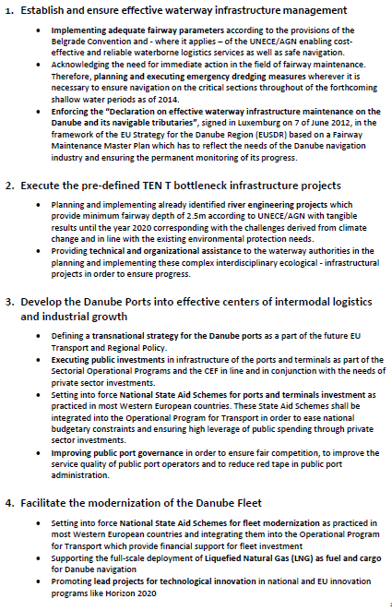
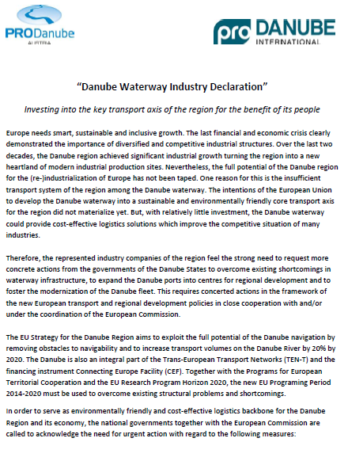
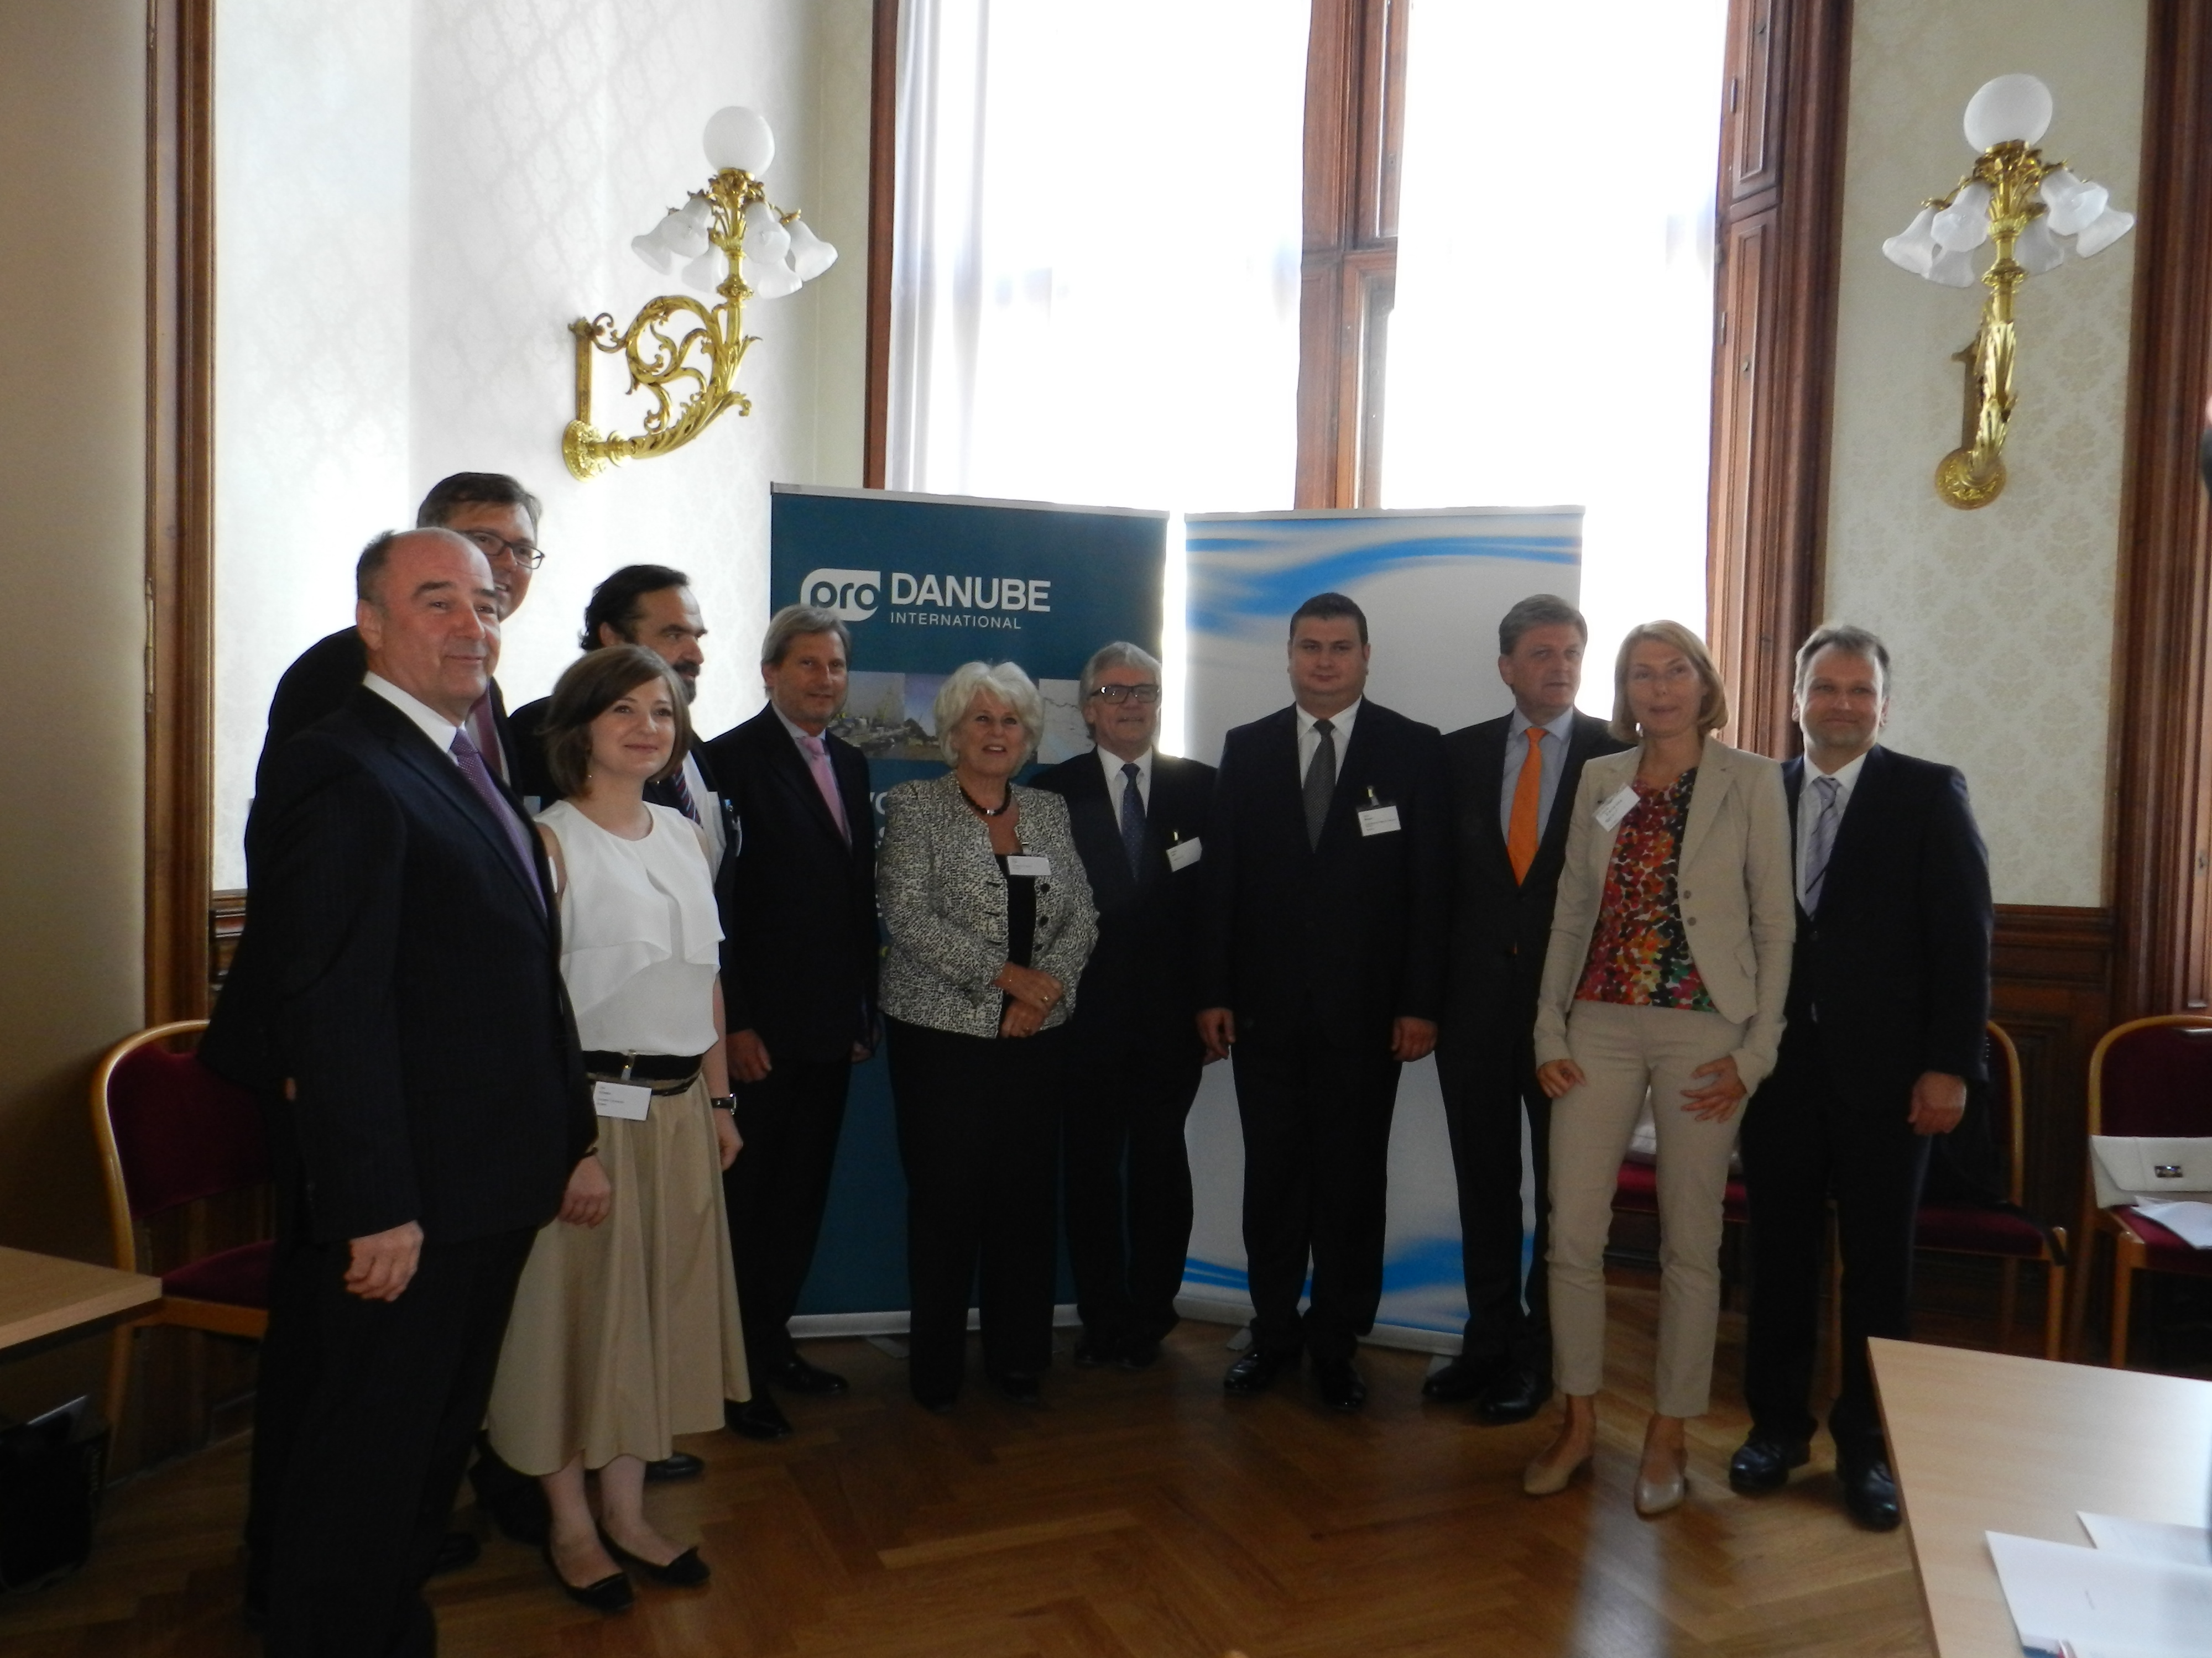
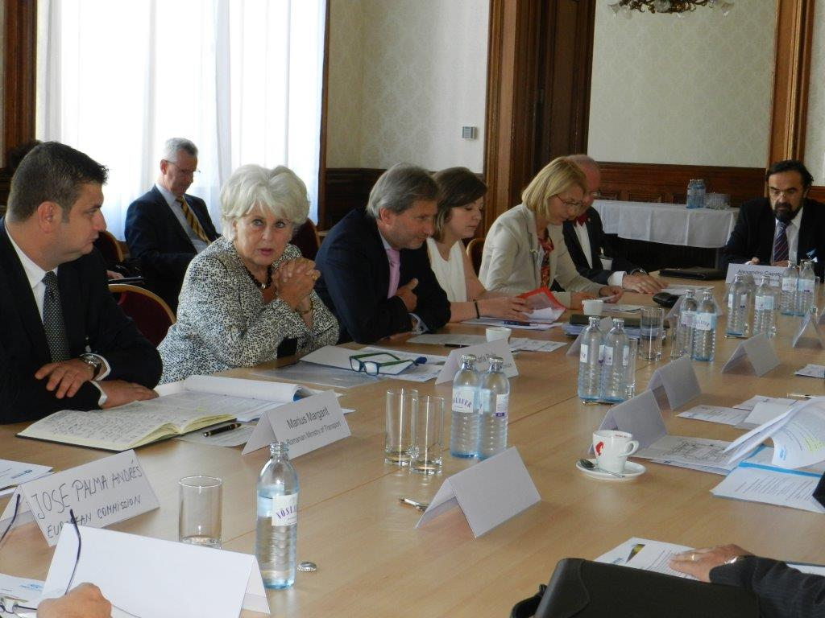
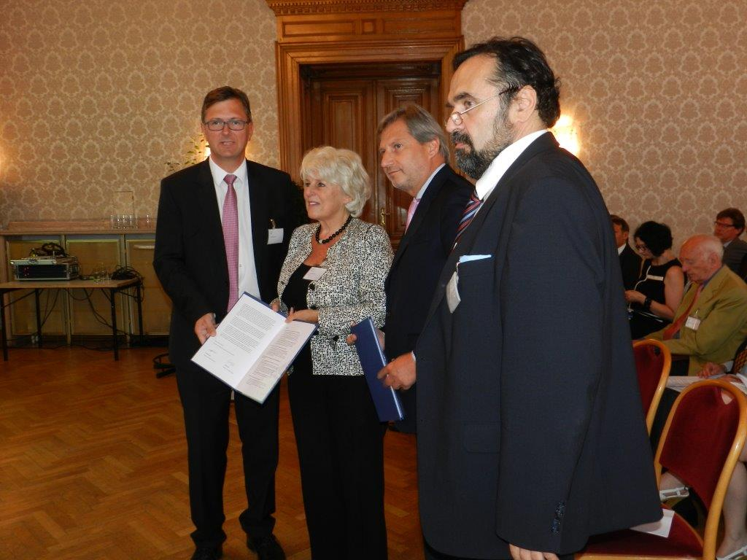
Danube Waterway Industry Declaration
Lists required policy actions from viewpoint of most important transport users & industry stakeholders
Submitted to Commissioner Hahn/Kallas (represented by Mrs. Karla Peijs in the High Level Round Table “Industry meets Policy”
Within the framework of the 3rd EUSDR Annual Forum, Vienna 27 June 2014, more than 120 participants in open workshop
Organised by Pro Danube International together with DG Regio services

Slide 6
Administrative barriers – PDI Electronic Reporting Tool (1)
Objectives in line with the PDI vision of “Same River – Same Rules”:
To provide a tool for the stakeholders of Danube navigation:
to report administrative barriers that they have experienced
to name positive experiences
Sound database is pre-condition for putting lights on barriers; will be the basis for interventions /further actions of PDI.
Available languages:
Default: English
Optional: German, Hungarian, Romanian
Registration:
PDI Members are pre-registered
Registration is open for all other stakeholders
(with a valid email address)

Slide 7
Administrative barriers – PDI Electronic Reporting Tool (2)
Functionalities
Identification of the category of the reporting person
Selection interface on language
Selection interface:
“Blaming a barrier”
“Naming positive experience”
Filing the case:
Selection of authority/administration involved in the case
Location of the case
Date & time of the case
Textual description of the case
Upload box for files demonstrating the case
Monthly report site for registered users
Confirmation of submission via email

Slide 8
PROMINENT - General information
PROMINENT is ultimately aimed at providing solutions which make inland navigation as competitive as road transport in terms of air pollutant emissions by 2020 and beyond.
In parallel PROMINENT aims to the further decrease the energy consumption and carbon footprint of IWT, an area where IWT has already a strong advantage compared to road transport.
Funding programme: HORIZON 2020 (funding rate: 100%)
Start date: 1st May 2015; Duration: 36 months
Overall budget: 6,250,000 EUR; 17 Partner from 5 EU countries
Pro Danube Management GmbH Budget: 286,875 EUR; Major partner: Navrom Galati SA
PROMINENT targets Developing cost-effective solutions and standardised applications (reducing required investment costs): 70%+ coverage – Developing solutions that are applicable to at least 70% of the European inland fleet and their operating areas. 30% costs reductions – Reducing implementation costs of innovative greening solutions by 30%. Involving all relevant actors concerned in the research and innovation process 100% inclusive - All stakeholders who are required for the full coverage of the innovation cycle from initial concept to real-life deployment are to be taken on board. Actively addressing and removing current implementation barriers by 2020 Visible and physical results by 2017 – Producing results on the ground during the project lifetime 2020 as ultimate time horizon ­– Setting up a roll-out strategy which is geared towards producing the required full impacts by no later than 2020.

Slide 9
PROMINENT - Work plan

Slide 10
PROMINENT - SWP 5.4 Pilot energy efficient navigation
Objectives:
to overlay fairway survey data with flow data generated by vessel measurements
to provide a real-time advising system for the boatmaster on the optimum choice of the fairway track and cruising speed
to support waterway administrations with additional information on the fairway conditions
Tasks:
installation of advanced echo sounder and other vessel equipment
definition and application of rules and procedures for data generation and data use
development of tools for energy efficient navigation
test operations on the Rhine and the Danube
technical evaluation and conclusions
The envisaged system will have a high potential economic and environmental impact
applied to both new and existing vessels
reduction of fuel consumption and corresponding emissions to air
prepare full-scale implementation and impacts by 2020

Slide 11
Fairway Rehabilitation & Maintenance Master Plan (FRMMP) (1)
Sets out the necessary actions in order to reach recommended Levels of Service for the Danube River
Triggered by the Declaration on Effective Waterway Infrastructure Maintenance on the Danube and its Navigable Tributaries (Luxembourg, 7 June 2012)
The FRMMP was endorsed by the Danube Transport Ministers in Brussels on 3rd December 2014

Slide 12
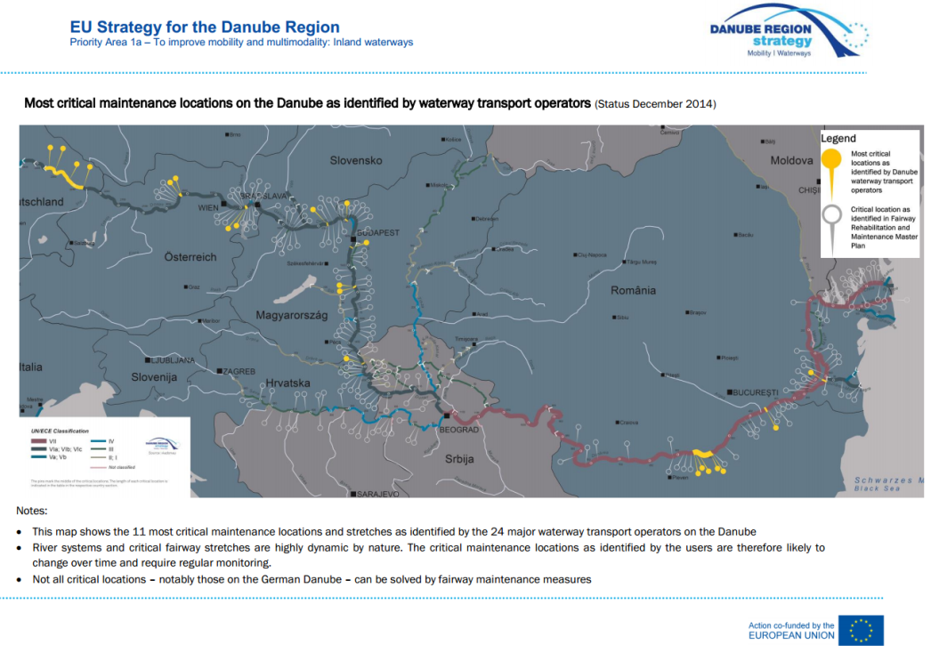
Fairway Rehabilitation & Maintenance Master Plan (FRMMP) (2)
Most critical maintenance locations on the Danube as identified with strong support of PDI members

Slide 13
CEF Applications for the implementation of the FRMMP (1)
Pilot activities to develop the technical and operational capacity for Danube fairway rehabilitation – PATTERN, 2014-RO-TMC-0421-S
Applicant: River Administration of the Lower Danube Galati - AFDJ Galati / Romania
Planned duration: July 2015 – June 2019
Project volume: 24,995,000 EUR, Expected EC contribution: 21,245,750 EUR (85%)
Project filed in: CEF MAP Call 2014 F04 / Pre-identified projects on the Core Network corridors / Inland Waterways and Ports
Objectives:
Procurement of technical vessels for dredging and signaling (cutter suction dredger, hopper split barges, 2 working vessels, one marking vessel and other technical equipment)
Pilot operations in dredging and fairway marking in order to tackle the most critical fairway limitations on the Romanian Danube. These most critical spots have been identified in the FRMMP and will be prioritized with the help of the FAIRway project (2014-RO-TMC-0231-S)
PATTERN enables Romania to fulfill the obligations set out in the Fairway Rehabilitation and Maintenance Master Plan – Danube and its navigable tributaries (FRMMP)

Slide 14
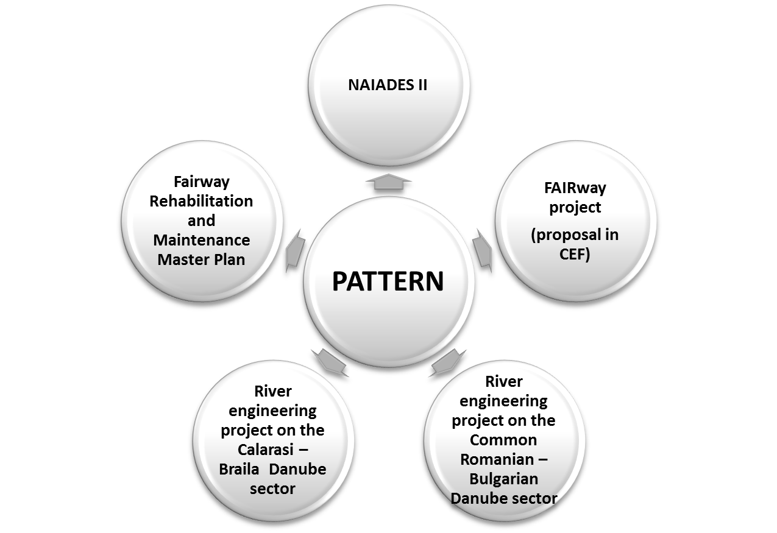
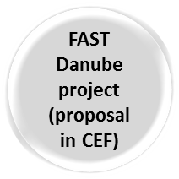
CEF Applications for the implementation of the FRMMP (2)
Corresponding applications:
FAIRway (2014-RO-TMC-0231-S) which is multi-national project to elaborate coordinated national roadmaps and define the pilots for the implementation of the Master Plan (FRMMP).
AFDJ will procure one surveying and one marking vessel and execute several tasks related hydrological and hydrographic surveys
PDI will be member of Advisory Board
FAST DANUBE (2014-RO-TMC-0232-S) Technical Assistance for Revising and Complementing the Feasibility Study Regarding the Improvement of Navigation Conditions on the Romanian-Bulgarian Common Sector of the Danube and Complementary Studies
Updates and prepares River engineering project on Common RO-BG sector, 11/2014 – 01/2017

Slide 15
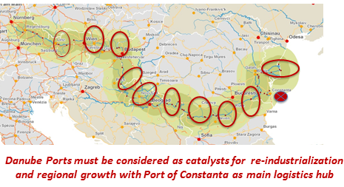
Port Development – Priorities 2015
Main Activities foreseen 2015:
Requesting a transnational strategy for Danube ports and implementation with EU funding schemes
Promote & facilitate National State Aid Schemes for port & terminal investment similar to Western Europe, back-financed via OPT for high leverage of public spending through private sector investments -> PDI Proposal : Coordination project in DANUBE Program
Improving public port governance to ensure fair competition, higher service quality & to reduce red tape -> PDI Proposal: Network of Port Authorities ad project in Danube Program
Implement “Green Danube Ports Project Proposal” with a multi-national cooperation project in DANUBE program
Facilitate public investment in port & terminal infrastructure via National Sectorial Programs in line and in cooperation with private sector needs & investments via support to members projects
Baseline:
Danube Ports as focal points for European transport & regional policy
Key elements for a sustainable & efficient transport system, natural centres of economic activities
High potential for regional growth through cross-border initiatives

Slide 16
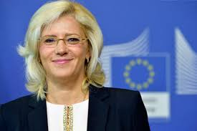
Industry meets policy - Follow up Event
Objectives:
Enable direct communication Captains of Industries – Commissioner Cretu
Engage high level industrialist in EUSDR
Mobilize industry support in order to create higher momentum at national governmental/administrative level
Report progress on FRMMP to navigation sector
Receive feedback for optimization
Disseminate DG Regio programs/initiatives
Continuation of very successful event in Vienna, June 2014
Proposed date & Location:
30th October 2015 in Ulm as part of the Annual Forum of EUSDR
Two linked events:
Restricted High level Round Table
Open Workshop with industry representatives

Slide 17
Thank you for your attention!
Alexandru Capatu
Chairman Pro Danube International
Email: capatu@prodanube.eu
Mobil: +436643025874
Manfred Seitz
General Secretary
Pro Danube International
Email: seitz@prodanube.eu
Mobil: +436764067878
Robert Rafael
Senior Project Manager
Pro Danube Management GmbH
Email: rafael@prodanube.eu
Mobile: +4369916139614

