Slide 1

Minstry of Infrastructure of Ukraine
Policy approach for integrated development of navigation in Ukraine
Olena Starikova

Slide 2
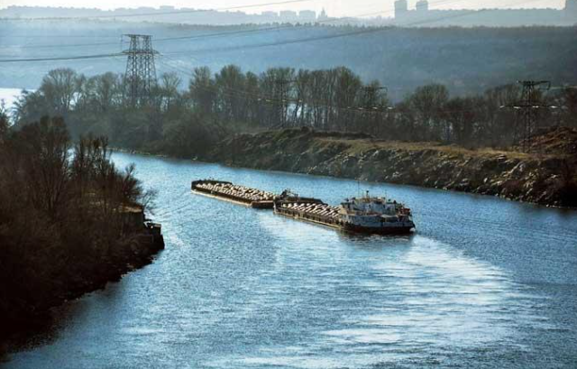
Ukraine’s river industry had been waiting for the adoption of the Law of Ukraine
On Inland Water Transport for over 10 years. This is the law that makes it possible to implement the EU Directives that pertain to inland navigation.
Upon long discussions, at the end of 2020 the Verkhovna Rada of Ukraine adopted the Law that comes into power at the beginning of 2022 and serves as the legal framework for the operation of inland navigation in Ukraine and a foundation for the implementation of European inland transport legislation.

Slide 3
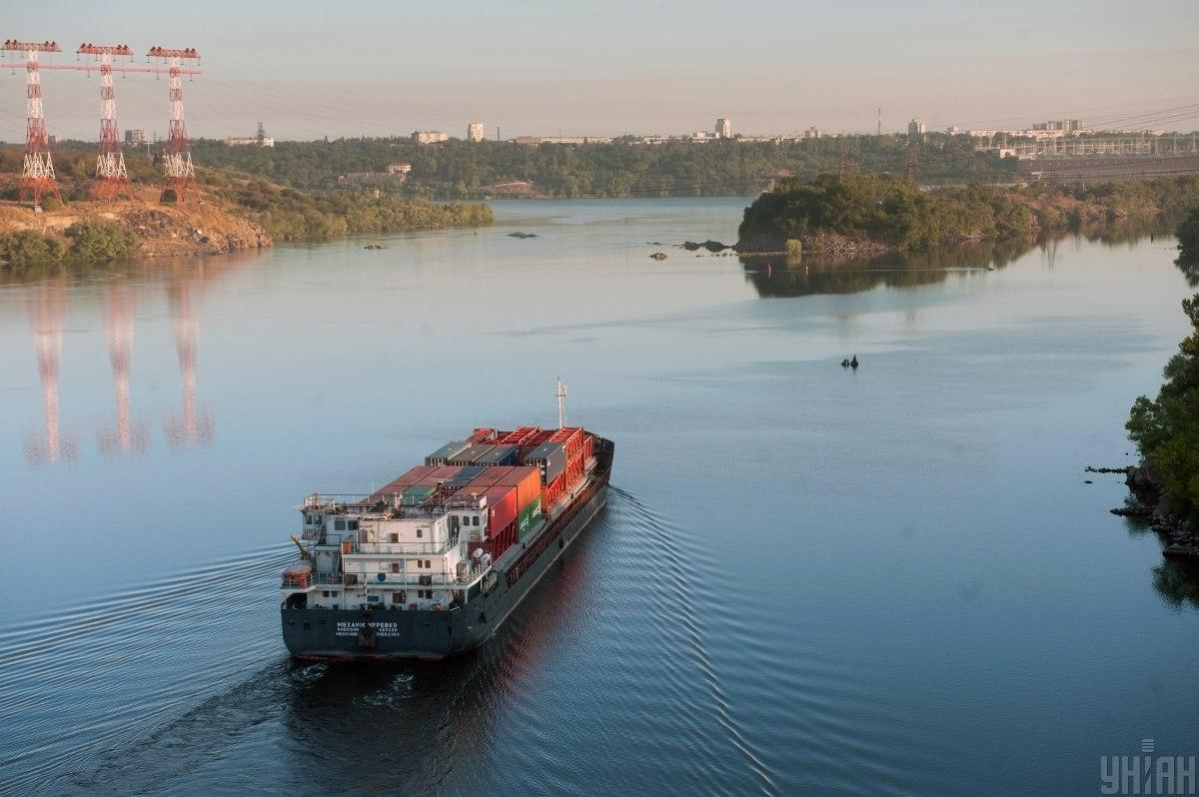
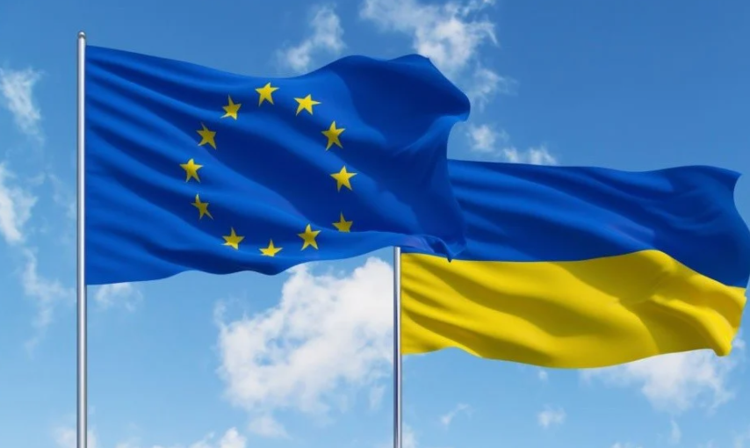
The following are the EU legislative acts in the area of inland legislation
that are key and of great priority for Ukraine; these have been largely already implemented by the Law of Ukraine On Inland Water Transport:
Directive EU 2016/1629 (technical requirements for inland navigation vessels, including СESNI ES-TRIN standard);
Directive EU 2017/2397 (technical requirements for inland navigation vessels, including CESNI ES-QIN standard);
Directive EU 2005/44 (river information service harmonization);
Directive EU 87/540 (on access to the occupation of carrier of goods by inland waterways).

Slide 4
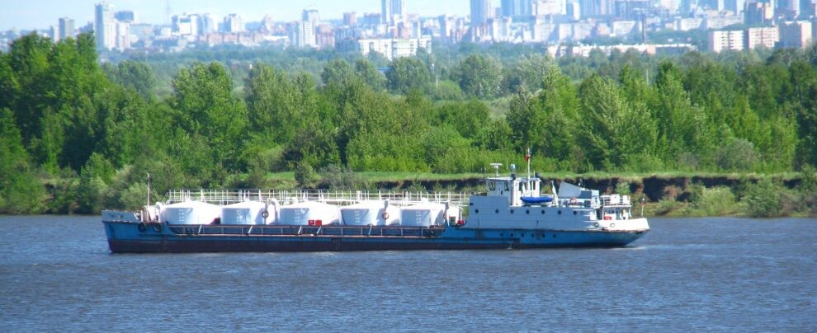
Ukraine’s IWW shipping market liberalization by means of abolition of bureaucratic procedures - entry into river ports shall not require obtaining permits from the Maritime Administration for the inland navigation vessels that carry document and certified personnel of the EU Member States. The same applies for vessels with maritime documents compliant with safety requirements and able to navigate on rivers.

Slide 5





This year Ukraine is going through an active stage of development of normative legal acts at the level of the Ministry of Infrastructure which are called to implement the next stage of the European requirements.
Specialists of the Ministry of Infrastructure of Ukraine and the Maritime Administration cooperate, in particular, with the following:
The EU Technical Assistance Project for Dnipro Transport Development;
The Reform Support Team at the Ministry of Infrastructure of Ukraine;
UNECE;
Priority Coordinators for the Inland Navigation and Mobility, Danube Region EU Strategy;
The Danube Commission

Slide 6
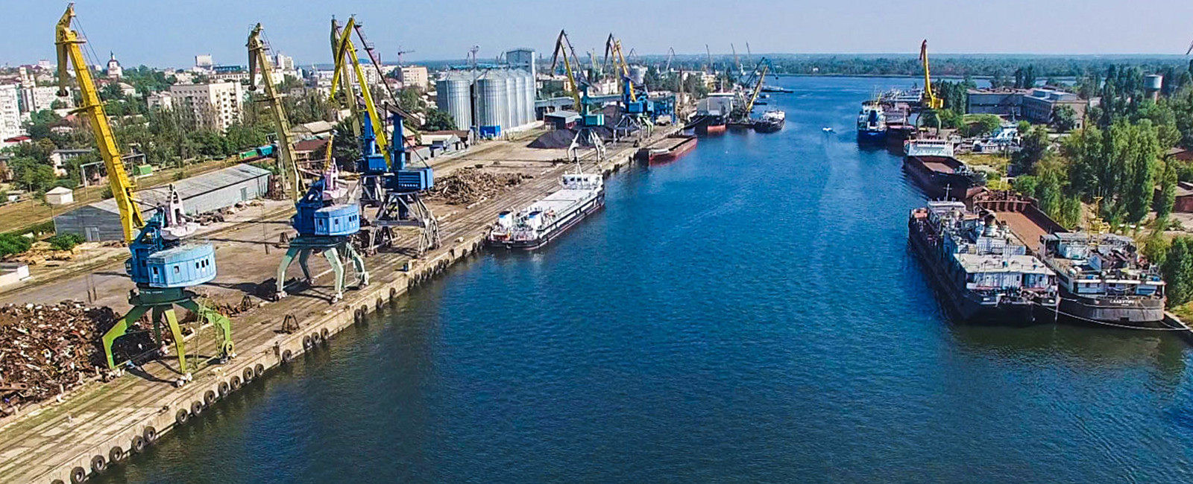
The Ministry of Infrastructure has developed draft Strategy of IWT Development till 2031 and the Action Plan for its Implementation - an industry-specific document for state planning mainly targeted at the establishment of the IWT and its infrastructure that are competitive, safe, and attractive for business to meet the cargo shipping market needs.

Slide 7
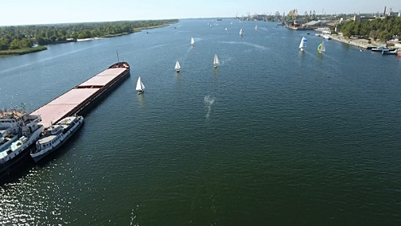
Provided harmonization on legislative level of intense development of river logistics with a balance of environmental interests:
* implementation of innovative energy efficient and environmentally friendly technologies;
* obligation of the river port (terminal) to ensure the reception of vessels oil containing leftovers, ship wastewater, general waste for their further disinfection and disposal;
* the vessel is allowed to sail on the IWW provided that it complies, in particular, with the requirements for environmental protection regulations;
* discharge of wastewater from vessels is allowed only if they are treated and disinfected in ship installations in accordance with the requirements of the International Convention for the Prevention of Pollution from Ships 1973, as amended by the Protocol of 1978 thereto, or in accordance with technical requirements for inland vessels approved by the Ministry of Infrastructure of Ukraine.

Slide 8
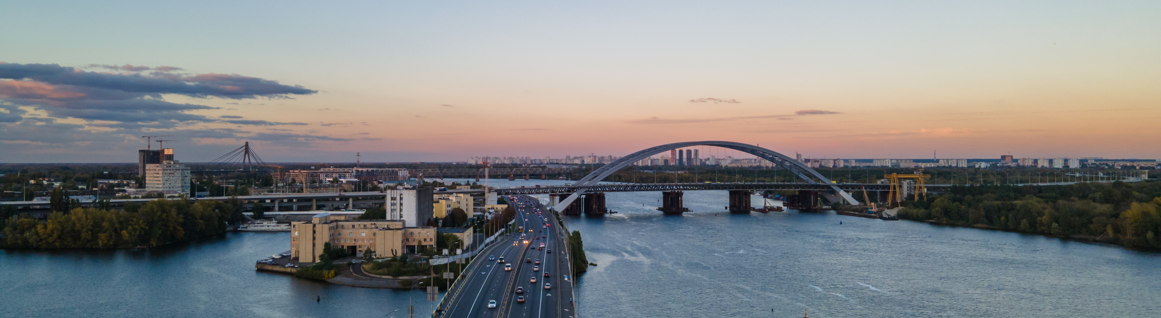
Action Plan of the draft of Ukrainian IWW development strategy for the period until 1931, which was recently undergoing the procedure of strategic environmental assessment, also contains the tasksensuring environmental balance:
creation of the sufficient, state-of-the-art, environmentally friendly and energy efficient fleet, ensuring compliance of the fleet with EU environmental standards, in particular, through:
-harmonization of national legislation with the requirements for emission limits for vessels in accordance with the Regulation (EU)2016/1628;
-development of a program of measures to stimulate domestic shippers to the use of power plants that meet the level of emissions of III A or higher, in accordance with the Regulations(EU)2016/1628;
-enhancing environmental culture by organizing and conducting trainings for crews of IWW vessels on compliance with environmental standards: ES-QIN and CESNI resolution 2018-II-3.

Slide 9
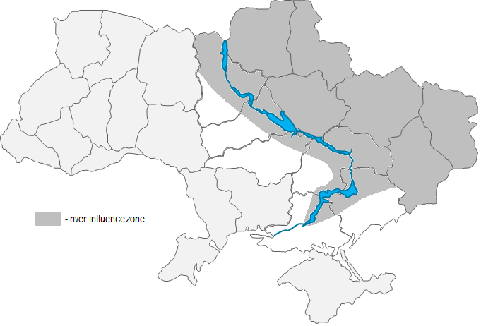

The potential maximum cargo base of the Dnipro River equals around 60 mil. tons and covers 12 regions of Ukraine.
The potential of river transport is used by no more than a third of its full capacity.
The volume of the potential cargo base is about 60 million tons with an increase to 82 million tons by 2030.
Cargo of origin or destination from/to 12 regions of Ukraine is economically feasible to transport on the Dnieper
Chernihiv
Sumy
Kyiv
Poltava
~60 mil. t
Kharkiv
Luhansk
Cherkasy
Dnipro
Donetsk
Kirovohrad
Dniprо
Zaporizhzhya
Regions with high economic feasibility of river transport use
Kherson
- Occupied territories
Sourse: Ukrainian River Fleet, COWI (EIB)
9

Slide 10
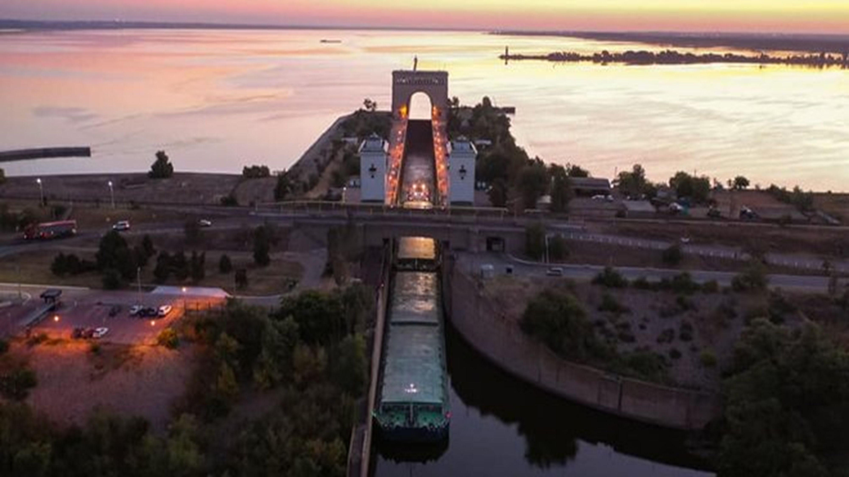
ENVIRONMENTAL BENEFITS OF IWW:
Modern river transport is the most environmentally friendly in comparison with rail and road, which significantly increases its competitiveness given the latest trends in EU greening policies and the implementation of relevant standards. According to research, CO2(carbon dioxide) emissions from IWT are approximately 3 times lower (1 t/km) than for road transport, and the possibility of using soot filters on IWT vessels can reduce up to 90% of NOX(nitrous oxide) emissions, which are responsible for air pollution and the greenhouse effect, and to reduce the level of PM (particulate matter) by up to 98%. Given this, can be stated that the reorientation of some cargo from highways to IWW -will have a significant positive environmental effect.

Slide 11
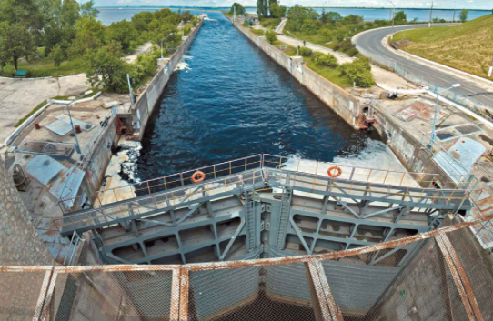
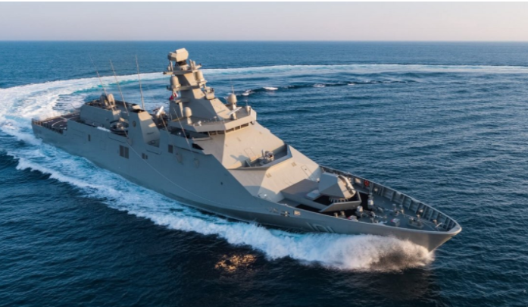

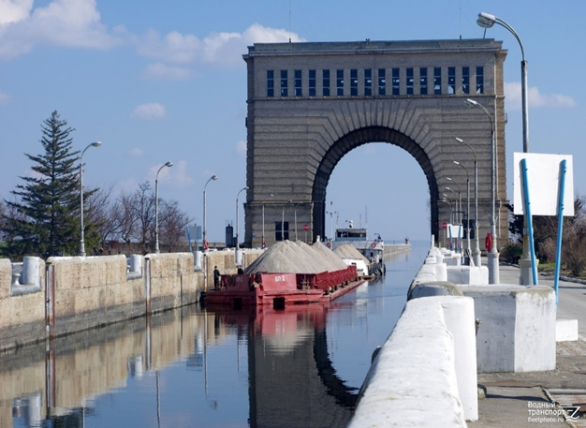
Ukraine’s further plans for the inland water transport development for the nearest future:
Capital repair of locks
River Information Service development
IWT process automation
Ukrainian fleet modernization
Investment engagement for the IWT infrastructure development

Slide 12
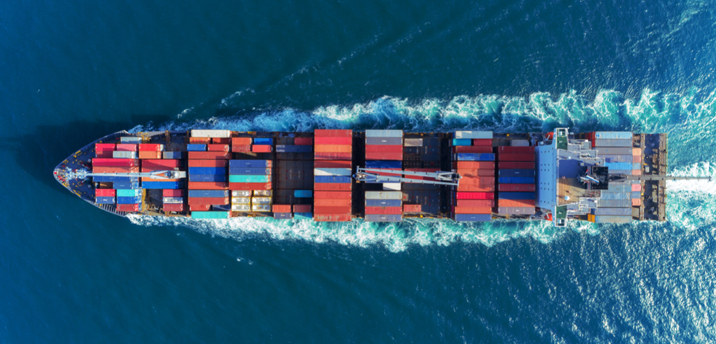
Apart from the implementation measures, several key steps are necessary for the fulfillment of the concept established by the Law of Ukraine On Inland Water Transport:
Establishment of a special State IWW Fund - for stable and proper maintenance of the IWT infrastructure;
Reorganization of the IWW maintenance system - currently diversified functions to be joined under a unified state enterprise accountable to the Ministry of Infrastructure.

Slide 13
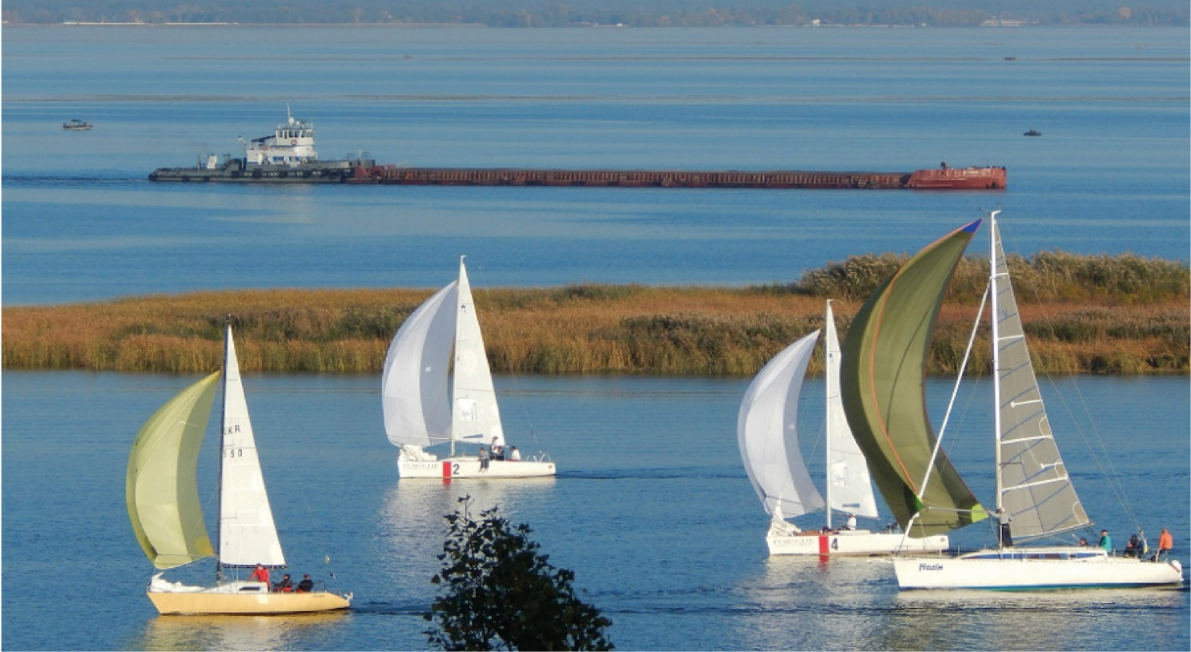
Thank you for your attention!

