Slide 1
Paper charts & Atlas of berth
Budapest, 14.4.2015, Stefan Polhorsky / SVP, s.p.

Slide 2
agenda
Provision of „Paper charts“
Production of an „Atlas of berth“

Slide 3
Provision of „Paper charts“
„Carte de Pilotage“ – official DC chart – last update in 1992
„Streckenatlas“ – „first idea“ coming from WSD (DE)
Product of FGS covering DE part of Danube
First draft presented on Danube Commission on 5/2010 by Mr. Haupt (FGS Regensburg)
Presentation of the idea, core data, production process, comparison of the differences with content of existing „Carte de Pilotage“
Idea of creation of the chart & harmonisation of the content – within the project „NEWADA duo“

Slide 4
Provision of „Paper charts“
Actions done by project „NEWADA duo“:
Creation of the tools
Tool installation on national level into D4D infrastructure
Further adjustments done
Mandatory for tools using – IENC in 2.1 standard
Content of the charts:
IENC in IE Standard 2.1, cross-profile of the bridges, locks, contact details of the relevant institutions, etc.
Status of Paper charts production from PP
Different production processes – finally results available

Slide 5
Provision of „Paper charts“
Status of Paper chart – PDF
via donau (AT) – entire stretch
SVP (SK) – entire stretch
OVF (HU) – 3 pilot stretches
Plovput (RS) – entire stretch
EAEMDR (BG) – pilot stretch
AFDJ (RO) – pilot stretch
ACN (RO) – entire stretch (canal)
FGS (DE) – entire stretch (no project partner)

Slide 6
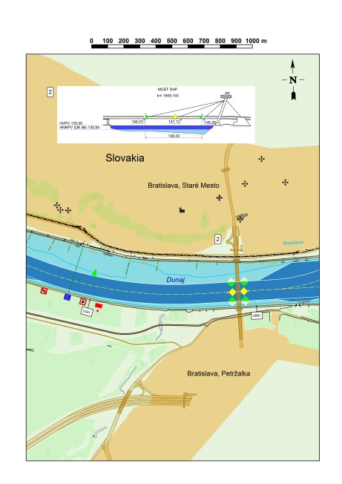
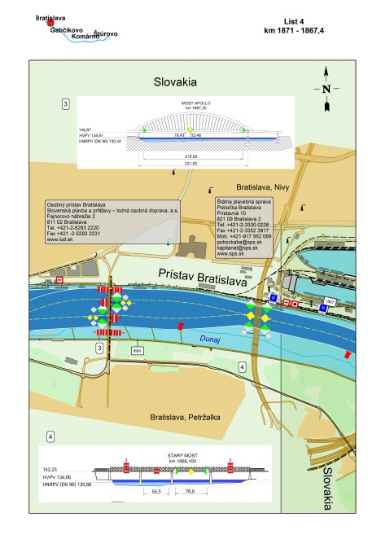
„Paper charts“ - examples
AT
SK
RS

Slide 7
Production of an „Atlas of berth“
Actions done by project „NEWADA duo“:
Relevant data collection on national level
Creation of the Atlas of berth via using of the developed online tool
Mandatory for tools using – IENC in 2.1 standard
Status of Atlas of berth – web portal & PDF version – done by all project partners + DE
Updating in future

Slide 8
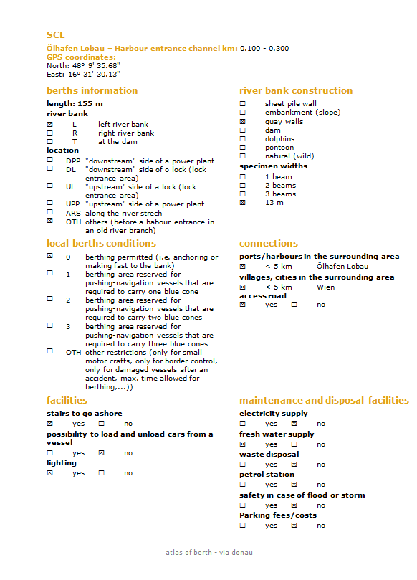
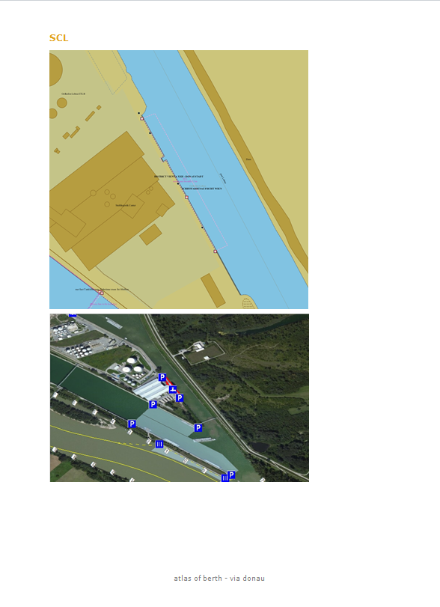
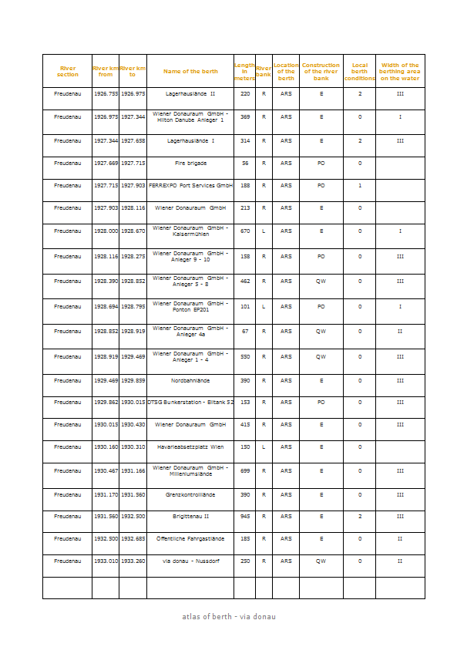
Production of an „Atlas of berth“

Slide 9
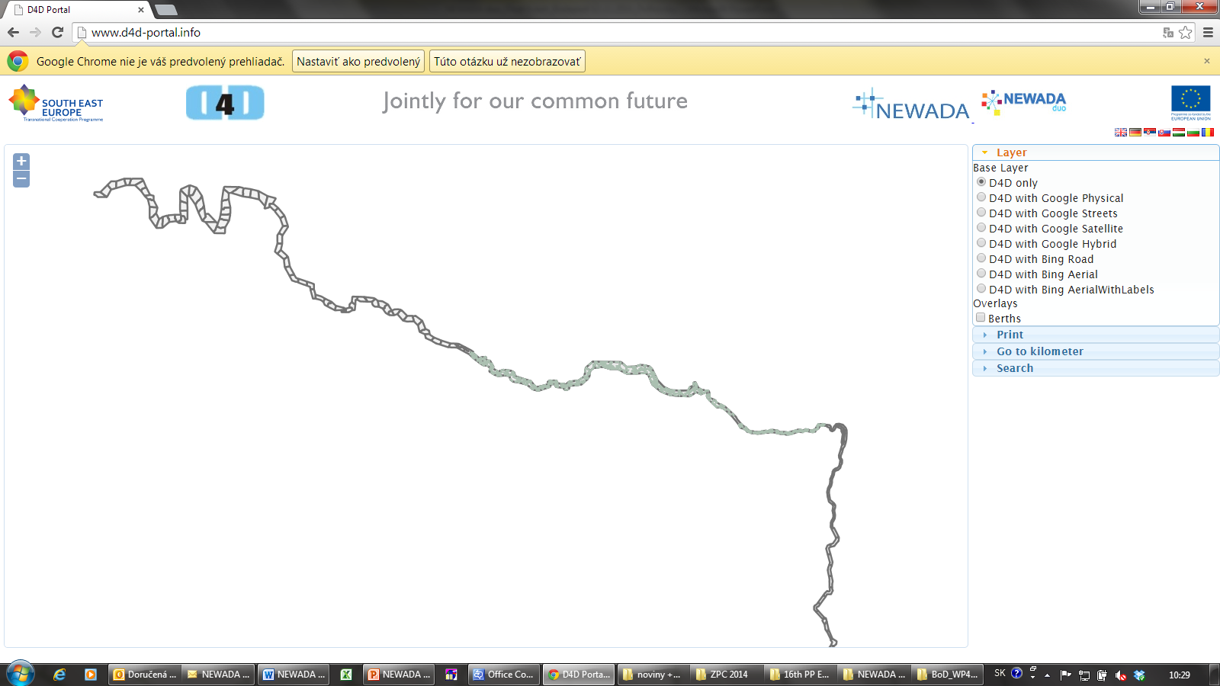
„Atlas of berth“ on D4D portal

Slide 10
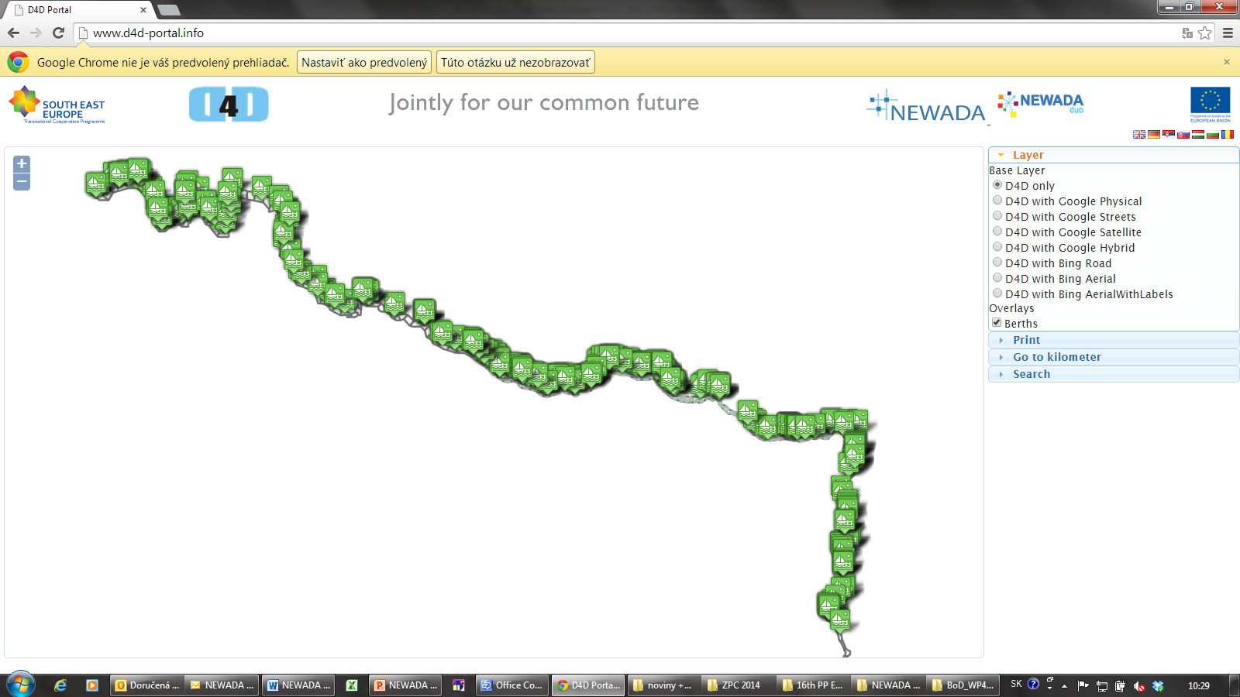
„Atlas of berth“ on D4D portal

Slide 11
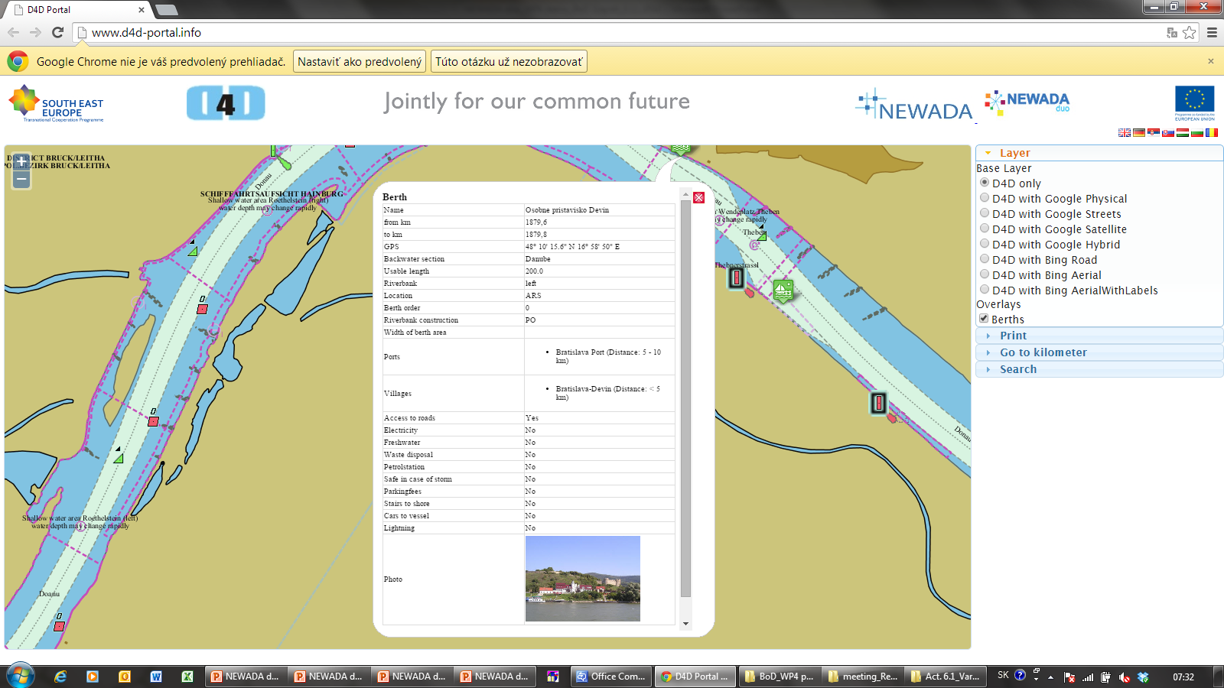
„Atlas of berth“ on D4D portal

Slide 12
Summary
Improvement and harmonization of „Paper charts“ content & possible cooperation with DC regarding the „Carte de Pilotage“ future vision
Updating of existing and creation of „new“ berth places along Danube

Slide 13
Stefan Polhorsky stefan.polhorsky@svp.sk

