Slide 1
Danube Commission
Technical Workshop
WP 3 – Harmonisation of basic data
Budapest, April 15th 2015, Claudiu Dutu – AFDJ Galati

Slide 2
WP 3 – Harmonisation of basic data
Act. 3.1 – Common approach regarding water level information & forecast;
Act. 3.2 – Harmonisation of shallow section information;
Act. 3.3 – Pilot actions for marking plans;

Slide 3
Act. 3.1 – Common approach regarding water level information & forecast;
PP: via-donau, SVP, OVF, Plovput, EAEMDR, AFDJ and ACN;
Results:
Reports on common quality of water level information (Water Gauge Catalogue along the Danube);
Concept on water gauge monitoring;
Report about harmonization of water level forecast;
Concept to improve the national water level information;

Slide 4
Act. 3.2 – Harmonisation of shallow section information;
PP: via-donau, SVP, OVF, APP, Plovput, EAEMDR, AFDJ and ACN;
Results:
SQR on shallow section information - national;
Concept for common quality of service for displaying shallow section information;

Slide 5
Act. 3.3 – Pilot actions for marking plans;
PP: APP, Plovput, EAEMDR and AFDJ;
Results:
SQR on current procedure for marking plan - national;

Slide 6
Structure of common DB Marking Plan / System
MASTER
DATABASE
HR
RS
RO
BG
Notes:
Four partners

Slide 7
Marking System overview
This project's purpose is to bring into accord the coastal and floating signalization by creating a common system which can manage the fairway marking activities.
application for the fairway administration ship – this application will be used to send the data collected from field to the fairway administration office.
application for the fairway administration office – this application will be used for processing data received from the field and creating the actual marking plan and marking system; after the data is analyzed and filtered, it can be sent to the central server as part of the marking plan (or marking system).
a central server application – represents the central component of the system. All the data regarding the marking plan and marking system gathered by the hydrographic offices will be sent here.
Notes:
This project's purpose is to bring into accord the coastal and floating signalization by creating a common system which can manage the fairway marking activities.
This kind of system will provide a centralized administration for the data, support for planning future marking activities, efficient reporting tools and will optimize the entire process by collecting information on the current status of the waterway together with data about involved human resources, materials and fuel consumption.

Slide 8
Data workflow
Test > 2 minutes workflow

Slide 9
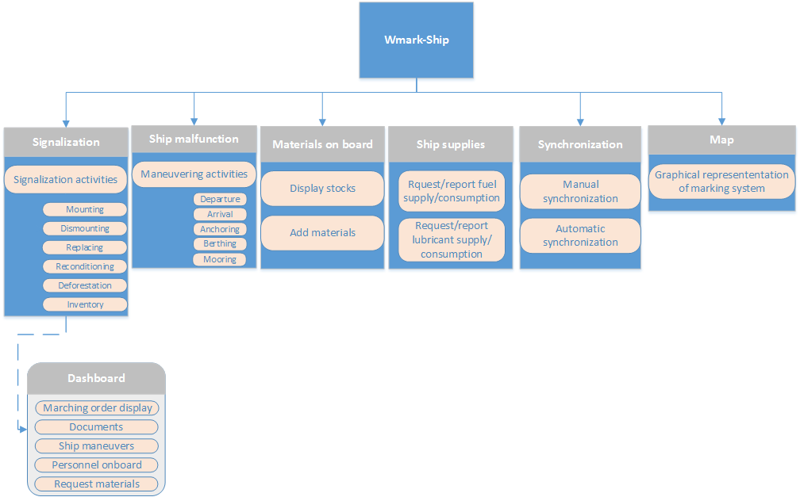
Wmark-Ship application modules

Slide 10
Signalization module
The signalization module provides the users with all the necessary tools for collecting data after each action that has been taken.
Sub modules :
Current marking system - containing all the signals (coastal and floating) for a specific portion of the Danube with specific information for each signal (CEVNI class, CEVNI code, distances to the banks, kilometric position, etc). The user can add or remove signals, consult information, define new activities, report damages.
Marching order dashboard - displays the current Marching Order, as well as a list of previous Marching Orders. The user will be able to consult the current marching order and check or add the tasks he has to fulfill, consult documents, register personnel onboard, report ship maneuvers and request new materials.

Slide 11
Signalization module

Slide 12
Wmark-Shore
WMark-Shore - application for the fairway administration offices through which the data received from the measurement ship will be analyzed, filtered and then sent to the central server.
WMark-Shore features:
Modular structure
Database server
Synchronization with the ship application
Marking plan
Marking system
GIS map to represent the signalization for both marking plan and marking system
Reporting tools for all the activities held on the ship
Administration tools

Slide 13
Wmark-Shore modules
Notes:
The marking plan module provides the users with tools for creating, maintaining and representing the marking plan.
The application gives users the opportunity to choose their strategy when they create a new plan:
Start from previous marking plan - makes a copy of the previous marking plan which can be modified by the users;
Start from current marking system - makes a copy of the current marking system which can be modified by the users;
All the data referring to the marking plan will be stored in local database tables.

Slide 14
Marking system module
The marking system module provides the users with tools for creating, maintaining and representing the marking system.
The input for the marking system must be validated by a marking supervisor.
All the data referring to the marking system will be stored in local database tables.
The marking system is editable, because the information is dynamic and sudden changes in the field can require changes on the system as well.

Slide 15
Marking system module

Slide 16
Visual representation of Marking Plan and Marking System
Map features:
ESRI World Imagery or Open Street Map background (depending on the user’s preference);
Kilometric and nautical miles positions;
Representation of the planted signals based on their geographical coordinates.
Notes:
Both Marking Plan and Marking System modules are represented using a graphical interface with map background.

Slide 17
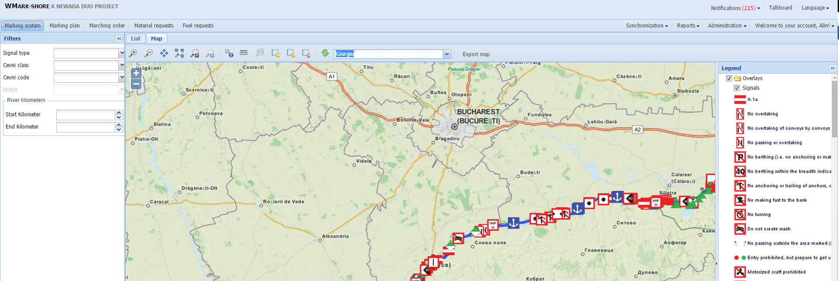
Visual representation of Marking Plan and Marking System

Slide 18
Act. 3.3 – Pilot actions for marking plans;
Results:
Concept including technical specifications and system architecture for common marking plan database;
MARKING SYSTEM
http://178.254.129.60:5666/

Slide 19
Marking system - 1

Slide 20
Marking system - 2

Slide 21
Marking system - 3

Slide 22
Marking system - 4

Slide 23
Marking system - 5

Slide 24
Marking system - 6

Slide 25
Marking system - 7

Slide 26
Marking system - 8

Slide 27
Marking system - 9

Slide 28
Marking system - 10

Slide 29
Future steps
Others functionalities for the Ship, Shore and centralized application;
Marking Plan / System on FIS Portal as separate layer;
Virtual AtoNs on Marking Plan;
Marking System for mobile app (iOS/ Android);

Slide 30
Future steps
Harmonisation of surveying activities
Harmonisation of dredging activities / maintenance activities of critical sections
Quality of information

Slide 31
CLAUDIU DUTU – AFDJ GALATI
ROMANIA
claudiu.dutu@afdj.ro

