Slide 1

Large Infrastructure Projects ltd. Sofia, Bulgaria
New Pan - European transport and water management project
Budapest, Danube Commission, 20 October 2016

Slide 2
Large Infrastructure Projects Ltd. is a private Bulgarian company with headquarters in Sofia.
ABC+De means Aegean sea to Baltic sea Connection and Danube river.
ABC+De is a new generation Pan-European integrative, infrastructure project for highly efficient, high-speed rail transport and for water management of the Danube River and tributaries.
The project coverage is in 9 EU countries; Greece, Bulgaria, Romania, Croatia, Hungary, Slovakia, Poland, Austria and Germany and in 3 non EU countries: Turkey, Serbia, Bosnia and Herzegovina.

Slide 3
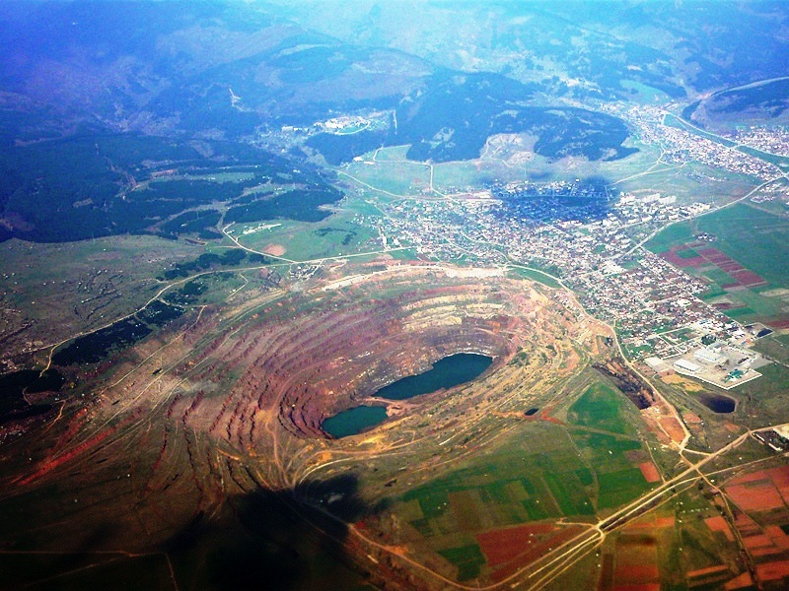
KREMIKOVTSI DEPOSIT

Slide 4
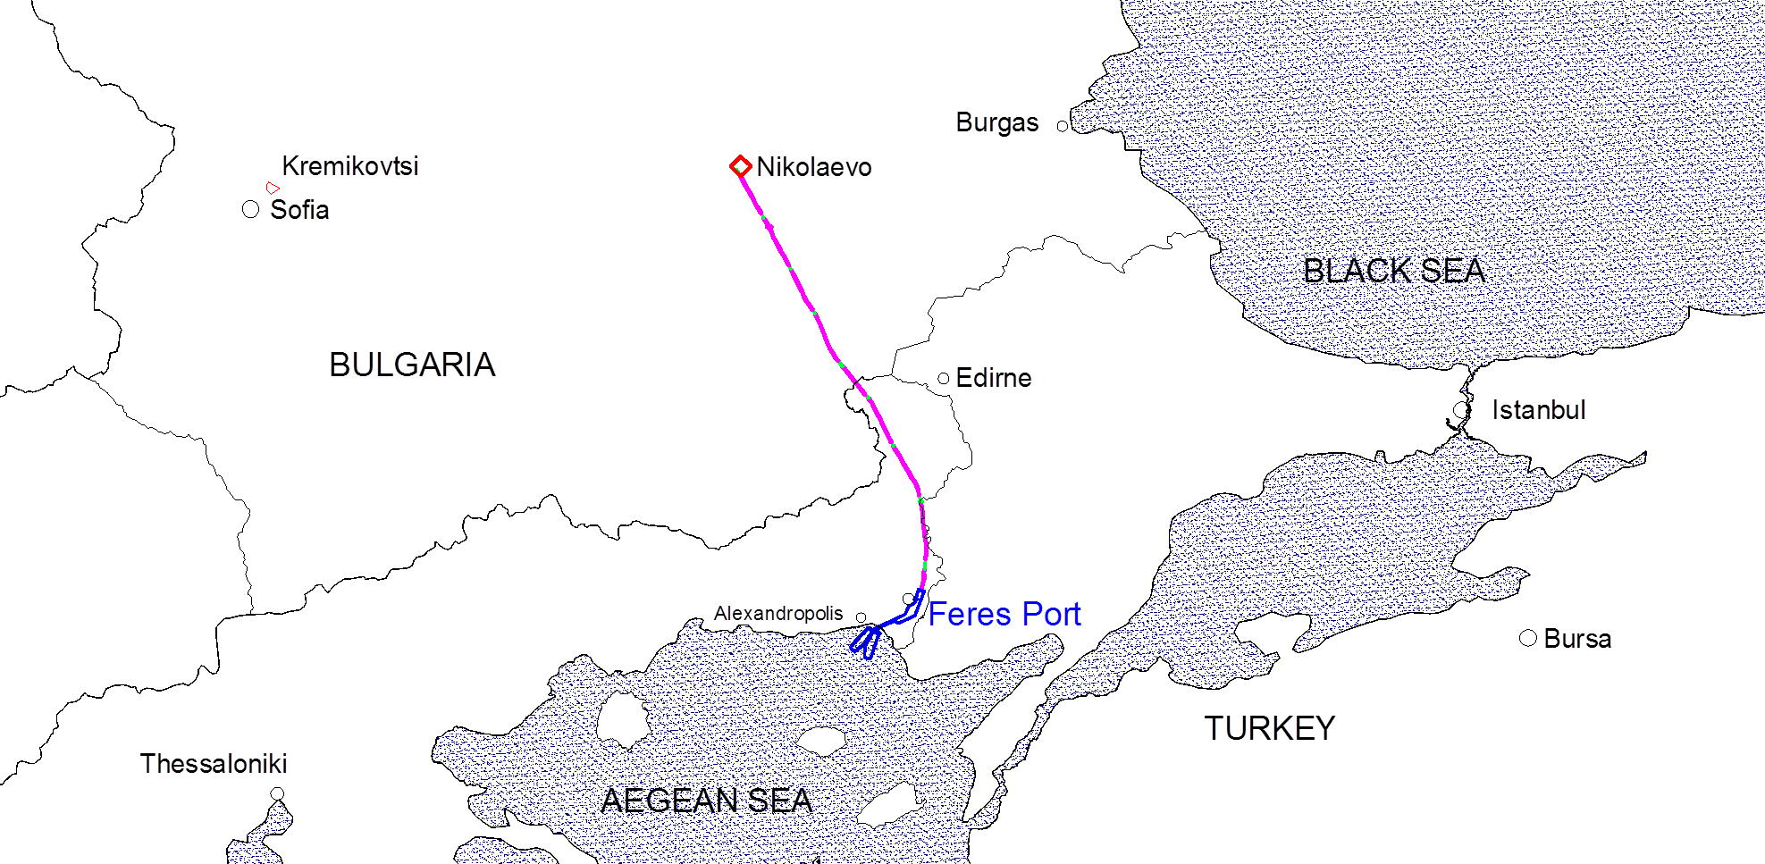
The ABC + De project evolved from a study of new port on the Aegean Sea and new railway connecting the port and the site for the new plant in the middle of Bulgaria (town of Nikolaevo ) for processing of ores to the largest Pan-European project extending from the Aegean Sea, and Marmara Sea to Baltic Sea and North Sea as well as all along the Danube.

Slide 5
ABC+De is a project that:
1. Creates a new route for the transport of goods between the Suez Canal, Aegean Sea, Marmara Sea and the Eastern, Central and Northern Europe;
2. Provides a new level of connectivity between people of Eastern and Western Europe by high speed trains (360 km / h);
3. Decides for centuries ahead the main problems on the Danube:
-Terminate the floods along the river and tributaries;
- Reduce the impact of droughts caused by climate change;
- Transform the river and tributaries from waterway in decline to transport corridor;
- Restore and improve biodiversity.
4. Develops the economy of the lagging behind regions in the eastern part of the EU
5. Reduces by millions of tons the carbon dioxide annually generation.

Slide 6
ABC+De
target market

Slide 7
ABC+De project market positioning
Main artery for transporting goods between Suez Canal, Middle East, Northeast Africa, Southeast Europe and the Central and Northern Europe;
New European trade gates;
Competitor of the air transport in short and medium distances in East Europe.

Slide 8
New Logistic centers
GERMANY- Hamburg South;
Uelzen North;
Berlin South
POLAND- Poznan South;
Warsaw-Lodz;
Debica North
AUSTRIA- Vienna West;
Heimatland;
SLOVAKIA- Devinska Nova Ves North
HUNGARY- H-SK-UA;
Gyor;
Szekesfehervar West;
Budapest West;
Budapest East;
Kecskemet South;
Szeged South
ROMANIA- Timisoara-Arad;
Cluj-Napoca;
Sibiu West;
Calimanesti;
Pitesti;
Brasov;
Bacau;
Iasi;
Bucharest North-West
Bucharest West;
Olteni
BULGARIA- Nikolaevo;
Lyubimets
GREECE- Feres
TURKEY- Catalca;
Bandirma South
Bursa

Slide 9
ABC + De project elements are:
1. New sea and river ports:
1.1. Feres port on the Aegean Sea
1.2. Wisla port on the Baltic Sea
1.3. New river ports on the Danube and tributaries in Bulgaria, Romania, Hungary, Slovakia, Austria and Croatia
2. South- North Stream (SNS) - a new high-speed railway line between Feres port and Wisla port .
Branches which connect the railway backbone include new railway routes to and from Istanbul , Bursa, Izmir , Bucharest (reconstruction), Budapest, Vienna, Warsaw (reconstruction), Hamburg/ Bremerhaven/Cuxhaven via Berlin
3. New logistics centers on ports and along the new railway line.
4. New Central Europe regional leisure and entertainment center in Hungary.
5. Activities in the project ABC + De for the Danube and tributaries.

Slide 10
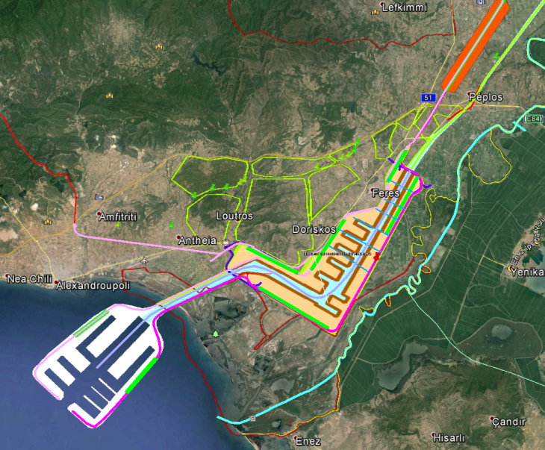
FERES PORT
The new port will be composed of two parts.
Deep section is located in Greek territorial waters.
The part in land is intended for ships carrying new cars, for ferries and cruise ships.
The two parts are connected with a channel.

Slide 11
Feres port
Deep sea water port, capable to handling more than 25 m draught ships;
Terminals for bulk cargo, containers, oil , LNG , general goods, agricultural products , semi – trailers , newly produced cars and other vehicles ; for acceptance of ferries and cruise ships;
May adopt ships due to the size and type of load can not pass through the Straits;
Feres port will be one of the few European ports where can berth new 26 300 TEUs ULCS;
New European trade gate;
Hub for Eastern Mediterranean, Aegean sea, Marmara sea , Black Sea, Azov Sea. Provided all conditions for transshipments;
Connectivity with railways, available highway and international airport;
Existing and new build supporting infrastructure - water, electricity, gas main pipeline;
“Green” port;
Design capacity - 400 million tons per year (phased), quay walls over 100 km (phased).

Slide 12
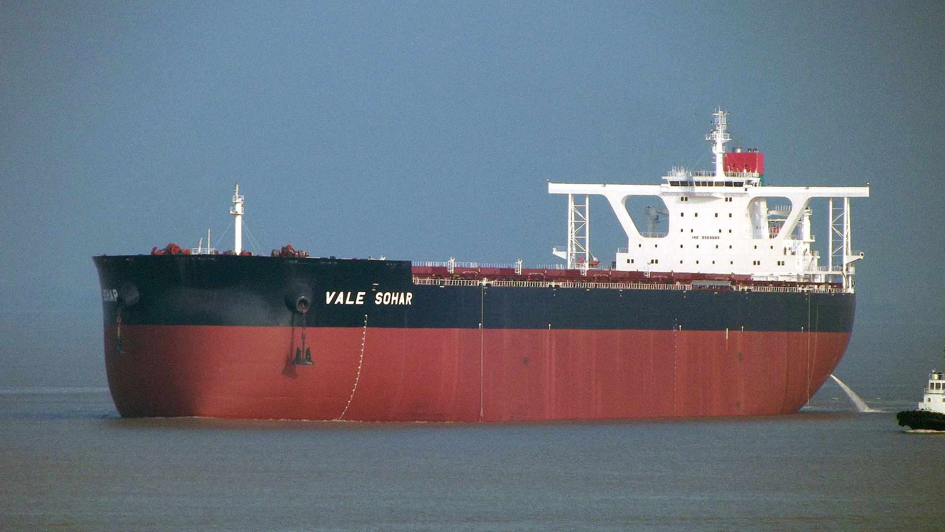
Bulk carrier
>400 000 DWT
Draught 23 m

Slide 13
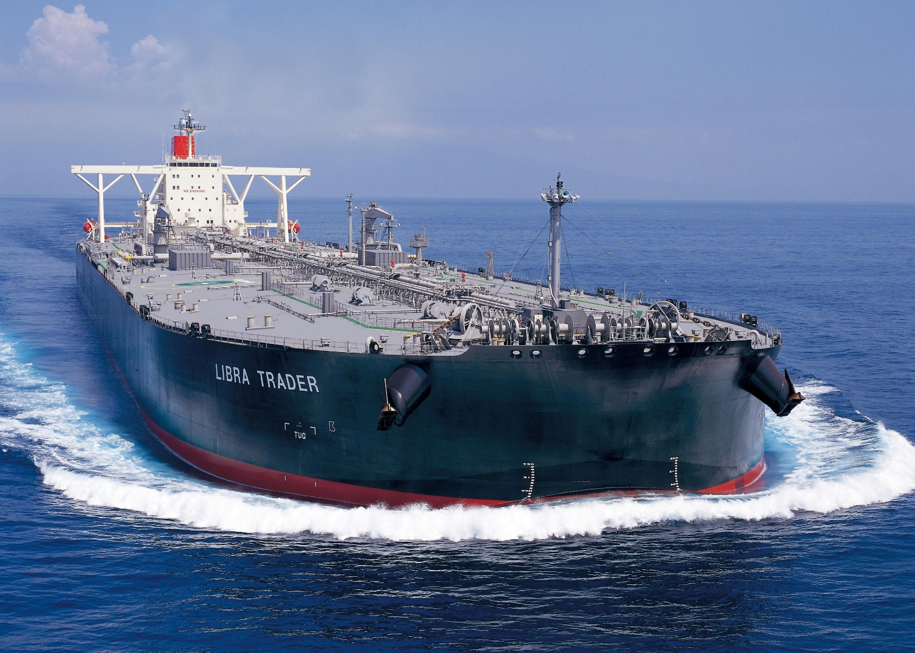
VLCC tanker
2 million barrels

Slide 14
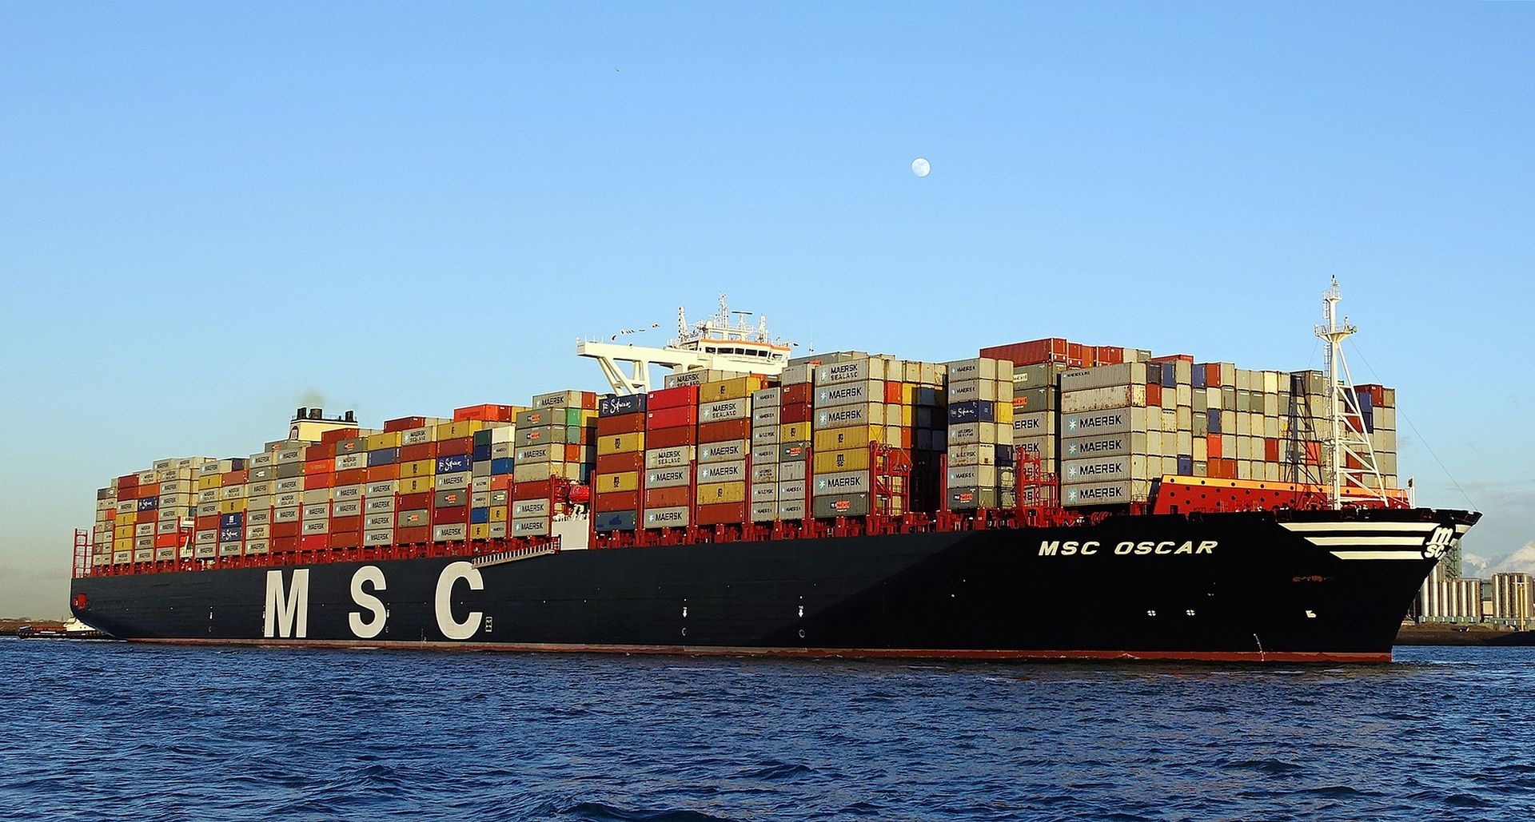
Container ship 19 500 TEU
(also for new ULCS 26 300 TEU )

Slide 15
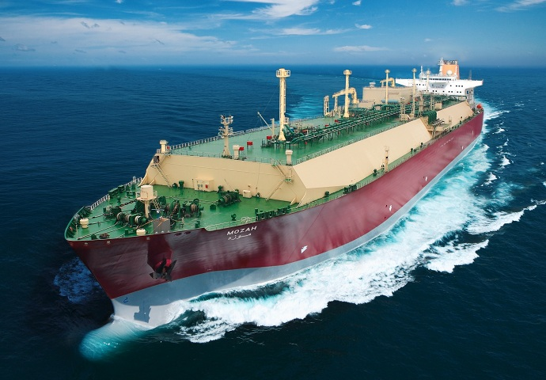
LNG tanker
266 000 cubic metres LNG
≈162 million cubic metres
natural gas

Slide 16
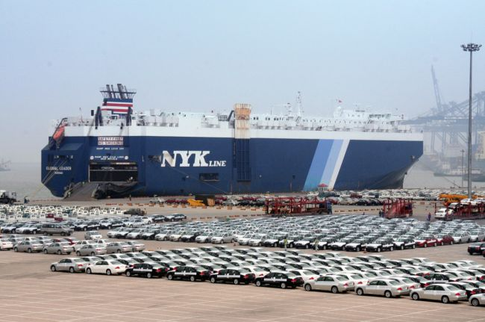
Car Carrier Ship
8500 cars

Slide 17
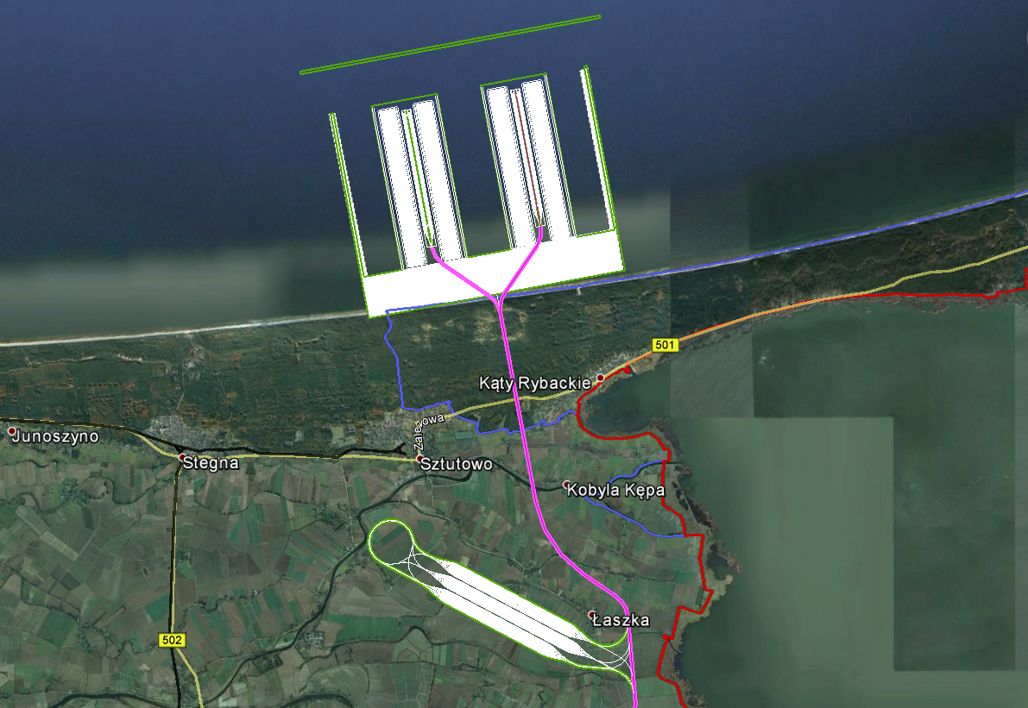
WISLA BALTIC
PORT

Slide 18
Wisla Baltic port
Designed primarily for the new Aegean sea- Baltic sea “green" corridor;
Terminals for containers, bulk cargo, LNG , general goods, agricultural products , semi –trailers , newly produced cars and other vehicles ; for acceptance of ferries;
Hub for the Baltic countries and Norway;
Design capacity - 150 million tons per year incl. 8 million TEUs, quay walls- 12,5 km.

Slide 19
South-North Stream (SNS)
The railway part of the ABC+De project is a unity of infrastructure, rolling stock, logistics centers and management .
State-of-the-art technologies. Driverless movement and automatic shunting.
Digitalization ^{n}
The railway is intended primarily for freight trains. The parameters of railway are designed also for high-speed trains movement;
Thanks to the SNS enormous capacity for freight and high commercial speed, the freight are carried out mainly at night. Passenger transport and railway maintenance occupy the daylight hours.
For freight transport the SNS is characterized by:
high capacity + high commercial speed = high efficiency
in a block train: up to 149 km/h competitive prices
476 TEUs or 1092 new cars average speed for prompt deliveries
or 4 529 980 Nm³ NG the freight trains
Fifteen times bigger throughput than an average European line railway
Huge amount of loads up to 1,2 billion t per year

Slide 20
Scheme of the railway stations along
the new ABC+De project railroad

Slide 21
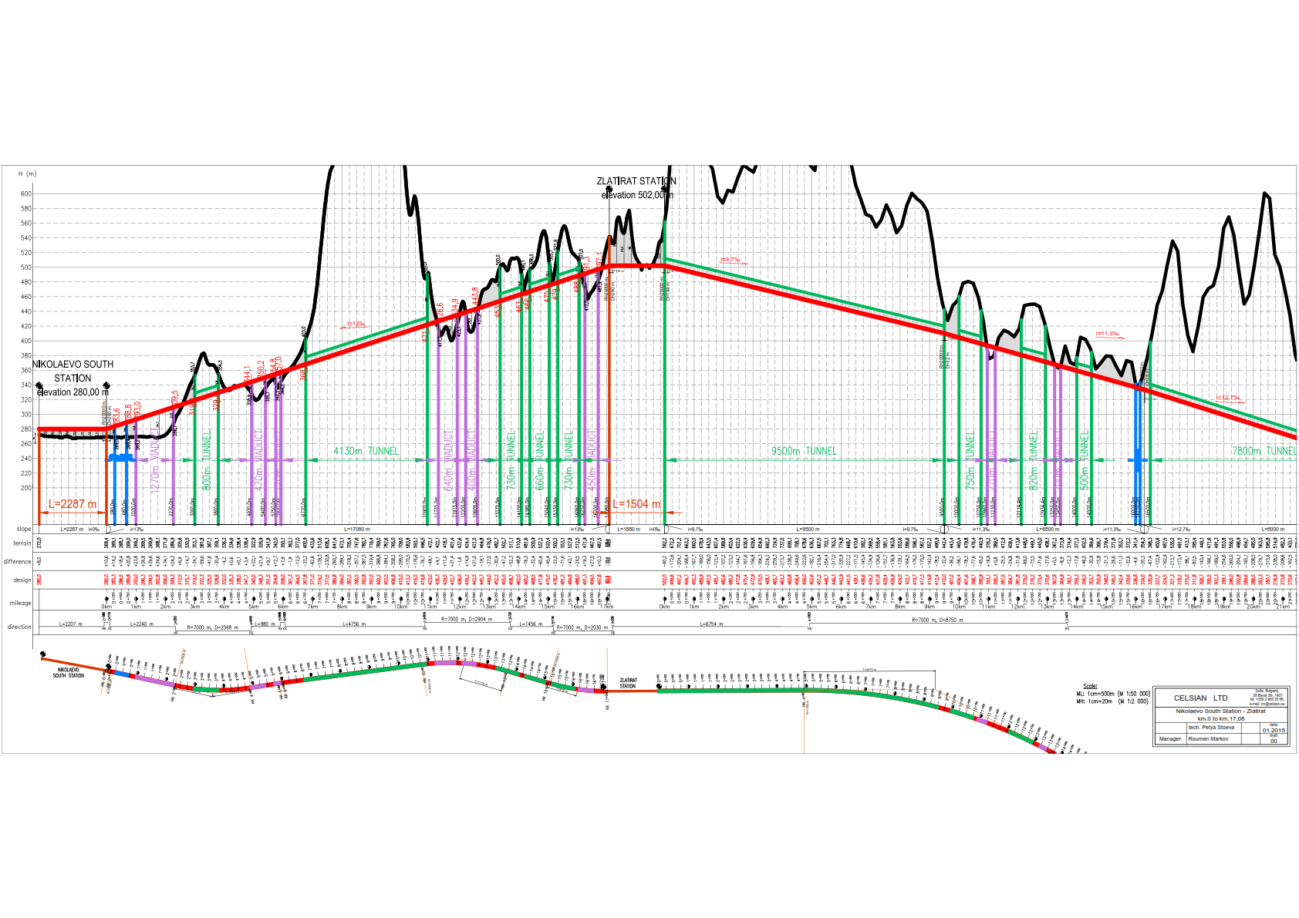

Slide 22
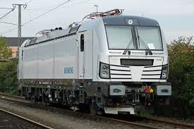
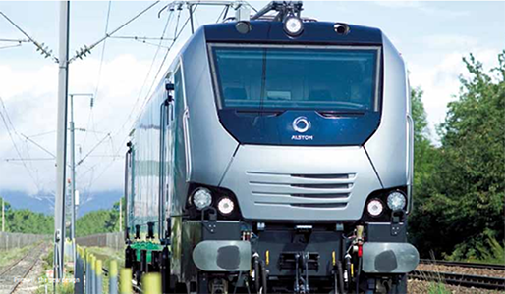
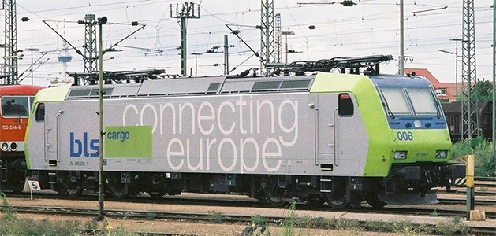
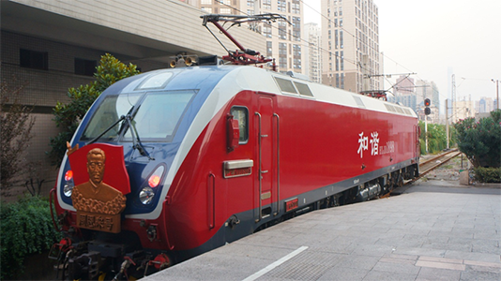
Freight locomotives

Slide 23
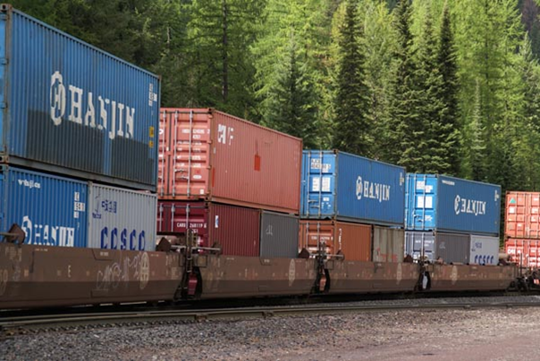
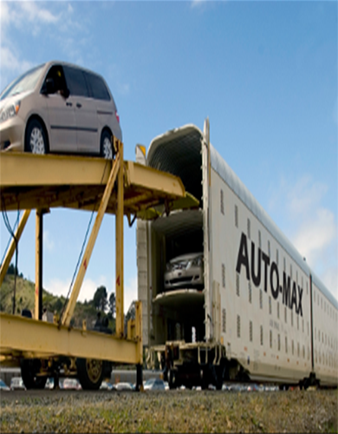
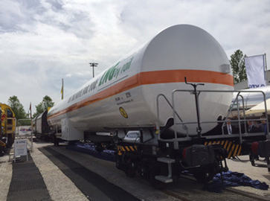
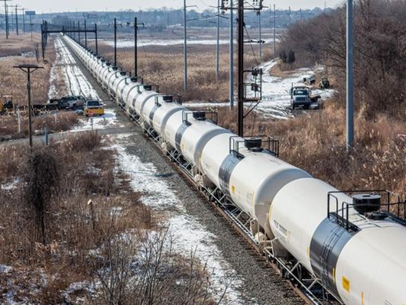

Slide 24
ABC+De freight trains timetables
FERES PORT - WISLA BALTIC PORT
FREIGHT TRAIN timetable
FERES PORT - Vienna West Log. Center
FREIGHT TRAIN timetable
FERES PORT - Berlin South Log. Center
FREIGHT TRAIN timetable

Slide 25
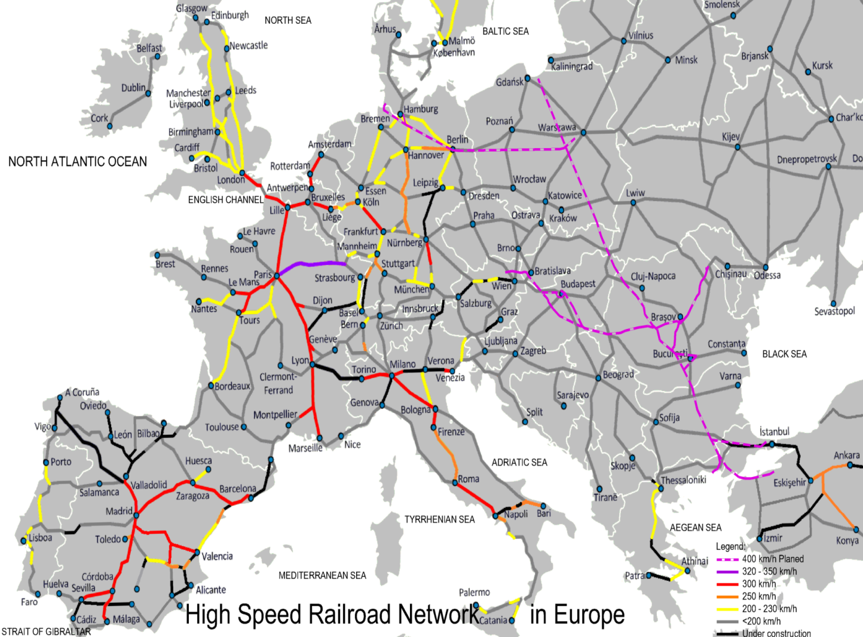
What is high speed passenger train?
- On existing lines in excess of 200 km/h
- On new lines in excess of 250 km/h
In the ABC+De project the max. service speed for passenger trains is 360 km/h
High Speed Train destinations in the ABC+De project are:
New Istanbul airport - Berlin
New Istanbul airport - Bucharest
New Istanbul airport - Warsaw
New Istanbul airport - Vienna
Bucharest - Berlin
Bucharest - Warsaw
Bucharest - Vienna
Warsaw - Berlin
New Istanbul airport - Sofia
Bucharest - Sofia

Slide 26
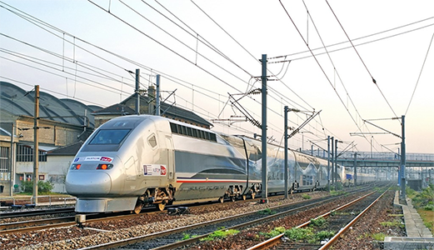
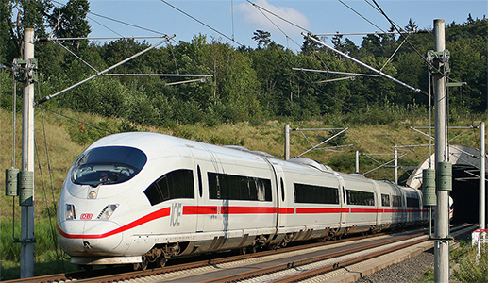

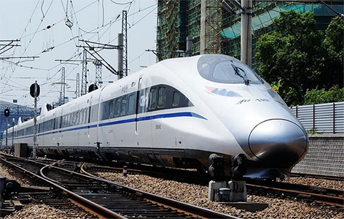

Slide 27
ABC+De high speed passenger trains timetables
Warsaw- Berlin
New Istanbul airport - Berlin
New Istanbul airport - Vienna

Slide 28
Activities on the ABC + De project for the Danube River and tributaries
Formula 7 in 1.
Termination of the floods on:
- Danube : in Passau; from Bad Deutsch km. 1888+000 to the river mouth;
- Sava River from Zagreb to the confluence of the river in the Danube;
- Tisza River from Csongrad ( Hungary ) to the confluence of the river in the Danube.
Criteria - providing settlements and adjacent areas against major floods with 0,1% probability ("thousand year wave");
2. Reducing the harmful effects of drought and climate change by providing additional amounts of water and their rational use;

Slide 29
Efficient shipping –
3.1. The waterway
- seventh class IWWs ; digitalization
- all year guaranteed 4 m draft for ships:
on the Danube - from the port of Constanta to Bad Deutsch- Altenburg km 1888+000;
on the Sava - from the confluence of a new large Sava–Danube canal in the Danube ( km 1337+500 ) to new port in Zagreb.
3.2. New highly efficient and environmentally friendly vessels- crewless ships, digitalization, alternative fuels, hybrid drives.
4. Relatedness of the ABC + De project solutions with the environment and biodiversity.
Restoration and development of the sturgeon populations .
5. Connectivity on both banks of the river. Prioritize the elements of the infrastructure along the Danube.
6. Production of "green" energy from hydropower - benefit, but not a primary objective of the project;
7. Unified management of the river and its tributaries.

Slide 30
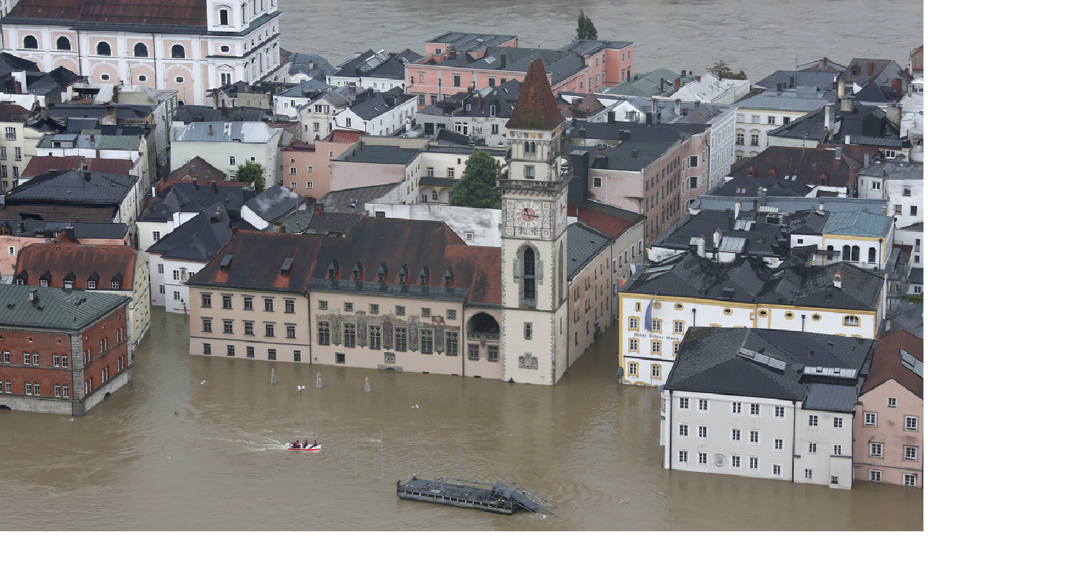
PASSAU

Slide 31
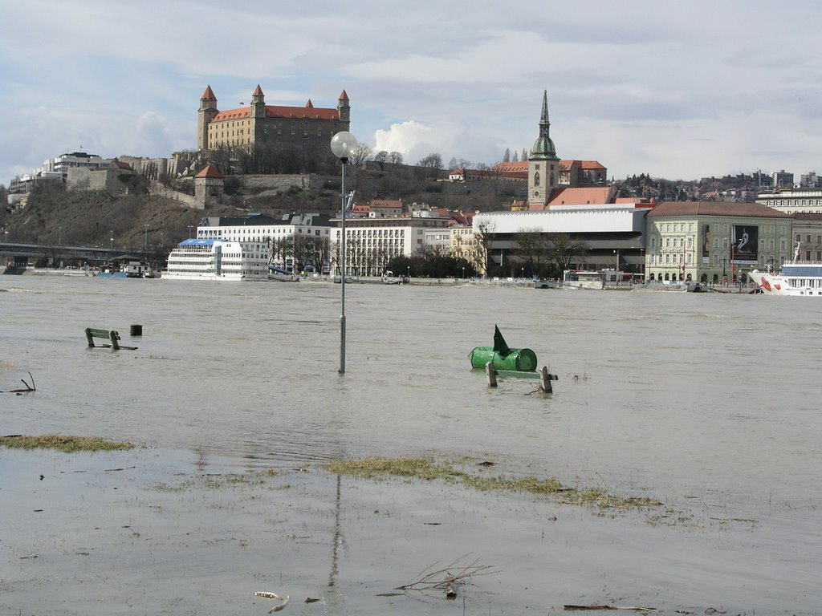
BRATISLAVA

Slide 32
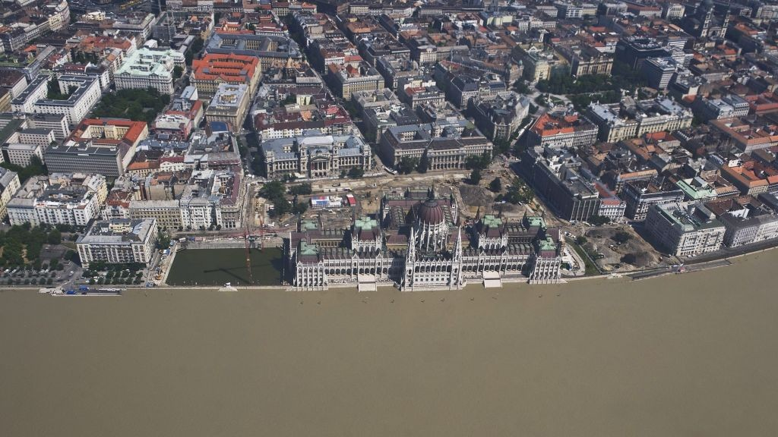
BUDAPEST

Slide 33
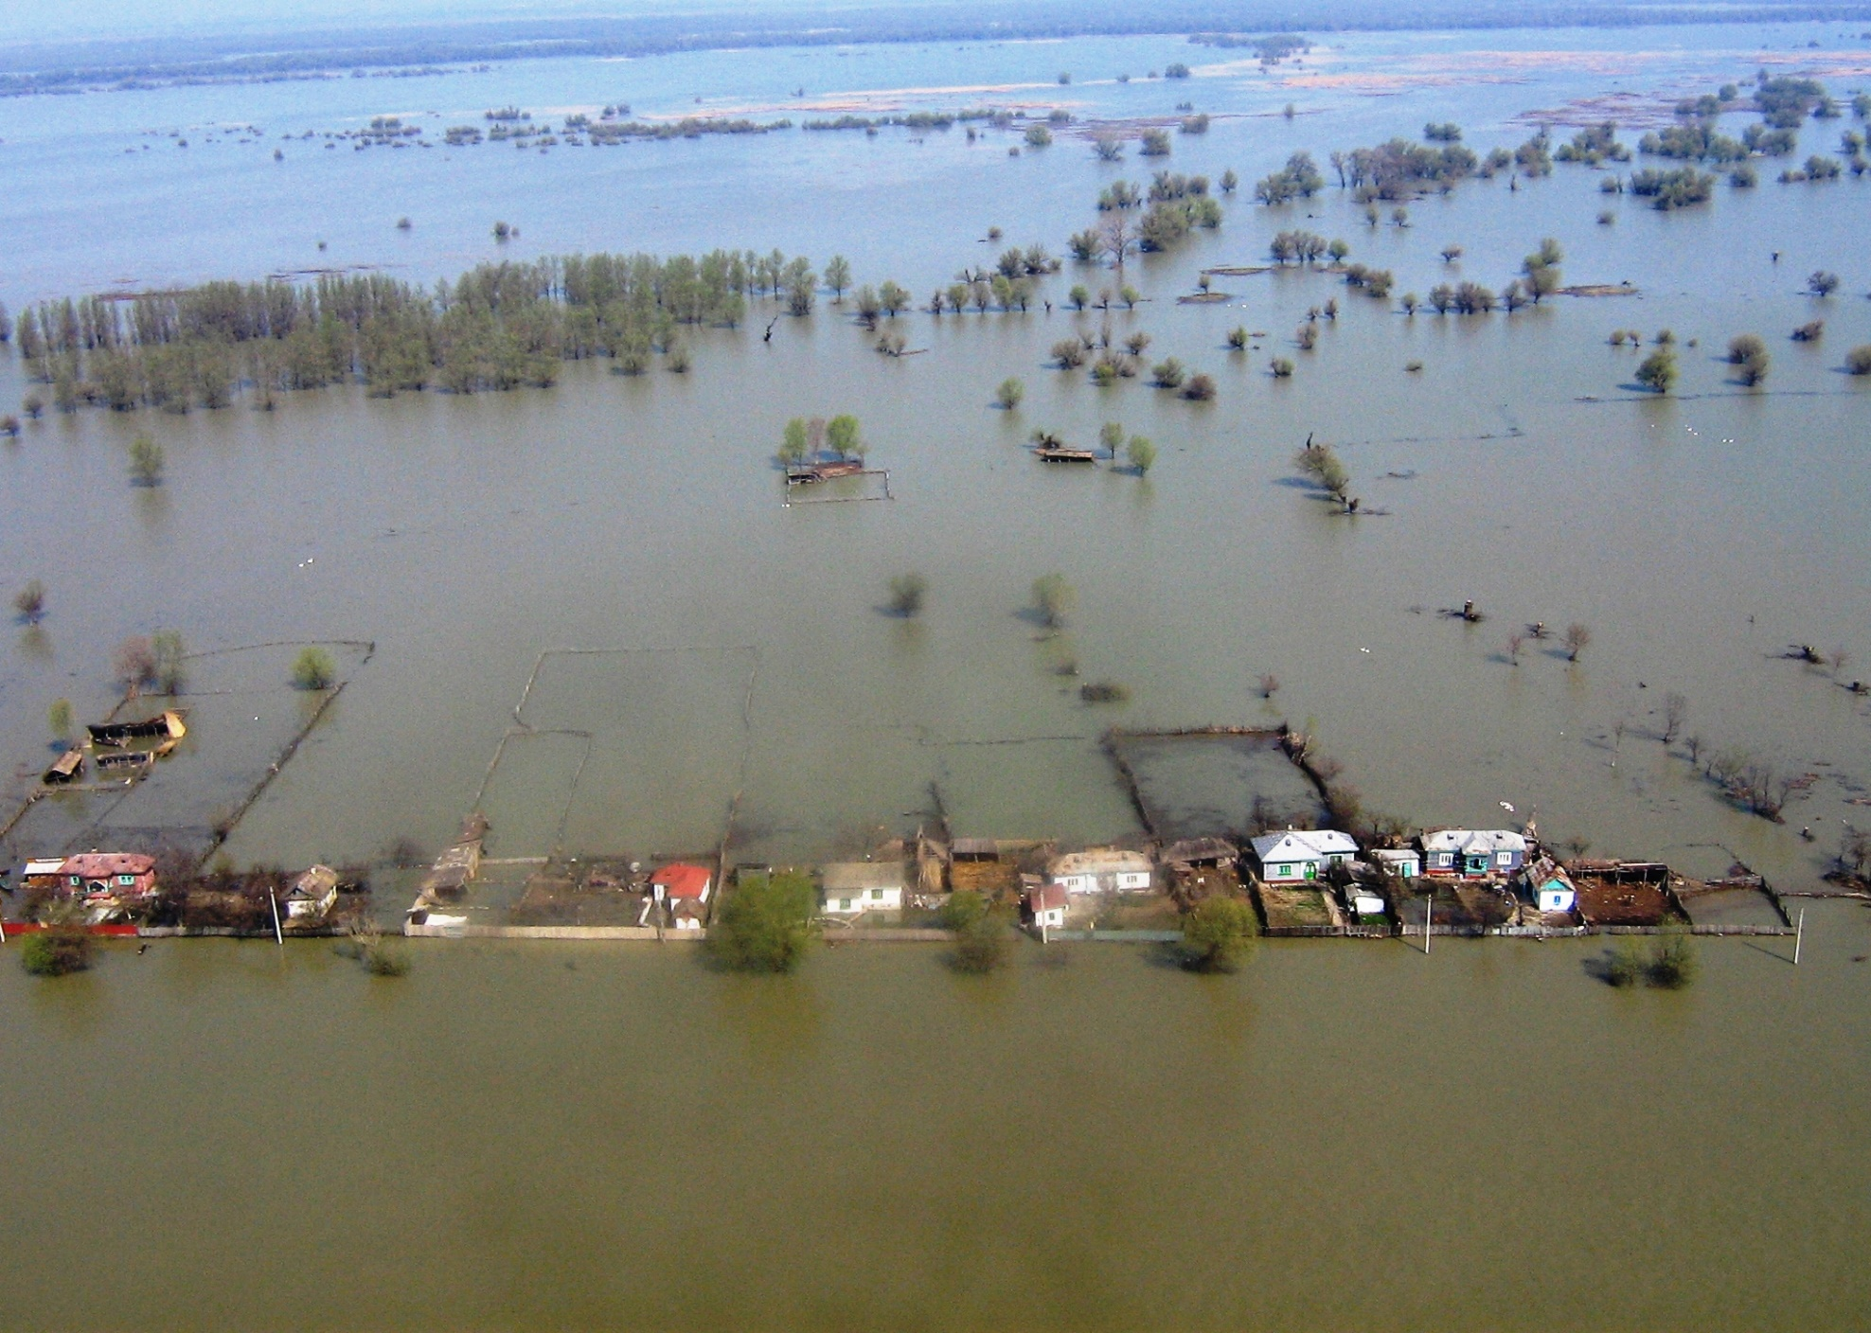
Tulcea district

Slide 34
Giurgiu flooding
Galati flooding

Slide 35
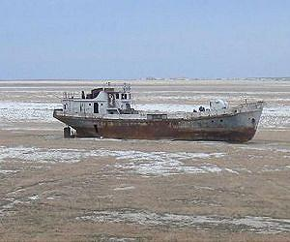

Slide 36
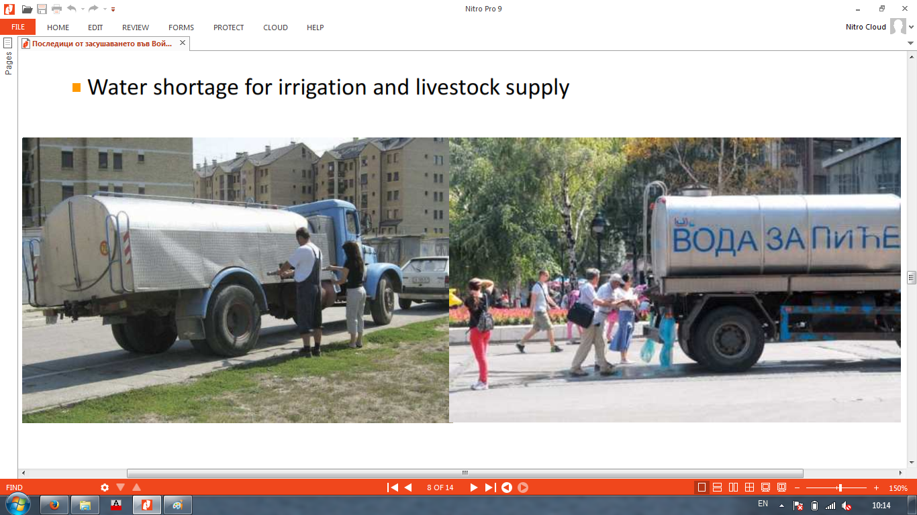

Slide 37
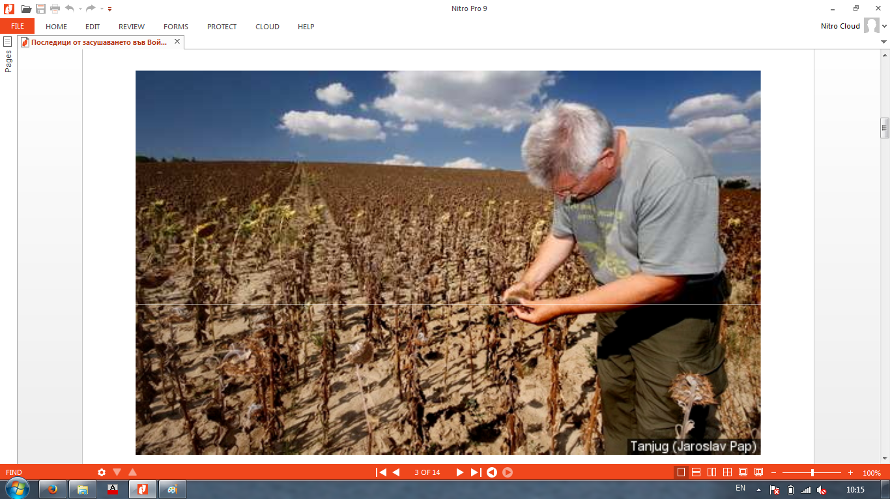

Slide 38
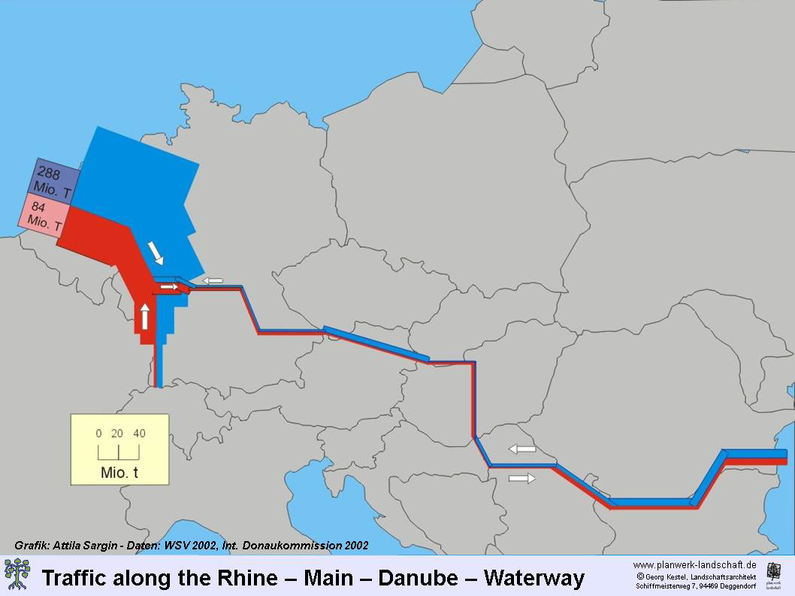
Traffic along the Rhine-Main-Danube waterway

Slide 39
DANUBE

Slide 40
Lower Danube

Slide 41
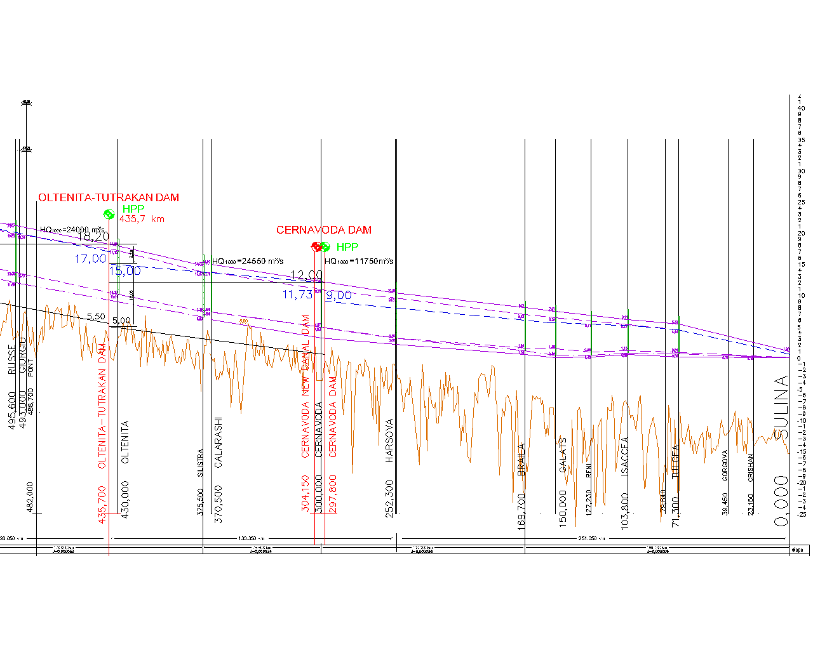

Slide 42
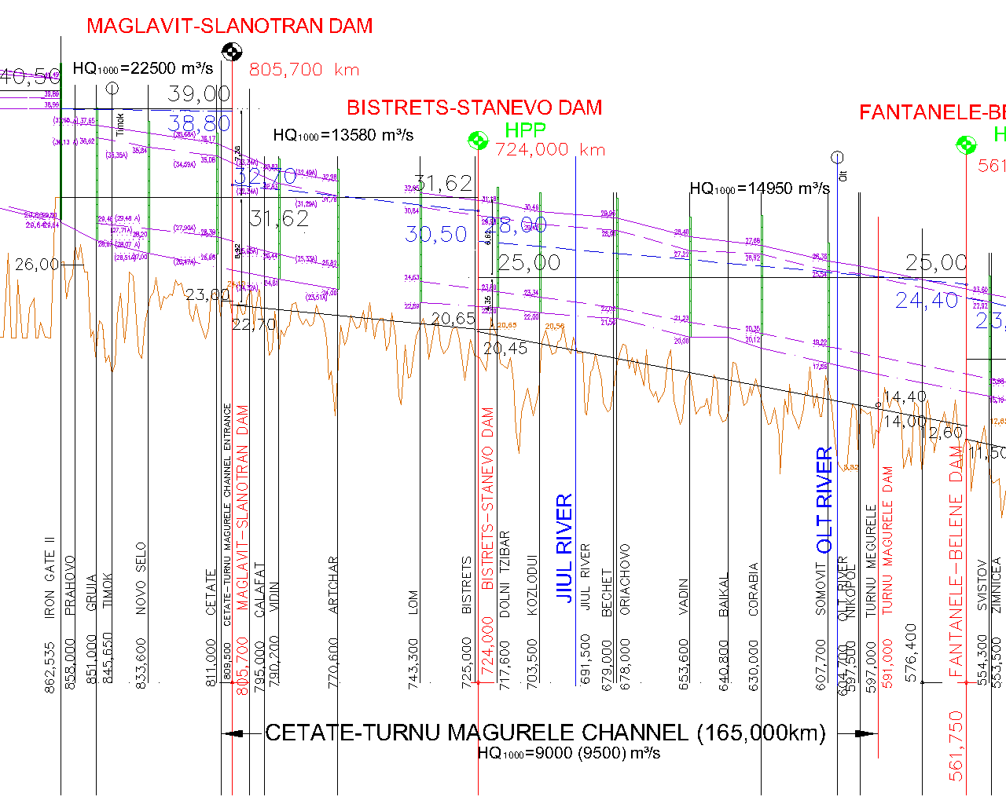

Slide 43
aaaaaa

Slide 44
Oltenita - Tutrakan dam

Slide 45
Fantanele-Belene dam
Belene canal dam
Fantanele-Belene dam

Slide 46
Bistret-Stanevo dam

Slide 47
MIDDLE
DANUBE

Slide 48
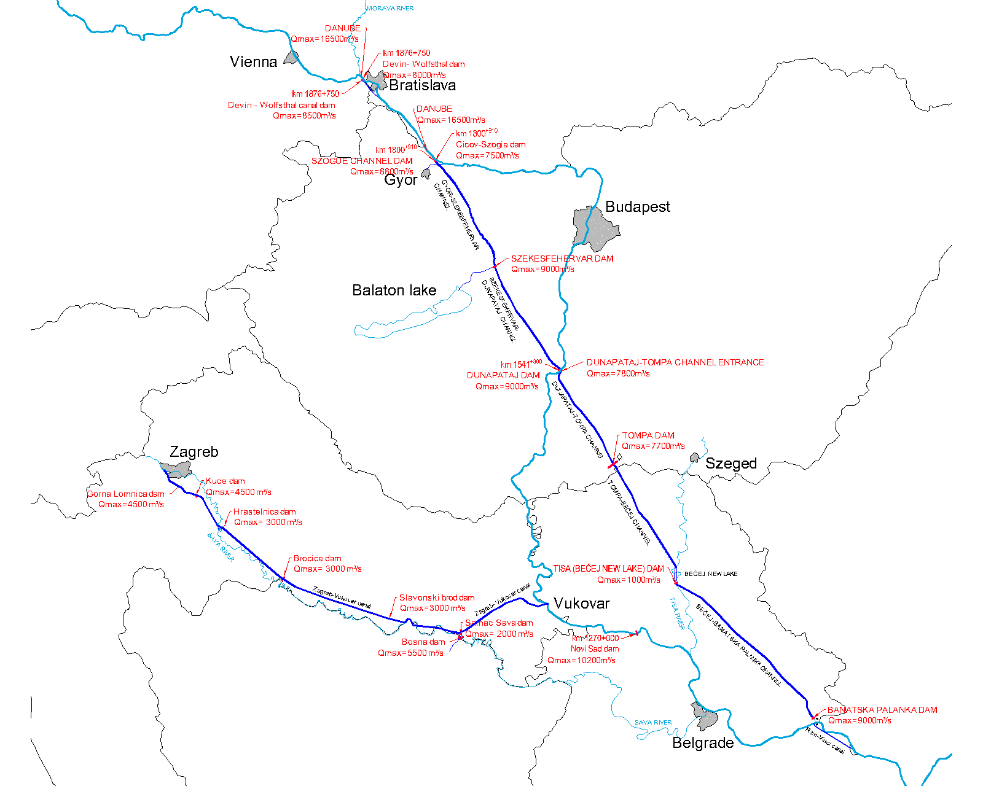

Slide 49
Devin

Slide 50
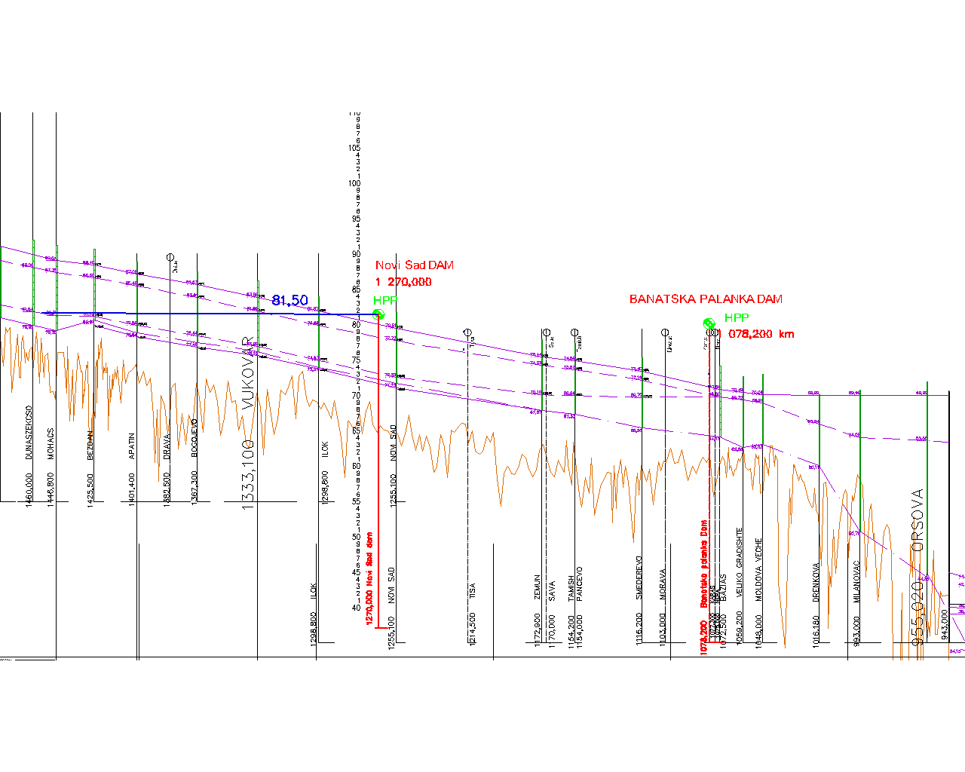

Slide 51
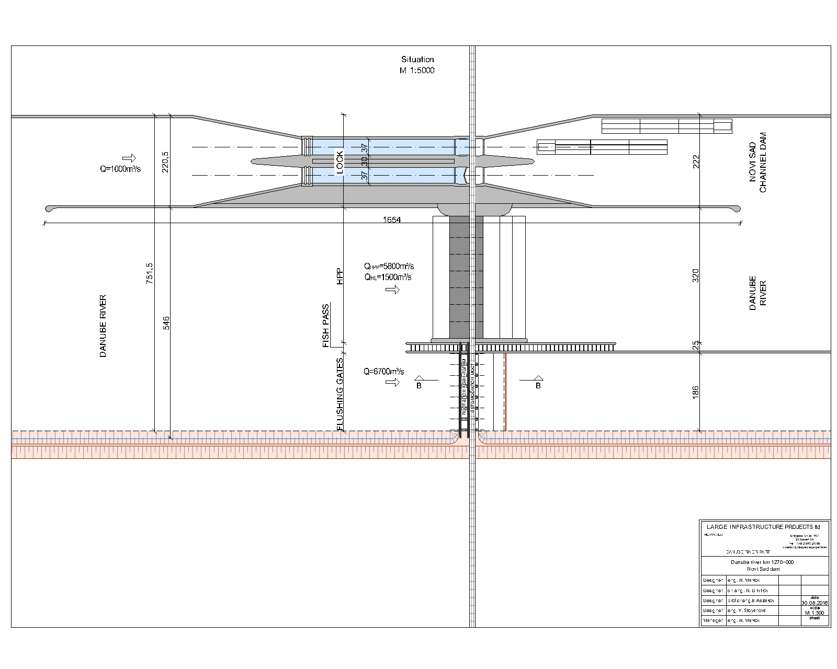

Slide 52
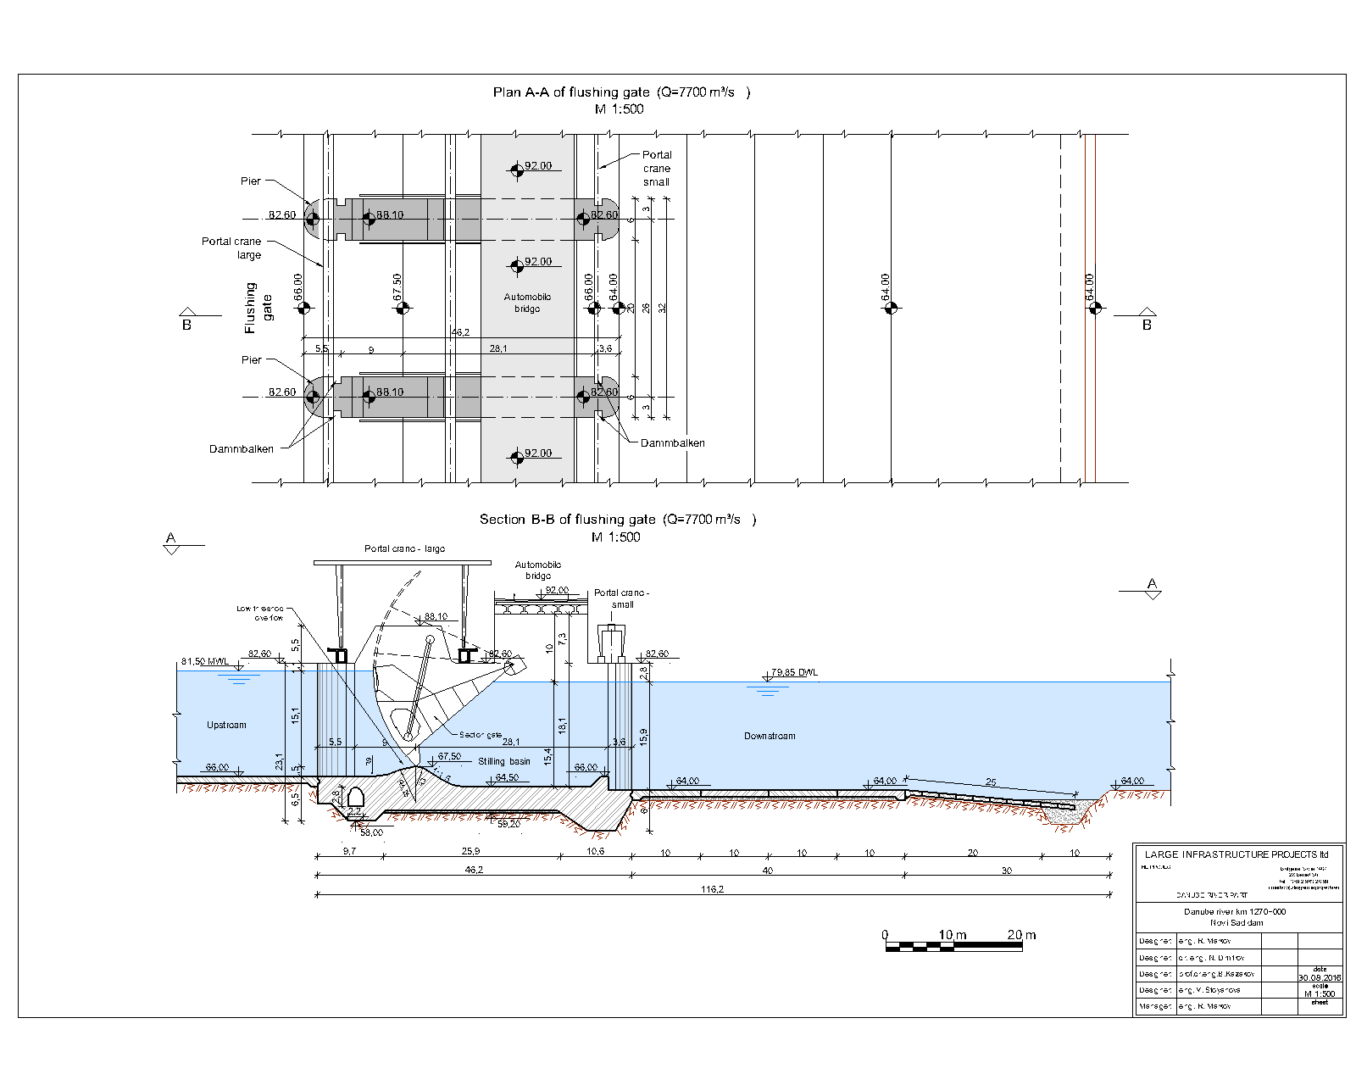

Slide 53
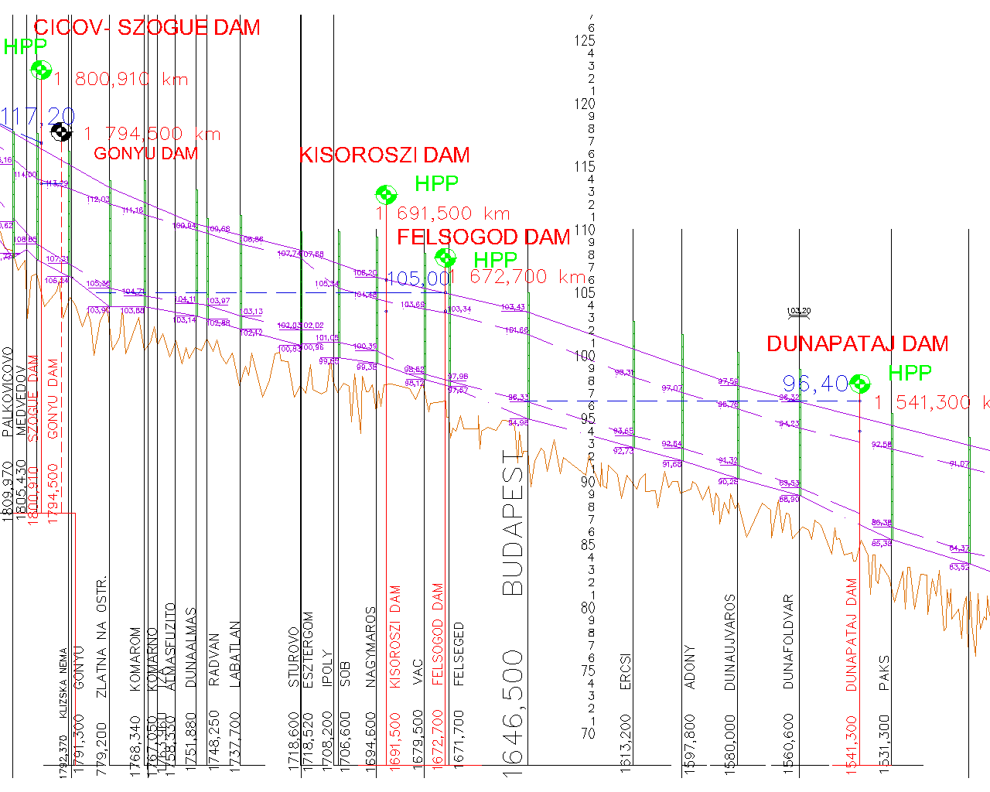

Slide 54
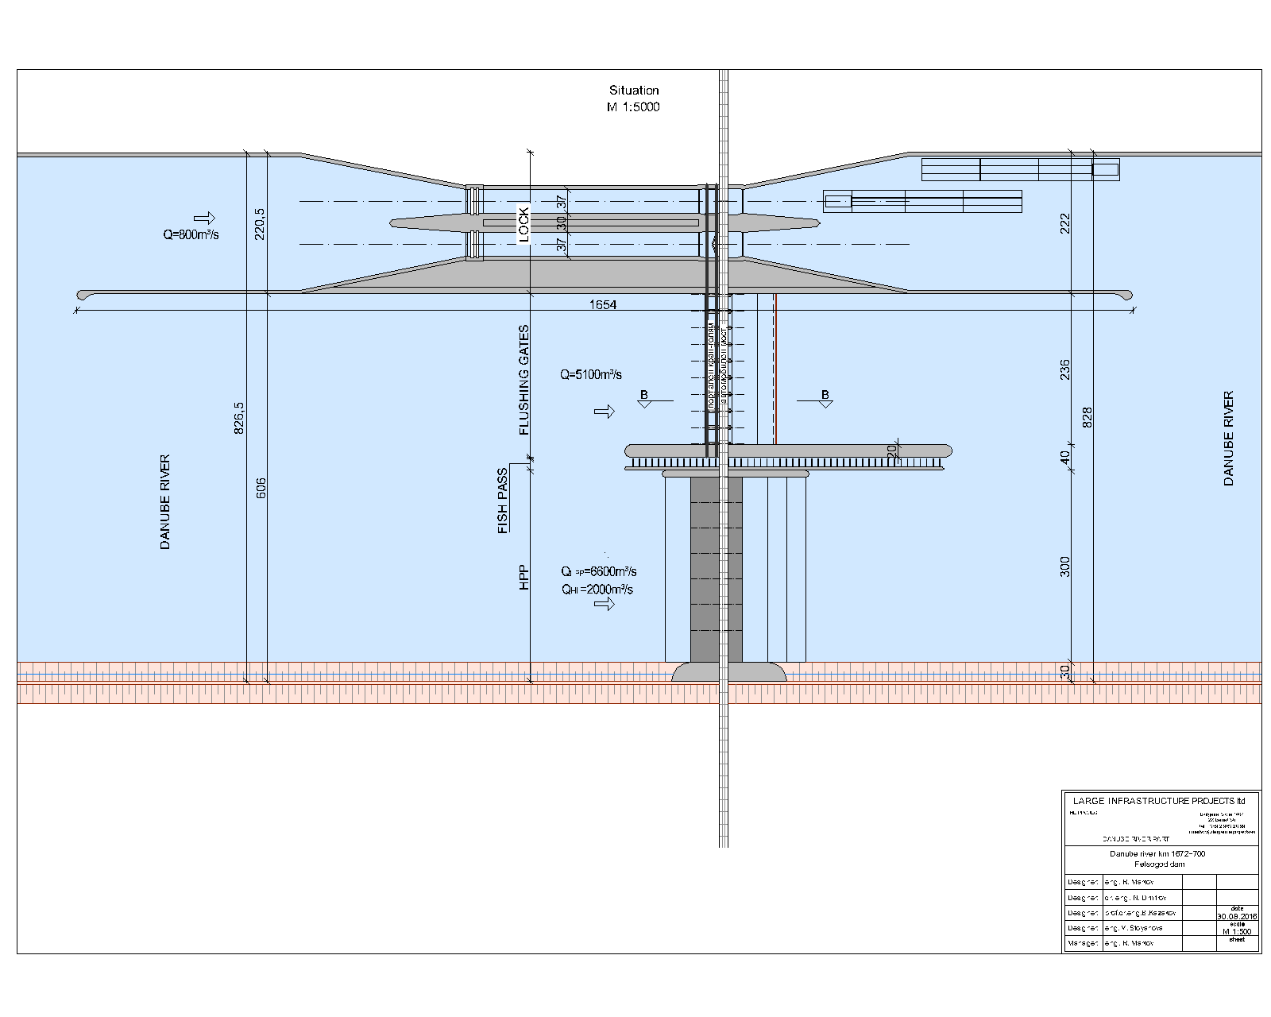

Slide 55
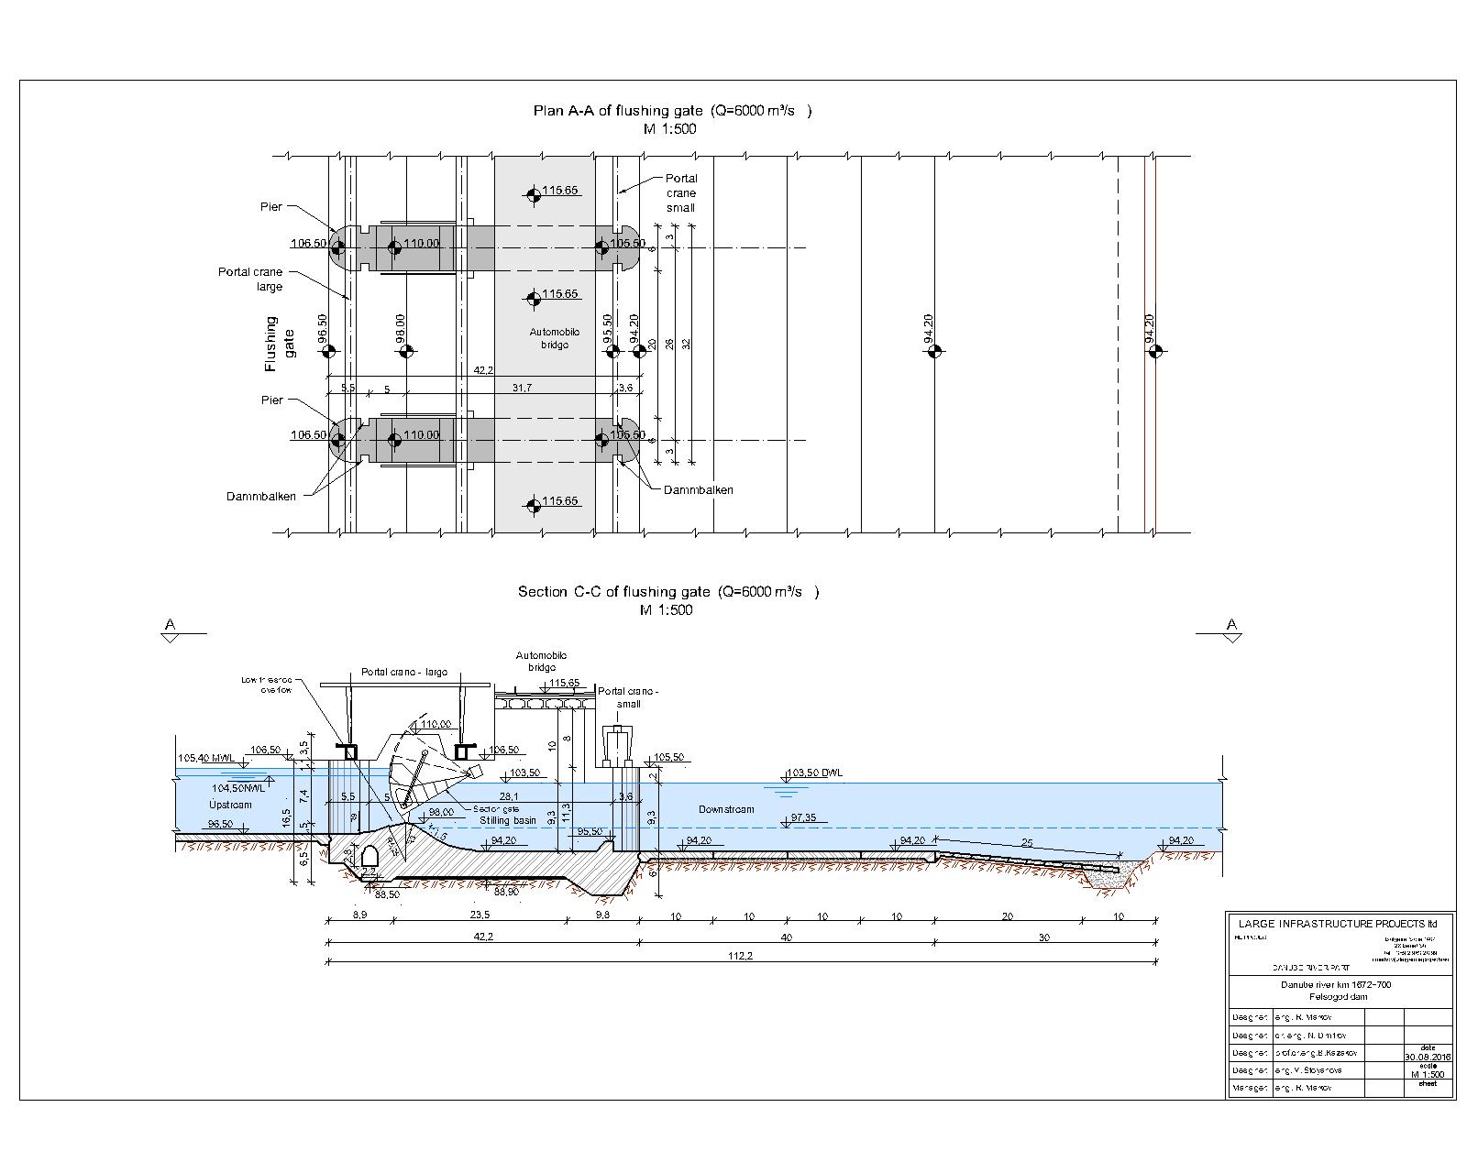

Slide 56
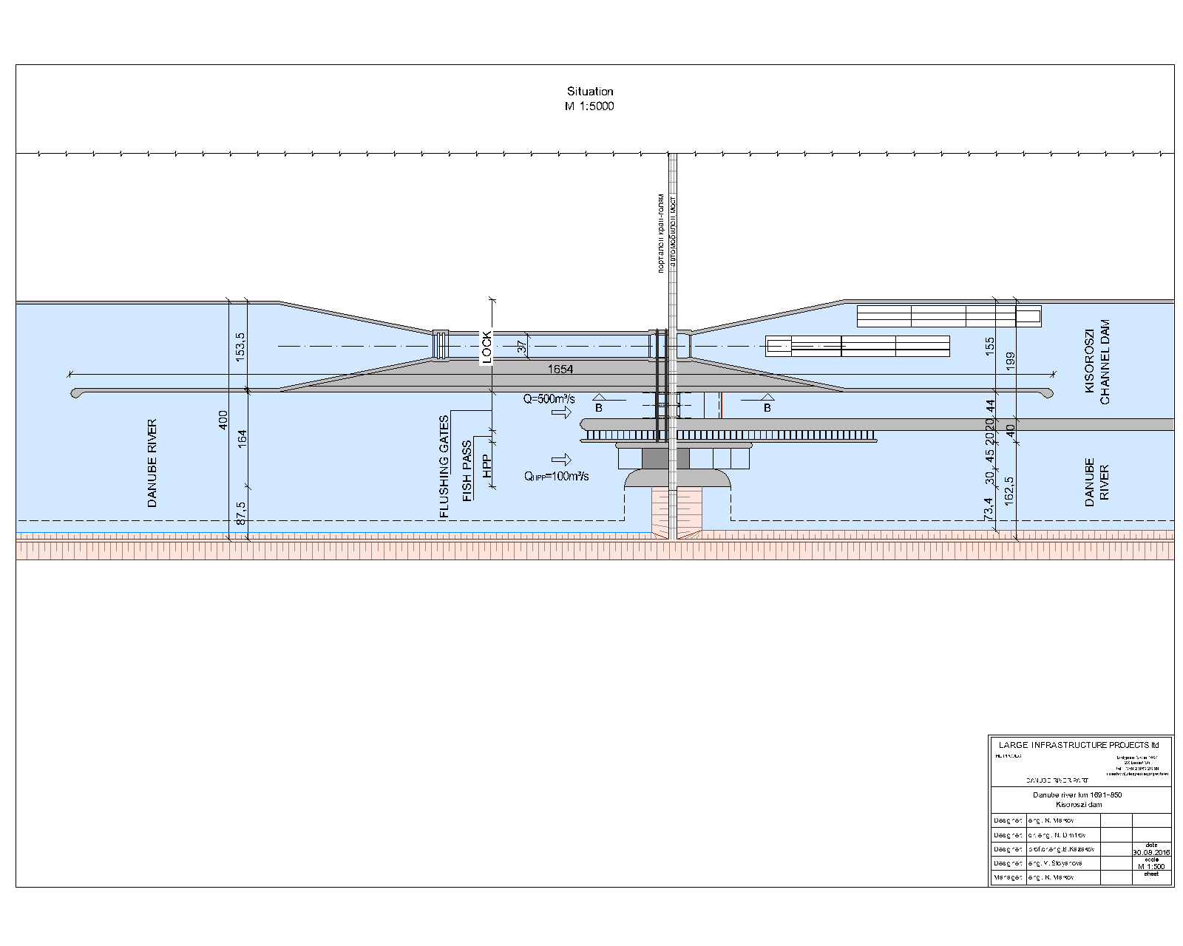

Slide 57
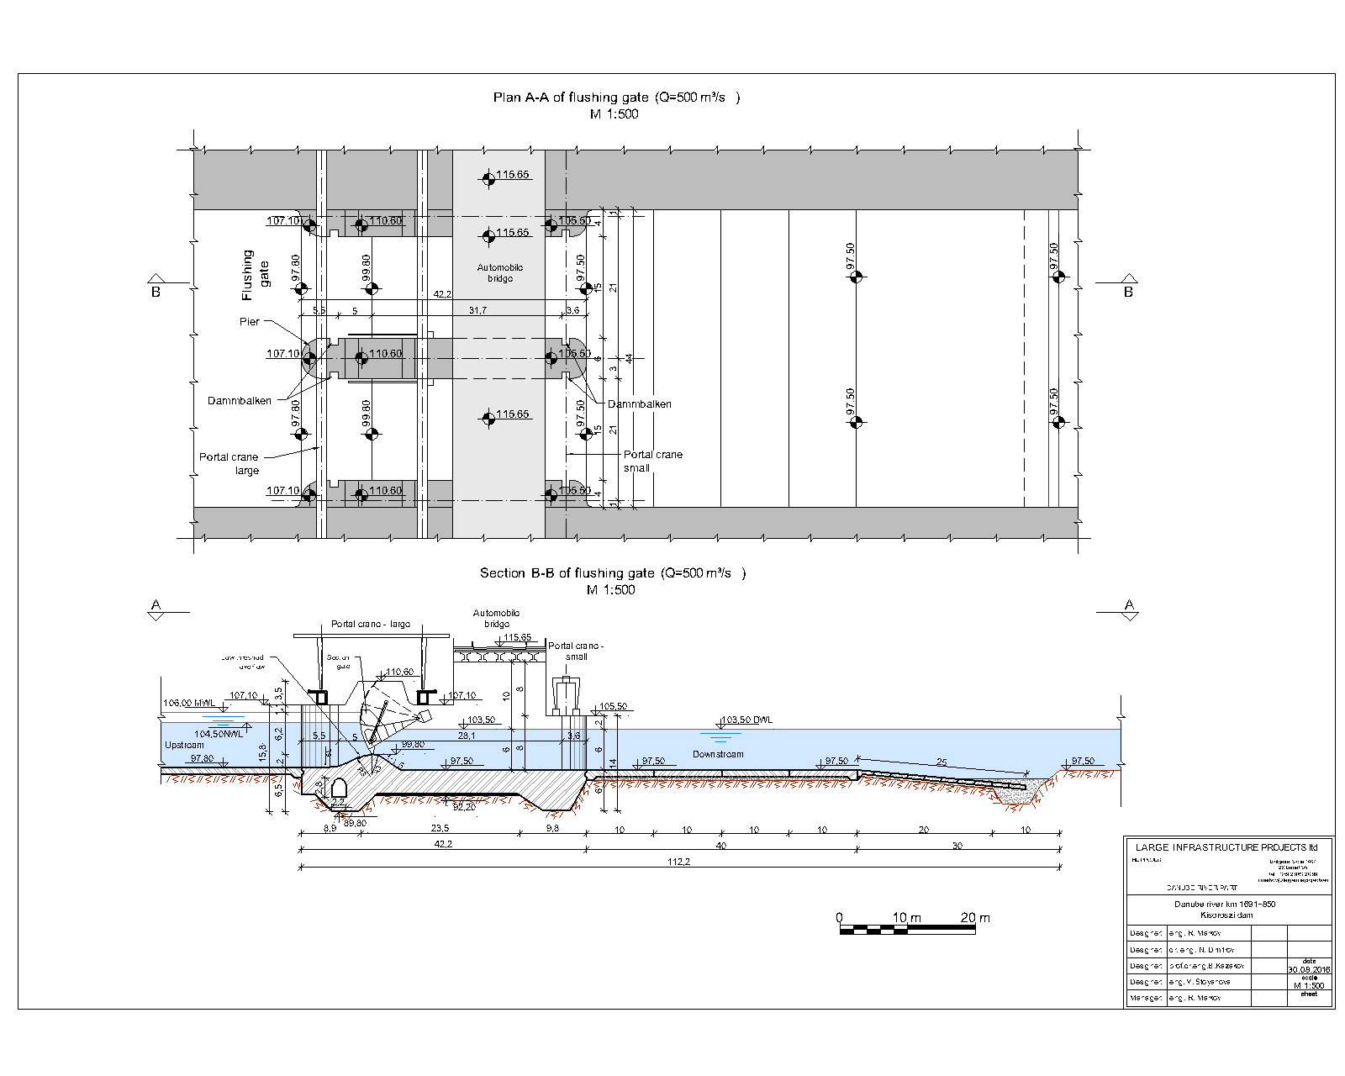

Slide 58
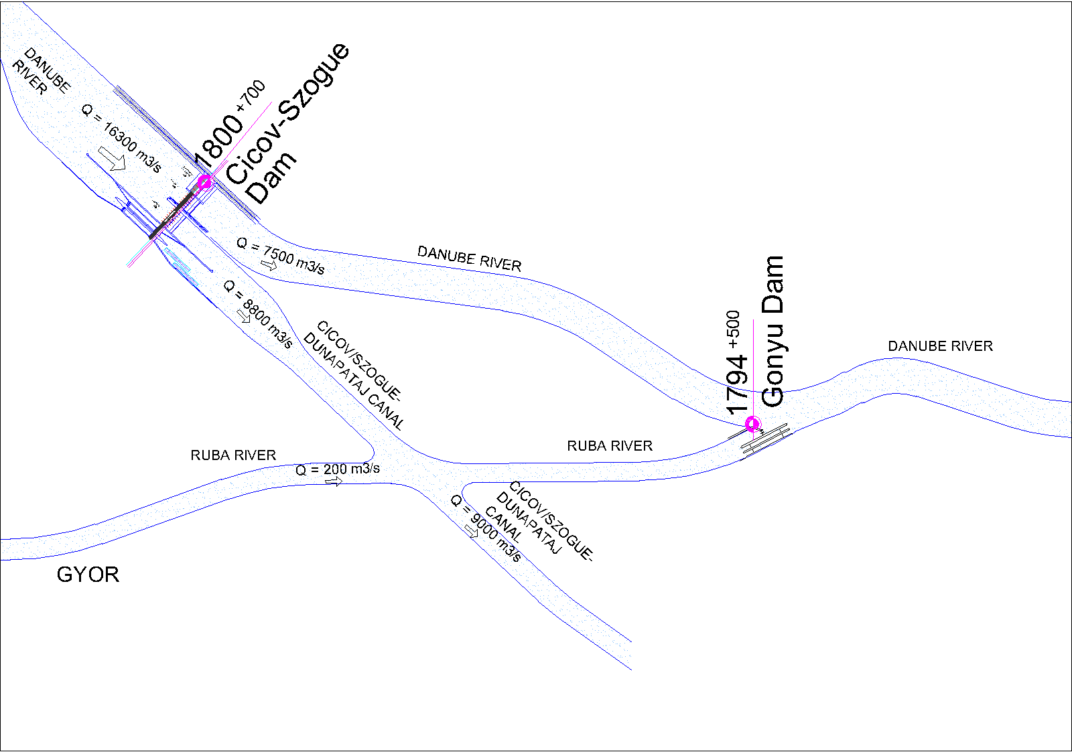
CICOV-SZOGUE DAM

Slide 59
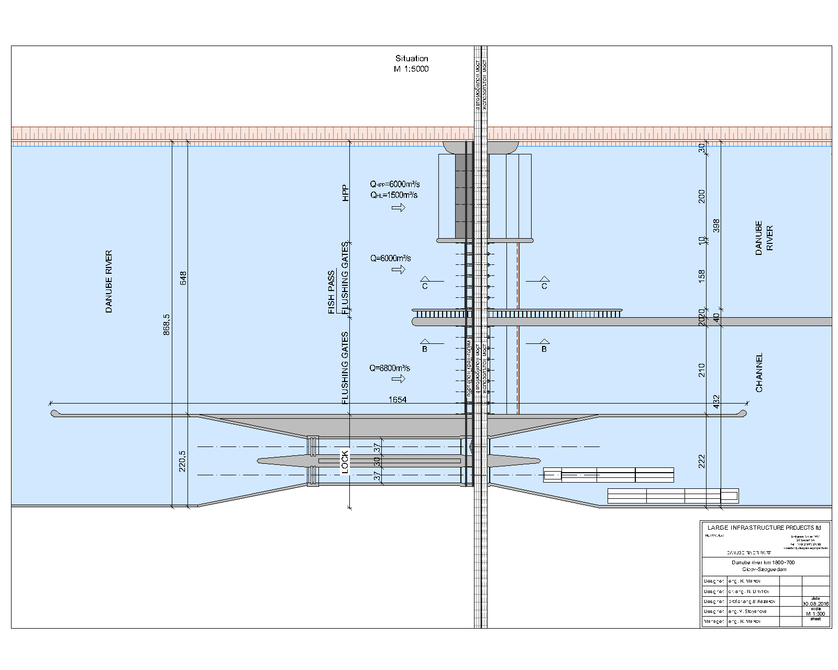

Slide 60
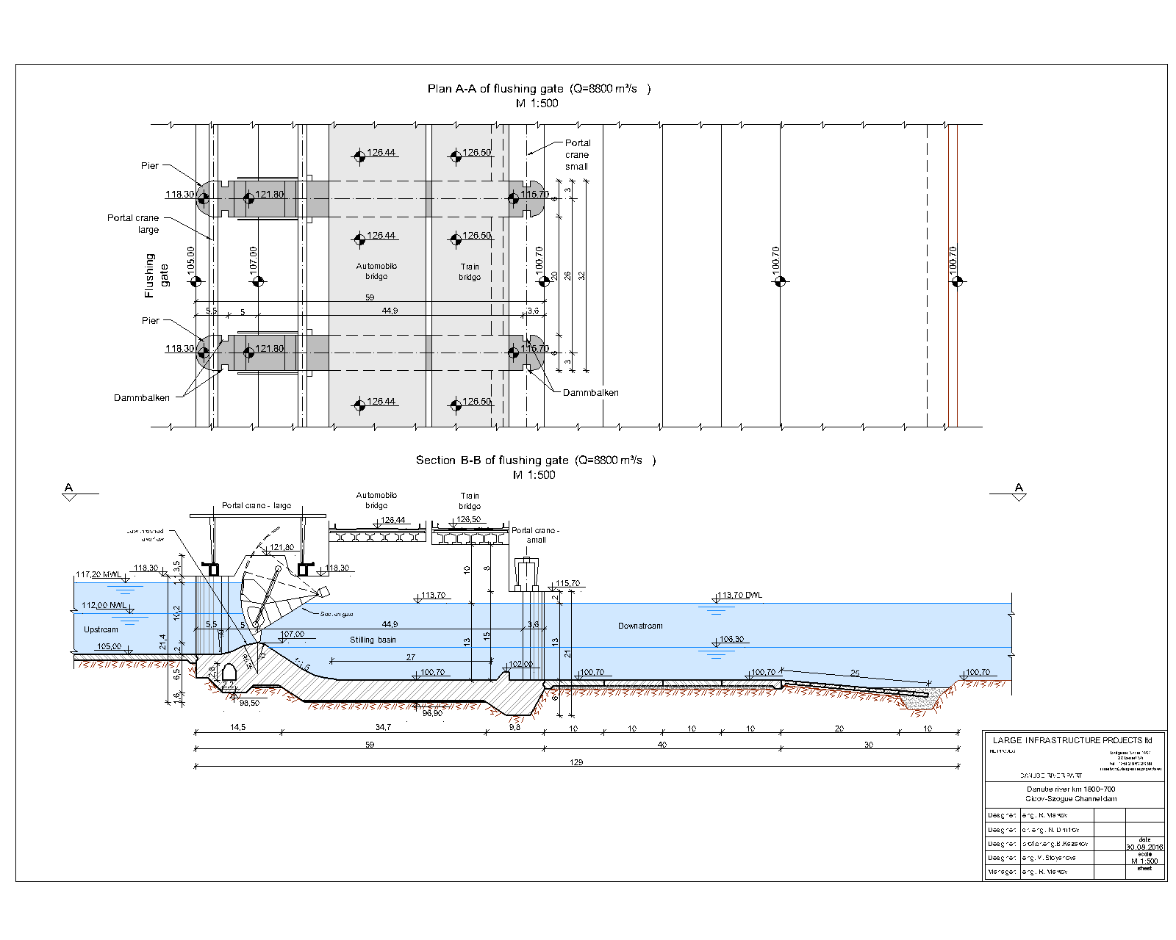

Slide 61
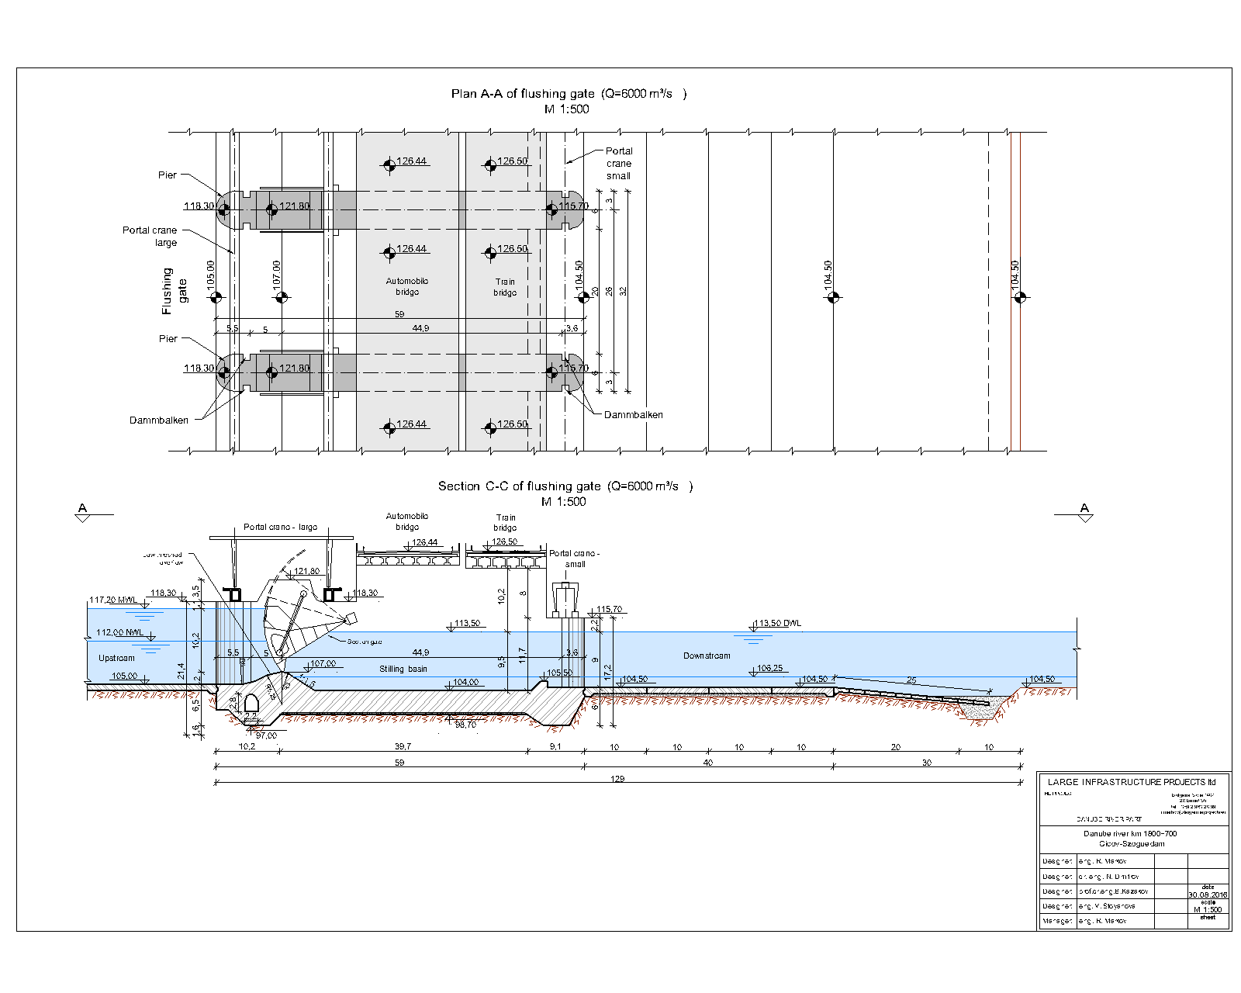

Slide 62
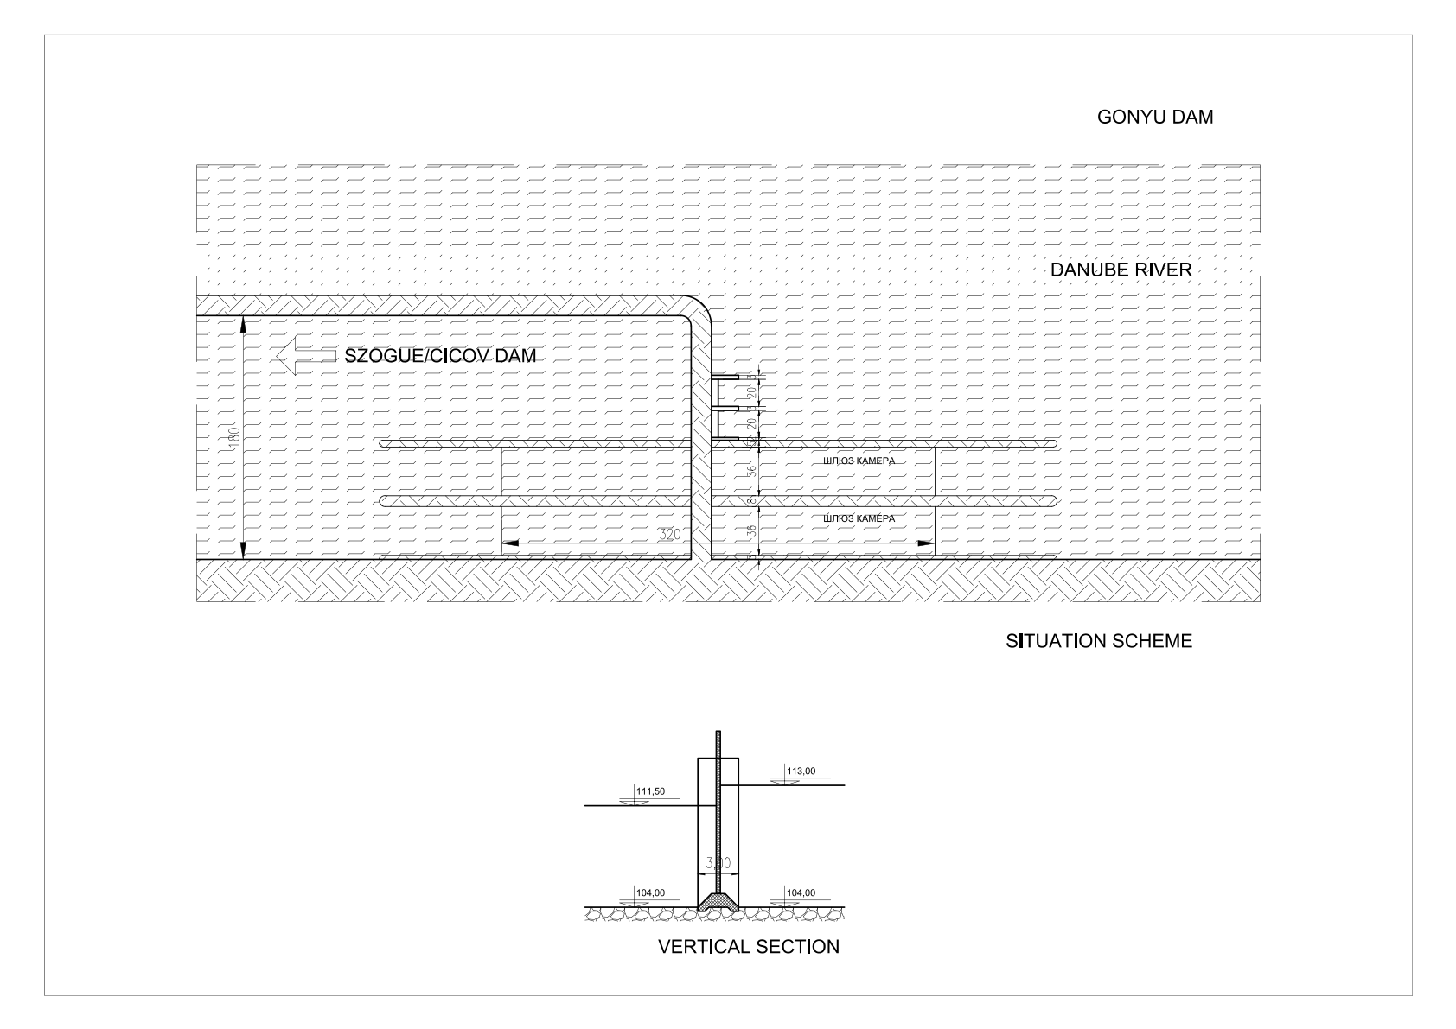

Slide 63
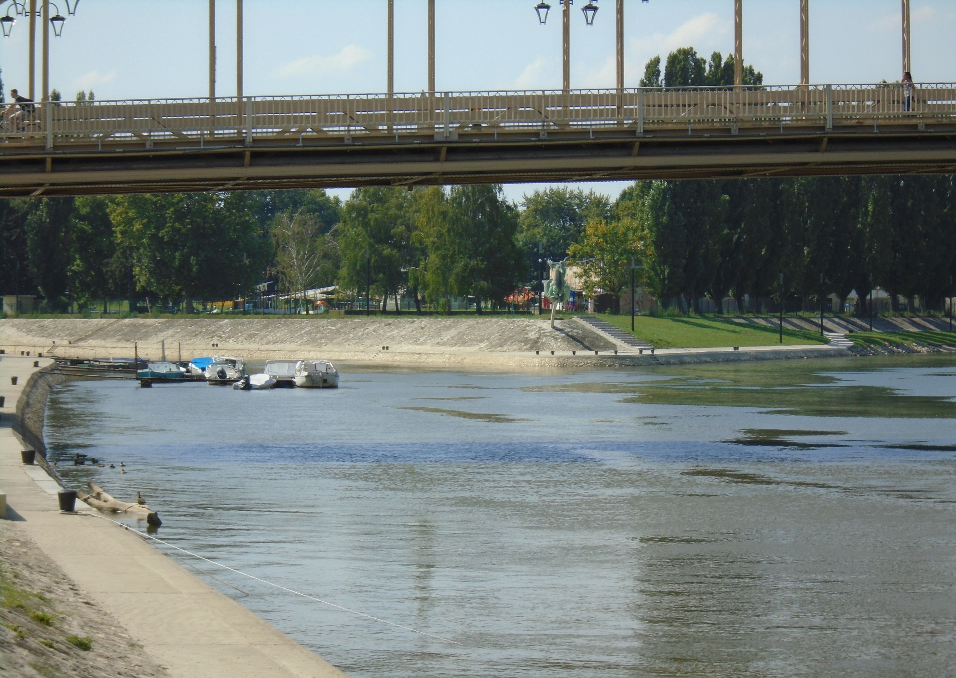

Slide 64
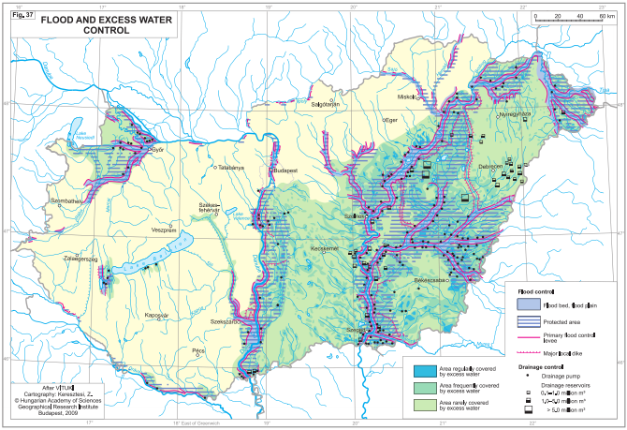

Slide 65
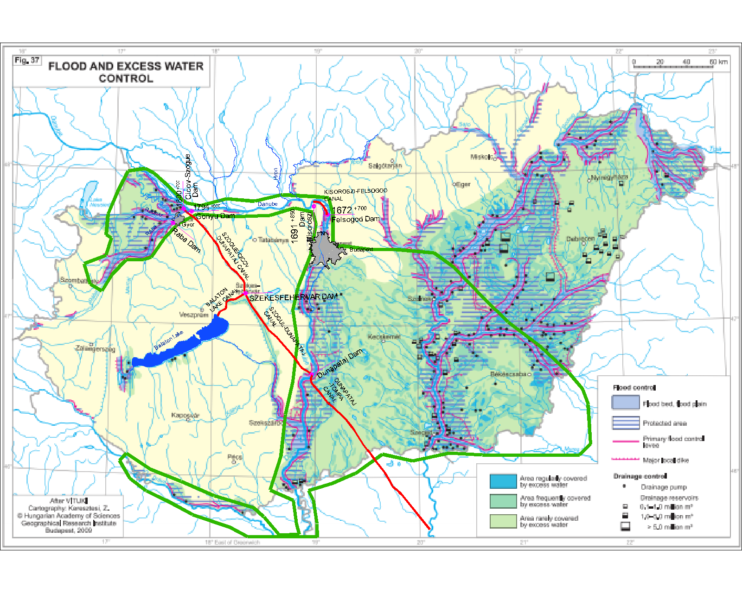

Slide 66
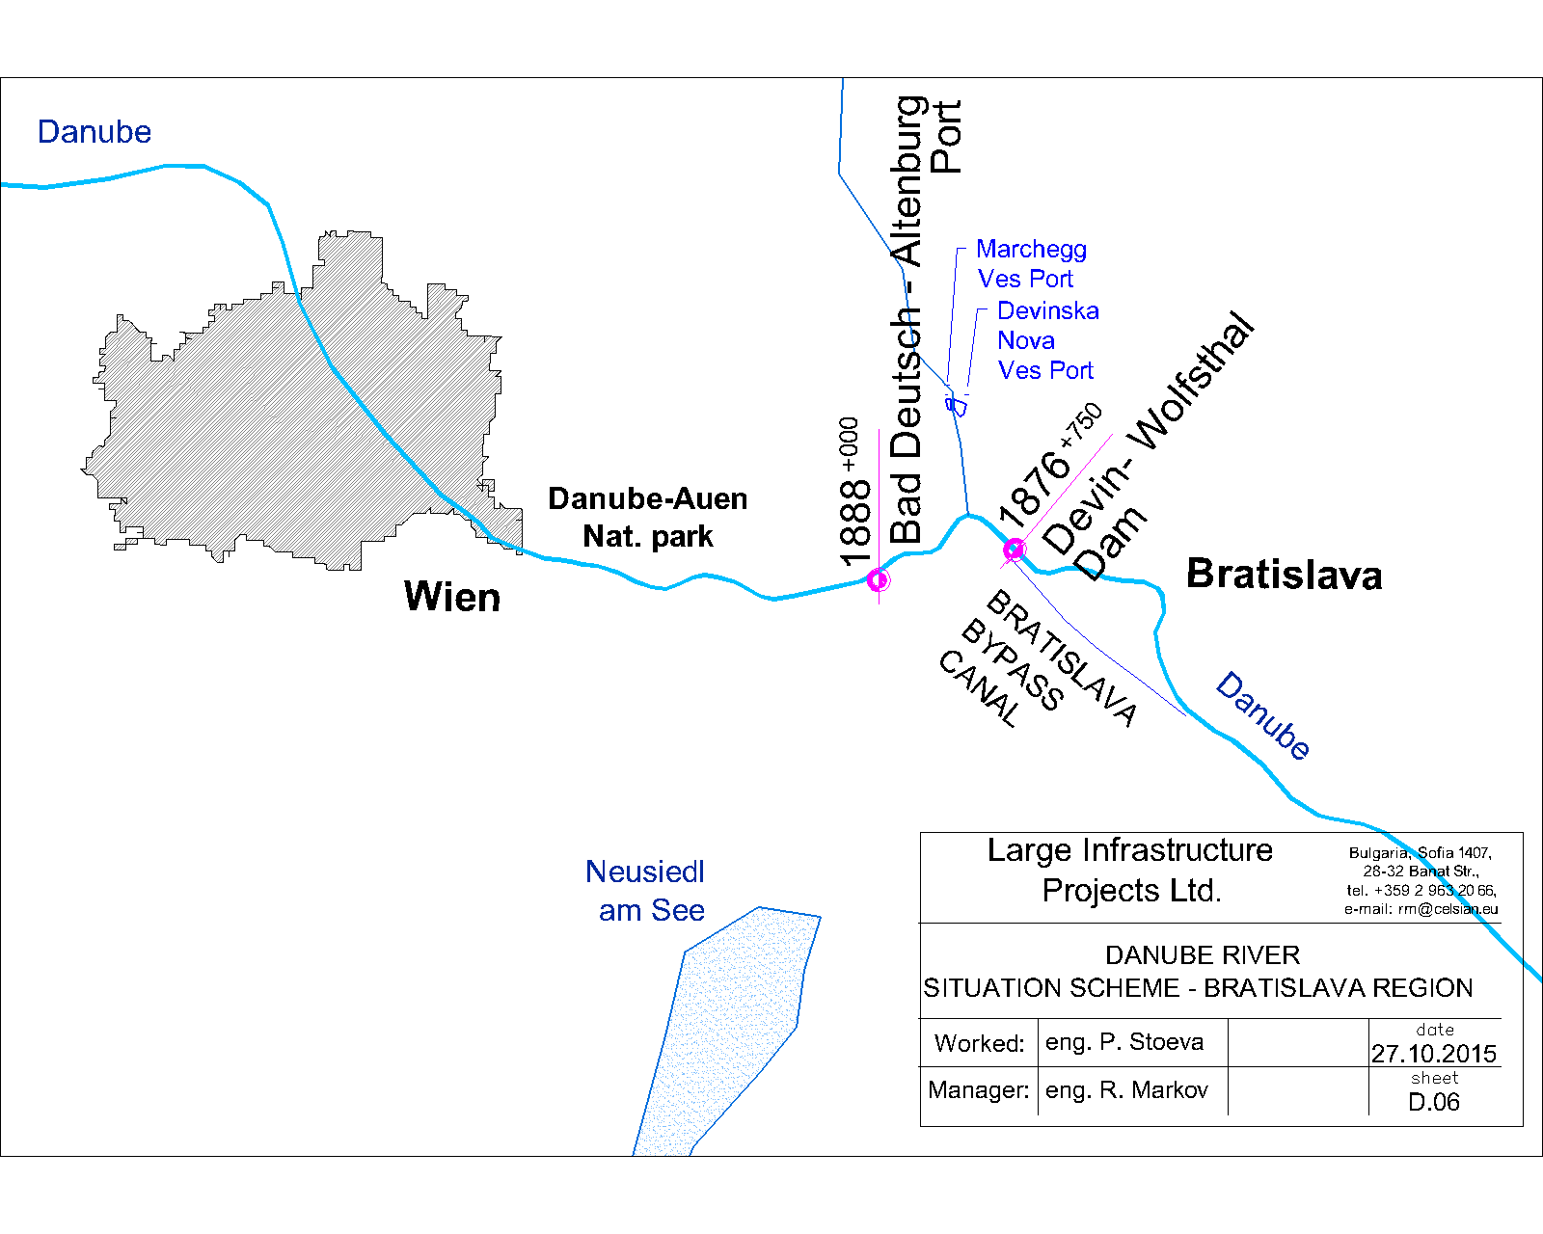

Slide 67


Slide 68


Slide 69


Slide 70


Slide 71


Slide 72


Slide 73

142,36m (06.2013)
141,70m

Slide 74


Slide 75


Slide 76


Slide 77


Slide 78


Slide 79
Energy by
the HIDRO POWER PLANTS
In Middle Danube

Slide 80
The ABC+De project activities will make the Danube river in a effective waterway
From the river mouth to 1888th km the characteristics of a convoy of barges and pusher will be:
Dimensions:
- length - 300,00 m ;
- draft - 4,00 m in the whole year (even at the lowest waters);
beam - 33,20 m.
Speed up to 17 km/ h
Capacity up to 30 000 tones of cargo ; up to 2250 TEUs.
As a result of the reduced distance and increased speed, the travel time from the new ports, located at the 533,000 ^{th} km to Bratislava / Vienna will be halved.

Slide 81
LARGE INFRASTRUCTURE PROJECTS LTD,
1407 Sofia, 28 Banat str., Bulgaria,
tel. +35929632099, f. +35928657326,
e-mail: office@largeinfraprojects.eu

