Slide 1
WORKSHOP CLNI 2012
CLNI 2012 CONVENTION AND ITS HISTORICAL BACKGROUND
Theresia Hacksteiner LL.M.
Secretary General IVR

Slide 2
WORKSHOP CLNI 2012
HARMONISATION/
UNIFICATION
INTERNATIONAL
CONDITIONS
PUBLICATIONS
COLLOQUIA

Slide 3
WORKSHOP CLNI 2012
IVR’S FOCUS
1. UNIFICATION TRANSPORT- AND LIABILITY LAW
CMNI, CLNI
2. COLLECTION OF PUBLICATIONS
- DATABASE OF JURISPRUDENCE
3. GUIDELINES ON IMPLEMENTATION OF CLNI

Slide 4
WORKSHOP CLNI 2012
2. COLLECTION OF PUBLICATIONS
- PUBLICATIONS ON CLNI/CMNI
- DATABASE OF JURISPRUDENCE
All published on www.ivr.nl under Legal

Slide 5
WORKSHOP CLNI 2012
2. COLLECTION OF PUBLICATIONS
- DATABASE OF JURISPRUDENCE
A collection of jugdements regarding CMNI and CLNI with reference
To the court and the location where the judgement officially has been published (if published)
To the article involved
A short summary of the substance

Slide 6
WORKSHOP CLNI 2012
CMNI
RB Rotterdam 30.9.2009 | ECLI:NL:RBROT:2009:9227 S&S 2010,27 | Art. 3 Abs. 2, 10 Abs. 2, 16 Abs. 1 | Begriff Ablieferung
 | Der Begriff Ablieferung (“aflevering”, “delivery” , “livraison”) wird in der CMNI nicht näher definiert. Im Lichte der CMNI als Ganzes und dessen Art. 10 Abs. 2 im Besonderen muss der Begriff Ablieferung im Sinne von Art. 3 Abs. 2 oder Art. 16 Abs. 1 CMNI als der Moment, an dem der Frachtführer dem Empfänger (oder sonstigem Berechtigten) die Gelegenheit bietet, über die Güter an Bord des Schiffes zu verfügen, ausgelegt werden. Der wegen Regen an den von Deutschland in die Niederlande beförderten Gütern während des Löschens entstandene Schaden ereignete sich nachdem das Schiff löschbereit war und kommt deshalb nicht mehr zu Lasten des Frachtführers.
RB Rotterdam 30.09.2009 | ECLI:NL:RBROT:2009:9227 | Arts. 3, para.2; 10, para. 2; 16, para. 1 | The term ‘delivery’
 | The term delivery (“Ablieferung”, “aflevering”, “livraison”) is not defined in the CMNI. In the light of the CNMI as a whole, and of Art. 10, para. 2 in particular, the term delivery as used in Art. 3, para. 2 or Art 16, para. 1 of the CNMI is understood to mean the moment at which the carrier gives the consignee (or any other person entitled to receive them) the opportunity to take charge of the goods on board the ship. The damage caused to the goods transported from Germany to the Netherlands by rain during unloading occurred after the ship had been prepared for unloading and is therefore not the liability of the carrier.

Slide 7
WORKSHOP CLNI 2012
CLNI
Hof Den Haag 26.10.1999 | ECLI:NL:GHSGR:1999:4181 (Berufung von ECLI:NL:RBROT:1996:2984, S&S 1997,41) S&S 2000,132 | Art. 2 CLNI | Haftung für Kosten und Massnahmen zur Vermeidung von Wasserverschmutzung
 | Zur Beschränkung der Haftung für Vorbeugungsmassnahmen zur Vermeidung von Umweltverschmutzung reicht nicht die Errichtung eines Sachfonds, sondern es muss der dazu bestimmte Wasserverschmutzungsfonds errichtet werden.
Hof Den Haag 26.10.1999 | ECLI:NL:GHSGR:1999:4181 (Appeal re: ECLI:NL:RBROT:1996:2984, S&S 1997,41), S&S 200, 132 | Art. 2 | Liability for costs and measures to prevent water pollution
 | To limit liability for preventive costs related to environmental contamination, it is not sufficient to constitute a property fund; rather the specific water pollution fund should be constituted

Slide 8
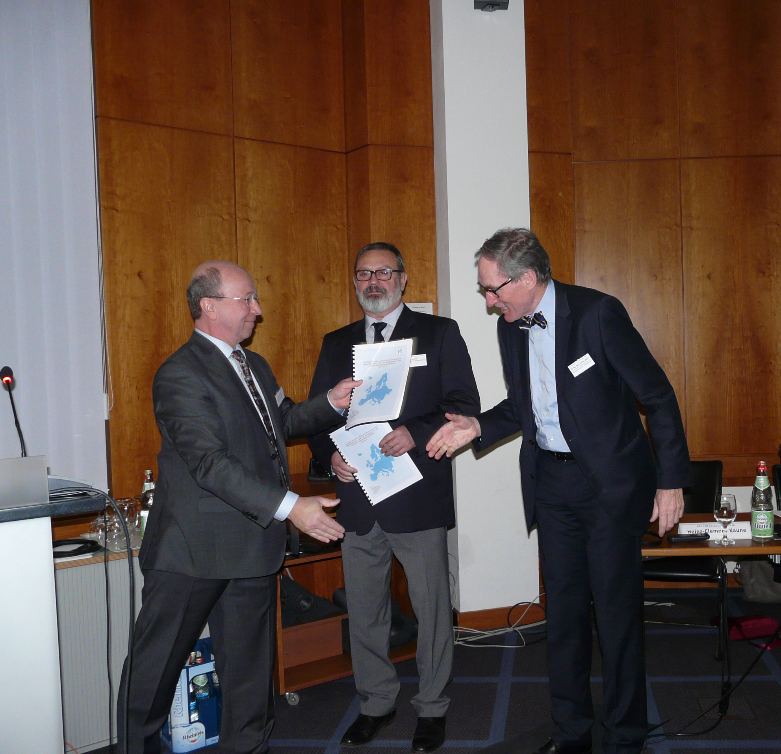
WORKSHOP CLNI 2012
8th IVR Colloquium on 17 & 18 March 2016 in Bonn.
Dr. Martin Fischer, chair of the IVR Legal Committee, hands the
guidelines to the director of the Danube Commission,
Dr. Petar Margic and the Secretary General of the
Central Commission for the Rhine,
Ing. Hans van der Werf LL.M.
The Guidelines were developed by the
Legal Committee of IVR in order to
support a broad deployment of the
Convention.

Slide 9
WORKSHOP CLNI 2012
DIPLOMATIC CONFERENCE 25-27.9.2012
under the patronage of the Central Commission For the Navigation on the Rhine (CCNR)
Follow up of the CLNI Convention 1988

Slide 10
WORKSHOP CLNI 2012
CLNI 2012
Signing of the FINAL ACT on 27 September 2012 in Strasbourg by 13 countries: Belgium, Bulgaria, Germany, France, Hungary, Luxembourg, the Netherlands, Austria, Poland, Serbia, Slovakia, the Czech Republic and Switzerland.
Belgium, France and Luxembourg also signed the Convention

Slide 11
WORKSHOP CLNI 2012
Reasons for the revision of the Convention
Limited regional scope of the current CLNI
Rhine and Moselle
European legal developments
Attempts of the EC to declare the Athens Convention applicable for passenger transport in Inland Navigation
Raise of the limits like in the maritime
LLMC Convention

Slide 12
WORKSHOP CLNI 2012
Reasons for the revision of the Convention
the revised Conventions opens the possibility to non Rhine and Moselle states to ratify.

Slide 13
WORKSHOP CLNI 2012
CHAPTER I
Right of limitation and persons entitled to limit liability
Vessel owners/salvors of vessels used for commercial navigational purposes (Art. 1)
Claims subject to limitation (art 2) in respect of
loss of life or personal injury
loss and damage to property
loss resulting from delay
loss resulting from infringement of rights
other than contractual rights

Slide 14
WORKSHOP CLNI 2012
Chapter I
Claims excepted from limitation (art 3)
Assistance or salvage
Contributions in general average
Nuclear damage

Slide 15
WORKSHOP CLNI 2012
Chapter II
Limits of liability
General limits (Art 6)
For claims other than those mentioned in Articles 7 and 8
100 % increase compared to 1988

Slide 16
WORKSHOP CLNI 2012
Limits of liability
Damage arising from the carriage of dangerous goods
(Art 7)
New compared to the current convention:
possibility of exclusion of the scope by reservation in the present convention
introduction of higher national limits (f.i. Germany and Netherlands)
Double amounts of the general limits in article 6
Reservation still possible (art. 18 /1b)

Slide 17
WORKSHOP CLNI 2012
Limits of liability
Passenger claims (Art 8)
Claims for loss of life or personal injury 100.000 (now 60.000) units of account multiplied by the number of passengers which a vessel is authorised to carry.
Omission of absolute limits (now resp. 3, 6 and 12 million units of account for vessels authorised to carry 100, 180 and more than 180 passengers)
Possibilities of reservation eliminated

Slide 18
WORKSHOP CLNI 2012
CHAPTER III – Constitution and working of a fund
(Art 12-14)
Limitation can be invoked either without (art. 11) or with the constitution of a fund.
IVR-Guidelines outlining the functioning of the two possibilities based upon some examples in the actual State Parties
Constitution of a fund canalises all claims towards the fund.

Slide 19
WORKSHOP CLNI 2012
Scope (Art. 15)
Purpose: opening of the scope
Convention shall apply where the vessel was being operated on a waterway located on the territory of a State Party
Any State may exclude the application of this Convention on waterways not listed in Annex I of the European Agreement on Main Inland Waterways of International Importance (AGN)
Any State may exclude the application of the Convention for a maximum of 8 years after entry into force on small crafts ( less than 20 m) exclusively used in internal traffic.
(proposal Hungary during DC)

Slide 20
WORKSHOP CLNI 2012
Reservations CLNI 2012
Article 18 o.a.
Any State may exclude the application of the rules iin respect of
..
claims mentioned in art. 7 (carriage of dangerous goods) in so far as they are governed by an international convention or domestic regulations excluding the limitation of liability or setting higher limits.
Claims for damage due to a change in the physical, chemical or biological quality of the water.

Slide 21
WORKSHOP CLNI 2012
Entry into force (Article 17)
1 year after the ratification by 4 States or
On the date on which the 1988 CLNI ceases to be in force, whichever date is the later.
The current Party States have signed during the signature of the Final Act a declaration for the cessation of the present convention.

Slide 22
WORKSHOP CLNI 2012
RATIFICATIONS SO FAR
Serbia, Luxembourg.
In Germany CLNI has already been transposed into national law. Belgium and the Netherlands expect to finalise the ratification process by mid 2017 the latest
Signing of the FINAL ACT on 27 September 2012 in Strasbourg by 13 countries: Belgium, Bulgaria, Germany, France, Hungary, Luxembourg, the Netherlands, Austria, Poland, Serbia, Slovakia, the Czech Republic and Switzerland.

Slide 23
WORKSHOP CLNI 2012
Importance of the Convention
legal certainty;
legal clarity;
opportunity for IWT countries ( particularly CEE countries) to introduce a limitation of liability through an international convention

Slide 24
WORKSHOP CLNI 2012
QUESTIONS?
THANK YOU FOR YOUR ATTENTION!

